Slide 1



VPOP – Optimization tool
Stakeholders engagement slide deck

Slide 2
Agenda
Background and objectives
1
Optimization process
2
Available resources
3

Slide 3
The multiplication of vaccine options and the global decrease of funding negatively impacts vaccine-related decision-making
Under pressure, immunization programs are forced to make biased, fragmented and reactive decisions
Global Public Health Megatrends
Strong decrease in global funding (from 30% to 40% between 2023 and 2025) with increased public health pressure due complex agendas
Ambitious objectives, including on introductions of new vaccines, in a context of stagnating DTP coverage
Global
Global funding decrease
Complexification of agendas
Diversification of vaccine options
Program performance stagnation
Emerging diseases/outbreaks
Increased pressure on immunization programs
Do more with less to improve the value for money of EPI: countries need to rely less on external funding and need to prioritize
Improve coverage and program efficiency while maximizing heath impact and disease control
Financial
Operational
Political
Poor decision-making
Unsustainable programs due to overly ambitious roadmaps hindering ability to deliver and creating competition for resources
Limited evidence-based recommendations underlying key immunization decisions
Reactive priority setting limiting strategic and longer-term planning
Unsustainable
Fragmented
Backwards
Reactive
Biased
Country

Slide 4


Optimization and prioritization processes aim at addressing these new challenges by strengthening decision-making
OPTIMIZATION
PRIORITIZATION
Improving the use of already introduced vaccines by adjusting products, schedules, presentations, or target groups to maximize the impact, efficiency, and coverage
Sequencing decisions on not yet introduced vaccines, determining which to introduce first or delay based on impact, feasibility, and resources
Decision to switch from PCV 13 to PCV 10 in the context of the new PCV product tender in 2024
2025 recommendation by a NITAG to introduce hexavalent, followed by rubella, M5CV and RSV
Examples

Slide 5
To ensure robust priority-setting countries need to review their entire portfolio in a holistic way, compare options and identify potential optimization changes
What countries should do
Why
Improve programme performance, especially coverage, vaccine wastage, cold chain, patient/HR experience, disease control
Align program cost with fiscal space and optimize value for money, allowing for potential reinvestment in existing or new programmes
Inform strategic planning to ensure consistency and sustainability of immunization roadmaps
Ensure secured and sustainable access to vaccines by sending market signals to donors and manufacturers
Review products, schedule, targets, presentation, use, composition
Propose optimization changes and sequence them in the short term
(1 to 5 years)

Slide 6
Agenda
Background
1
Optimization process
2
Available resources
3

Slide 7
Depending on context, countries will follow one of three configurations, impacting scope and timeline
PHASE 1: FRAMEWORK ADAPTATION
PHASE 2: EVIDENCE COLLECTION, ASSESSMENT, SEQUENCING
PHASE 3: RECOMMENDATIONS
Workshop
1
Workshop
2
Process design and stakeholder engagement
Data collection
Validation and documentation
Prioritization
only
1
Around 2 to 4 weeks
Workshop ~1day
Around 3 months (possibly less)
Workshop ~2 days
Maximum 2 months
Optimization
only
2
Around 2 to 4 weeks
Workshop ~half day
1 to 3 months
(depending on no of questions)
Workshop ~1 day
(depending on no of questions)
Maximum 1 month
Focus of this presentation
Prioritization
& Optimization
Around 2 to 4 weeks
Workshop ~1 to 2 days
3 to 4 months
Workshop ~3 days
Maximum 2 months
3

Slide 8
The optimization framework relies on a series of assessments and decisions based on a sub-set of pre-selected criteria
Framework Implementation Process
Phase 1: Framework Adaptation
Phase 2: Assessment, Appraisal, Optimization, Sequencing
Phase 3: Recommendations
All optimization questions based
on current portfolio
Selected optimization questions
with options
Prioritized options for each question
Prioritized questions
Scenarios of change sequence
Priority changes
Optimization
question 1
Preferred option
Second preferred
option
Discarded option
202X
202Y
202Z
202A
202X
202Y
202Z
202A
Scenario I
Scenario II
Low priority
changes
Main questions
PRESELECTION
Which optimization questions should be considered based on current portfolio and resource constraints?
OPTION RANKING
For each optimization question, which option is preferred based on selected criteria?
CHANGE PRIORITIZATION
Which optimization should be prioritized based on importance and feasibility?
CHANGE SEQUENCING
What programmatic constraints and other uncertainties must be considered for change timing??

Slide 9
Summarized process - This process can be summarized into a straightforward 10-step process for optimization
Phase | Step | What | Related activity
Phase 1 | 1 | Review current portfolio and potential optimization questions (preselect up to 10 questions) | Before and during online session
Phase 1 | 2 | Select up to 3 optimization questions to address (voting through an online questionnaire can help) and clearly define options | Workshop 1
 | 3 | For each question: Review and select up to 10 criteria out of 55 proposed and assign weight to criteria
 | 4 | For each criterion: Define measurable indicators
Phase 2 | 5 | For each criterion: Collect indicator data and prepare content to allow for easy comparison of options | Data collection
Phase 2 | 6 | For each question: Rank options on all criteria | Workshop 2
 | 7 | For each question: Based on average ranking and discussions, choose preferred/parked/discarded options
 | 8 | Compare optimization questions, discussing importance and feasibility, assessing trade offs and defining priority level (high/low) for each question
 | 9 | Define programmatic, budget and vaccine-specific constraints
 | 10 | Draft scenarios based on preferred options, priority level and constraints
9

Slide 10
Detailed process - Through portfolio assessment and criteria-based analysis, opportunities for optimization are identified
Phase 1: Framework Adaptation
Phase 2: Assessment, Optimization, Sequencing
Phase 3: Recommendations
2-4 weeks
1 month
1 month
Workshop
1
Workshop
2
Endorsement by Ministry of Health and integration into national program
Process design and stakeholder engagement
Data collection
Validation and documentation
Objectives:
Before workshop:
Based on the national EPI schedule, review all potential optimization questions
Confirm process, agree on steps and timeline, (including alignment with NIS development/update)
Engage key stakeholders and define R&Rs
Objectives:
Before workshop:
Collect, assess and synthesize available data
Objectives:
Document actionable recommendation(s)
Ensure consensus, consistency and compliance
Include selected options in NIS or other strategic planning document(s)
Develop actionable plan for switch implementation
During workshop:
Translate evidence into option ranking, for each optimization question
Explore programmatic constraints (including budget, market) to define the feasibility level of each optimization question
Develop sequencing recommendations
Develop recommendations for selected products/schedule/presentations
During workshop:
Define list of optimization questions and goals
Select criteria for decision-making for each optimization question and weighting scheme
Develop a workplan for data collection and synthesis
Output:
Selection of vaccines to optimize and corresponding questions (3 max)
Prioritized and weighted criteria for each question (10 max for each question)
Workplan for data collection
Output:
List of proposed optimization choices with ranked options
Sequencing scenarios for optimization choices incorporating programmatic and global market constraints
Output:
NITAG recommendation(s) for selected options
Updated NIS or other strategic planning document(s)
Plan for optimization implementation

Slide 11


The output will be a list of preferred options for each optimization question, backed by strong evidence for each option
Main outputs of the process
Evidence supporting decision
Consolidated list of optimization questions that were considered for each vaccine already in the portfolio
Prioritized ranking of options for each question
Feasibility assessment of potential switches/changes: distinguishing between high-impact, immediately implementable changes and those requiring further monitoring, resources, or evidence
Proposed sequence (and potential timing) of changes to be implemented to inform strategic documents¹
List of criteria selected for each optimization question (e.g. market availability, cost of each option), with their relative weight
Evidence for each criteria X option matrix element
When relevant, financial and budget impact analysis
Summarized statement for each option, highlighting benefits and requirement of each ranked option
Option ranking voting results for each criteria, and overall computed option scores/rank
Example of a summarized statement for Q1, Option1:
“Recent studies confirm that Pneumosil 10 (5-dose) achieves ~65% efficacy (95% CI: 55–75%) against invasive pneumococcal disease, comparable to PCV13 in similar settings. At ~USD 2 per dose, switching would lower the total vaccine program cost by nearly 40% compared to PCV13. The 5-dose vial format reduces cold chain volume by 30%, easing storage and transport bottlenecks. Observed wastage rates remain below 5% even in low-session sites. With proven immunogenicity across the 10 targeted serotypes (prevalent in [Country X]), Pneumosil-5 is a cost-saving, high-performance option for sustainable immunization.”
Q1: Change PCV product
Q2: Change RVV schedule
Preferred option #1
Preferred option #1
Pneumosil10, 5-dose
2 doses (1+1)
Examples
Preferred option #2
Preferred option #2
Prevenar 13, 4-dose
2 doses (2+0)
Preferred option #3
Pneumosil10, 1-dose
1. If the country decides to work on both optimization and prioritization, the proposed sequenced will also include potential new vaccine introductions

Slide 12
Agenda
Background
1
Optimization process
2
Available resources
3

Slide 13
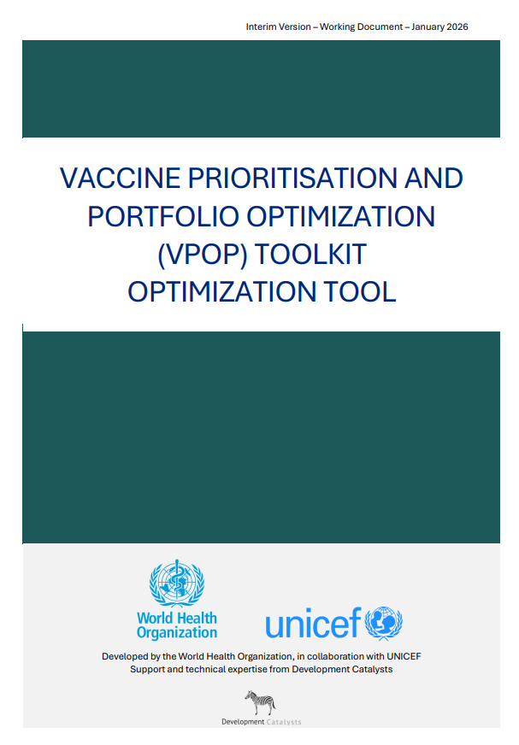



Tools are available to support structured evaluations
READ ME – Optimisation tool:
Guidance on process to optimize current portfolio of vaccines - now available on the NITAG Resource Centre
6 ancillary tools facilitating the NITAG’s and secretariat’s work at each step of the process -6 additional in development
0.1 Country Concept Note
0.2 Stakeholder engagement slidedeck
0.3 Workplan template
1.1 Prioritized list of criteria and indicators
1.2 List of Optimization questions
1.3 Data collection planning matrix
1.3 Online session slidedeck
1.4 Workshop 1 slidedeck
1.5 Google form result analysis
2.1 Ranking Calculations model
2.2 Guide to collecting evidence & building content
2.2 Workshop 2 slidedeck
Phase 0
Phase 1
Phase 2
Documents in italic are in development and will be available in Q2 2026

Slide 14
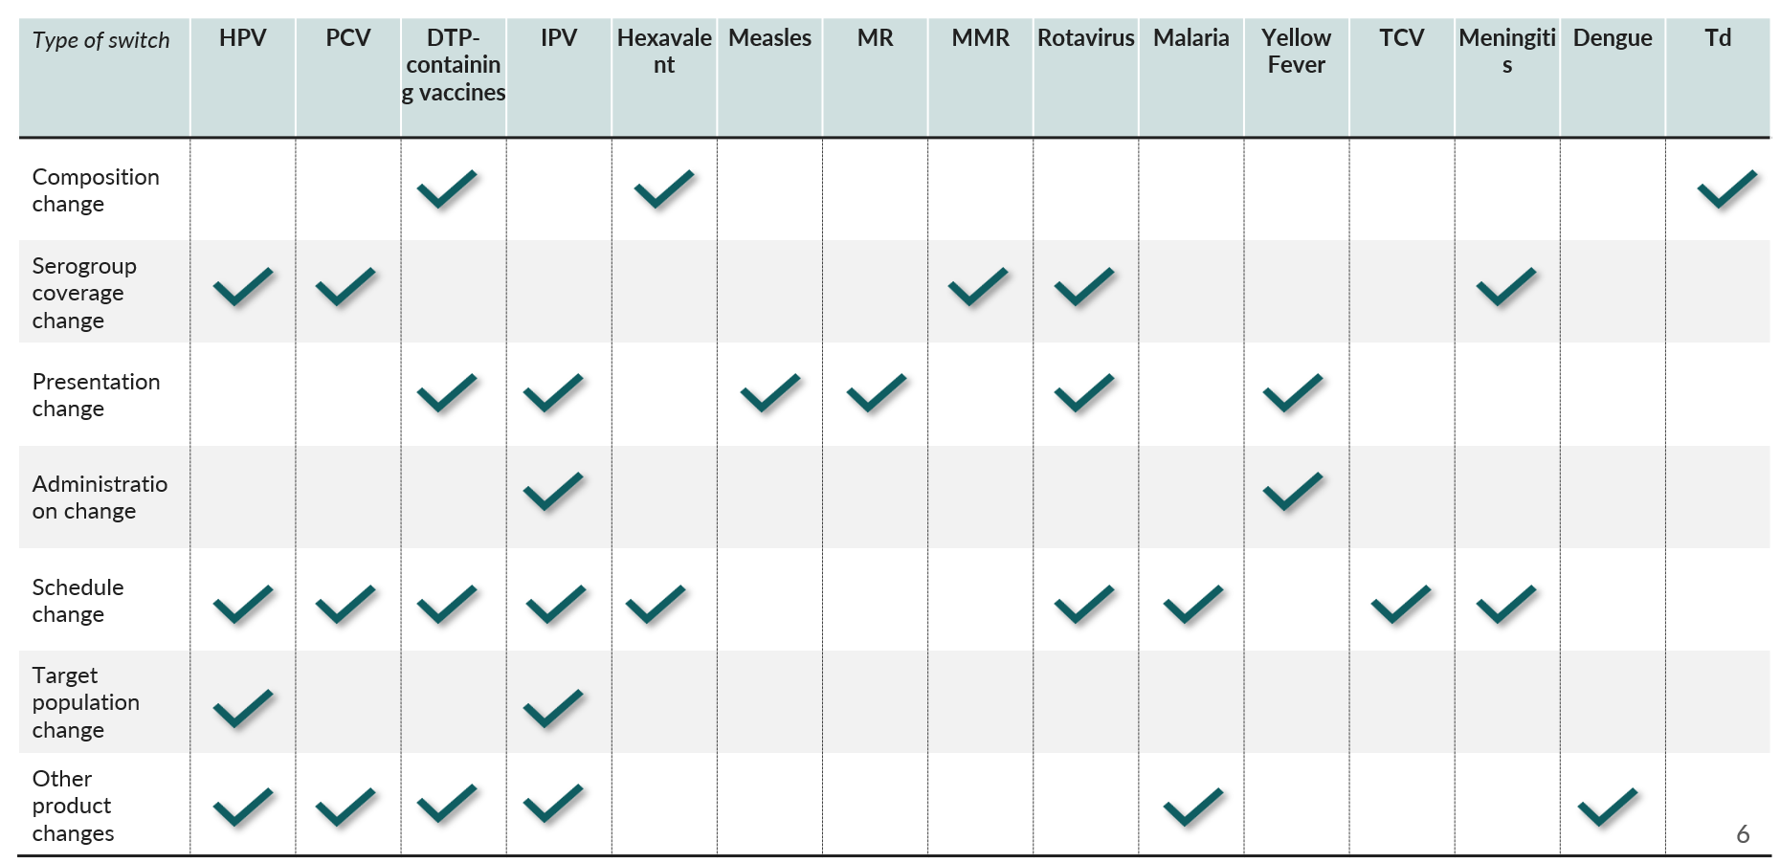
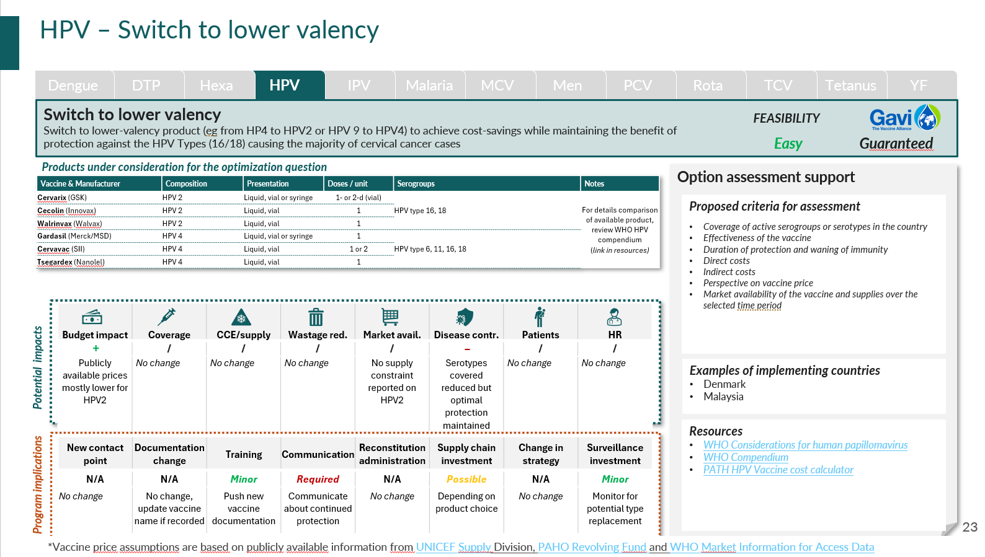
Zoom on Optimization questions - The process should begin with a comprehensive review of the existing immunization schedule
1
2
3
4
5
Start from current portfolio
Use the List of Optimization questions as benchmark
Filter for relevance
Select optimization questions
Select criteria
List all vaccines currently in use
Note formulations (valency, presentation, schedule, target group)
Perform fiscal / budget space analysis
Assess holistic budget constraints
Evaluate current global and relative value of vaccination programs
Go vaccine by vaccine
For each, check the list of possible optimization questions
Also review expected benefits and feasibility considerations for each question
For optimization questions, filter, before Workshop 1:
Which questions apply to your portfolio? (for GAVI countries, which are recommended)
Which correspond to strategic priorities (Budget impact, coverage, etc.)?
Which are most feasible?
Filter to prepare a short (8-10 max) list of questions
Select a limited number of optimization questions
Propose the filtered list of questions to the joint NITAG + EPI audience
Present key / summarized aspects of each optimization question
(Best practice) Organize a vote on optimization questions to support discussions
Collectively select a maximum of 3 questions for further assessment, together with criteria
For each optimization question, select ~10 criteria
Consult the list of criteria from the joint NVI-PST – Optimization guidance
Clarify objectives of the optimization
Select criteria as to align with stated objectives, potential impacts and program implications
(Best practice) Organize a vote on criteria to select for each question
Use the List of optimization questions
Use the optimization questions factsheets

Slide 15

Zoom on Optimization questions - Optimization questions by vaccine
Vaccines Type of change | Dengue | DTP-containing | Hexavalent | HPV | IPV | Malaria | MCV | Meningitis | PCV | Rotavirus | TCV | Tetanus | YF
Composition change
Serotype composition change
Presentation change
Administration change
Schedule change
Target population change
Other product changes

Slide 16








Zoom on Optimization questions - Potential HPV-related optimization questions
Dengue
DTP
Hexa
HPV
IPV
Malaria
MCV
Men
PCV
Rota
TCV
Tetanus
YF
Type of question | Serotype composition | Serotype composition | Schedule | Schedule | Target population | Target population | Product
Details | Switch to higher valency (4 or 9) | Switch to lower valency (2 or 4) | Change from 2 doses to 1 dose | Add booster doses | Change from girls only to girls and boys | Extend eligibility to older age group | Change product
Switch Implementation | Easy | Easy | Average | Complex | More complex | More complex | Very easy
Country examples | Yes | Yes | Yes | Yes | Yes | Yes | No
GAVI programme type | Guaranteed | Guaranteed | Guaranteed | N/A | N/A | N/A | Guaranteed
Expected benefits
Budget impact
Coverage & equity
CCE/supply
Wastage reduct. |  |  |  | Minor | Minor
Market availability
Disease control
Patient experience
HR experience

Slide 17

Zoom on Optimization fact sheets - HPV – Change from 2 doses to 1 dose
Dengue
DTP
Hexa
HPV
IPV
Malaria
MCV
Men
PCV
Rota
TCV
Tetanus
YF
Change from 2 doses to 1 dose schedule
Change to a 1-dose regimen that achieves comparable protection to two doses (as noted by WHO’s SAGE in 2022) in order to lower vaccine and delivery costs and expanding programmatic options, that can contribute to increased coverage.
FEASIBILITY
Average
Guaranteed
Products under consideration for the optimization question
Option assessment support
Vaccine & Manufacturer | Composition | Presentation | Doses / unit | Serogroups | 1-dose schedule | PQ (Dec 2025) | Notes
Cervarix (GSK) | HPV 2 | Liquid, vial or syringe | 1- or 2-d (vial) | HPV type 16, 18 | Yes | 2009 | For details comparison of available product, review WHO HPV compendium (link in resources)
Cecolin (Innovax) | HPV 2 | Liquid, vial | 1 |  | Yes | 2021
Walrinvax (Walvax) | HPV 2 | Liquid, vial | 1 |  |  | 2024
Gardasil (Merck/MSD) | HPV 4 | Liquid, vial or syringe | 1 | HPV type 6, 11, 16, 18 | Yes | 2009
Cervavac (SII) | HPV 4 | Liquid, vial | 1 or 2 |  |  | pending PQ
Tsegardex (Nanolel) | HPV 4 | Liquid, vial | 1 |  |  | No PQ
Gardasil9 (Merck/MSD) | HPV 9 | Liquid, vial or syringe | 1- or 2-d (vial) | HPV type 6, 11, 16, 18, 31, 33, 45, 52, 58 | Yes | 2018
Cecolin 9 (Innovax) | HPV 9 | Liquid, vial | 1 |  | Yes | No PQ
Proposed criteria for assessment
Acceptability of schedule
Coverage of active serogroups or serotypes in the country
Effectiveness of the vaccine
Herd immunity / protection
Direct costs
Indirect costs
Availability of adequate cold chain equipment at all levels or ability to procure CCE required to store the vaccine
Market availability of the vaccine and supplies over the selected time period
Expected impact of the introduction on the human resources
Budget impact | Coverage | CCE/supply | Wastage red. | Market avail. | Disease contr. | Patients | HR
+ + + | + | + + + | + | + + + | / | + + + | + + +
Half the doses | Opportunity to integrate with campaigns | Reduced volume | Lower systemic wastage | Half the doses | Non-inferior efficacy shown | Fewer injections (-50%) | Simpler schedule, less workload
Potential impacts
Examples of implementing countries
81 countries have switched to a 1-dose regimen
New contact point | Documentation change | Training | Communication | Reconstitution administration | Supply chain investment | Change in strategy | Surveillance investment
N/A | Required | Required | Required | N/A | N/A | Possible | Minor
No (removes a visit) | Cards and registers updated | Retraining on new schedule | Communication about 1 dose protection | No change | Lower cold-chain volume | Change in delivery (esp. school-based) | To confirm duration of protection
Resources
2022 SAGE Position Paper
WHO Considerations for human papillomavirus
WHO Compendium on HPV
HPV Vaccine schedule optimization guide
Program implications
*Vaccine price assumptions are based on publicly available information from UNICEF Supply Division, PAHO Revolving Fund and WHO Market Information for Access Data

