Slide 1
Global NITAG Network (GNN) SAGE Digest

Slide 2

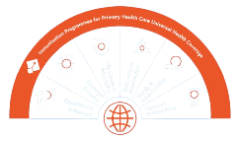







AGENDA
 | Global & regional reports
 | Immunization agenda 2030: mid-term report
 | COVID-19
 | New tuberculosis vaccines
 | Combination vaccines
 | Poliomyelitis
 | Malaria
 | Influenza A (H5) vaccines

Slide 3
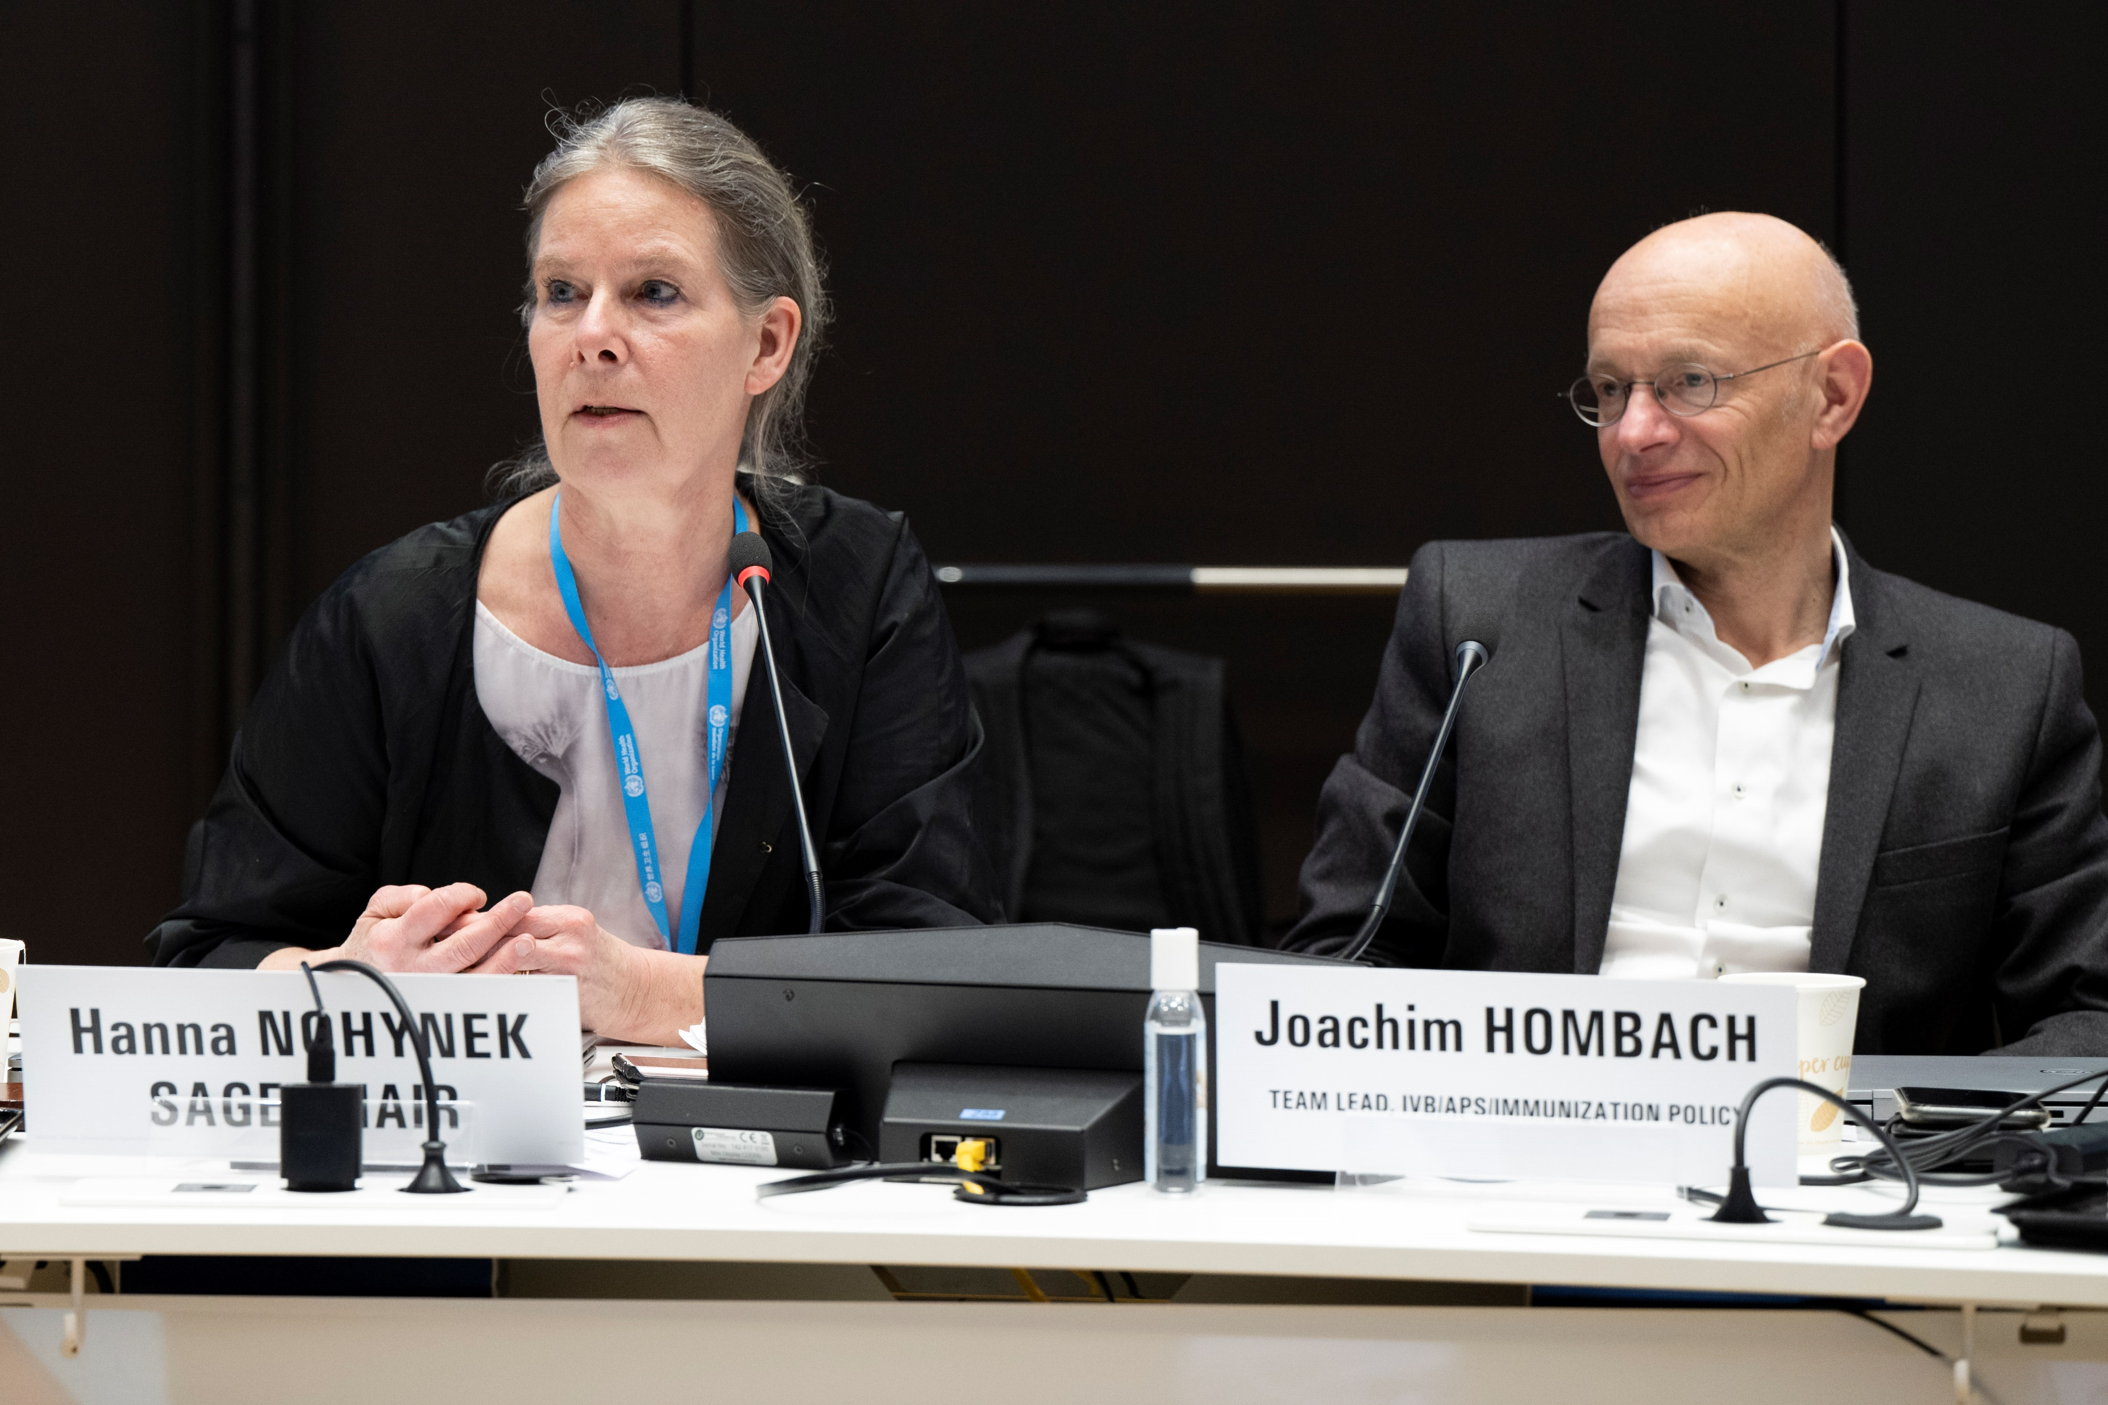
Last meeting for the SAGE Chair and SAGE executive secretary

Slide 4

Welcome to the new SAGE executive secretary
Dr. Annelies Wilder-Smith was recently appointed Executive Secretary of the SAGE Secretariat at WHO. Prior to this appointment, she led the development of WHO interim recommendations on the use of COVID-19 vaccines during the pandemic and coordinated two position papers on dengue vaccines. From 2022 to 2025, she served as Team Lead for Vaccine Development, where she managed the portfolio on novel vaccines against enteric pathogens and Group B Streptococcus, contributing to the publication of preferred product characteristics, strategic roadmaps, and the guidance document Evidence Considerations for Vaccine Policy.
She is also Honorary Professor of Emerging Infectious Diseases at the London School of Hygiene & Tropical Medicine and a Past President of the International Society of Travel Medicine (ISTM).

Slide 5

GLOBAL & REGIONAL REPORTS

Slide 6

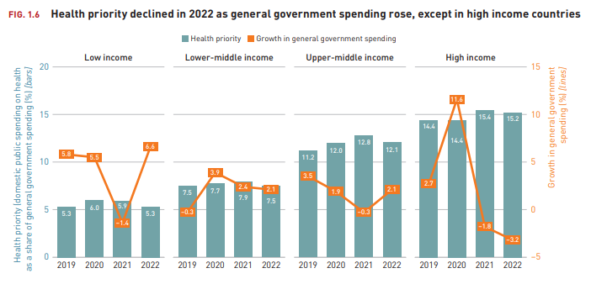
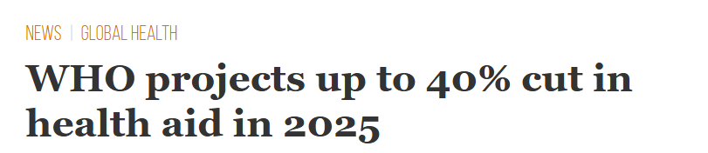
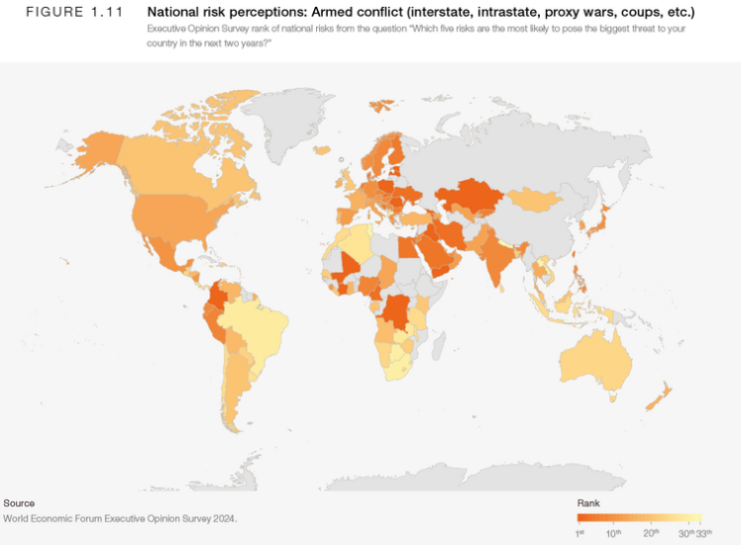



The global health context is becoming more challenging. For countries, for global health agencies
Constrained global funding landscape
Reduced domestic budget allocation for health
Persistent geopolitical instability
Shifts in global health architecture
Sources: Geopolitical: https://www.weforum.org/publications/global-risks-report-2025/in-full/global-risks-2025-a-world-of-growing-divisions-c943fe3ba0/; Domestic budget: https://iris.who.int/bitstream/handle/10665/379750/9789240104495-eng.pdf?sequence=1&isAllowed=y
Notes:
Constrained global funding landscape
The share of ODA allocated to the health sector declined by ~8 pp between 2021 and 2023
Global Health (e.g., WHO, Gavi and UNICEF) is navigating significant downsizing as a result of reduced funding
Reduced domestic budget allocation for health
Slow growth & stagnating increase in expenditure on vaccines in UMICs
Persistent geopolitical instability
Post-2020 conflicts have left >120 million people worldwide displaced
Governments are choosing to shift health and development funds towards defence
Increased nationalism is reducing engagement in multinational collaborations, including on vaccines
Shifts in global health architecture
Major funders and agencies are defining finite lifespans for significant areas of immunization work
Large, vertical programs are coming to an end in their current form
Country-led approaches will see more shifts of activity to the national or regional level

Slide 7
Immunization coverage is nearly back to pre-pandemic levels, with improvements in 2024 compared to 2023:
2019
2024
171k fewer Zero Dose Children (ZDC)
426k fewer Un and Under vaccinated
WUENIC 2024
Millions of Un and Under vaccinated children

Slide 8
Countries with Fragile, Conflict, & Vulnerable (FCV) settings are home to 24% of the world’s birth cohort, but have >50% of ZDC
76% of birth cohort
24% of birth cohort (31M)
7.3m ZDC
51% of total ZDC
7.0m ZDC
49% of total ZDC
Countries with FCV settings (n=26)
Countries without FCV settings (n=169)
Definitions: ​Countries are included in the FCV category if they have a Humanitarian Response Plan, or an active Flash Appeal, as per OCHA.
WUENIC 2024
Notes:
31m surviving infants live in countries with FCV settings (24% of all infants), yet they are disproportionally at risk of being completely unvaccinated, with 7.3m of them completely unvaccinated (51% of all zero dose children).
“Zero-dose prevalence” is 24% in countries with FCV settings, only 7% in other countries.
FCV settings= 26, it includes Palestine (mostly AFRO and EMRO, also PAHO). Without FCV settings (195-26= 169).
Asia and the Pacific
Afghanistan
Myanmar
Europe
Ukraine
Latin America and the Caribbean
Colombia
El Salvador
Guatemala
Haiti
Honduras
Venezuela
Middle East and North Africa
Occupied Palestinian Territory listed with FA
Lebanon listed with FA
Syria
Yemen
Southern and Eastern Africa
Ethiopia
Mozambique
Somalia
South Sudan
Sudan
West and Central Africa
Burkina Faso
Cameroon
Central African Republic
Chad
Democratic Republic of the Congo
Mali
Niger
Nigeria

Slide 9


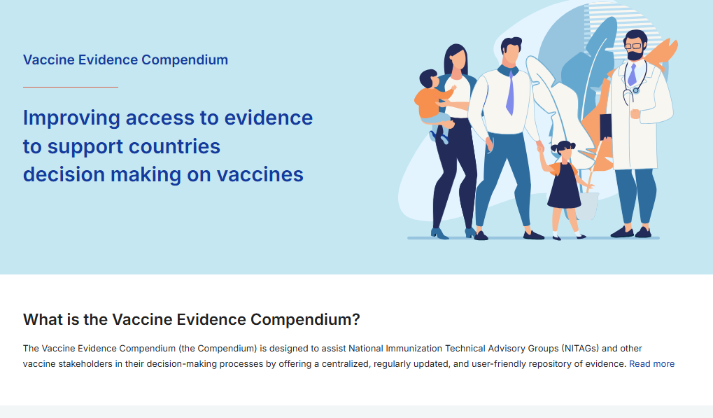






Promoting country ownership in decision-making to maximise health impact, within available resources
→ Maximize the present
Vaccine Optimisation
Assessing new products, presentations, schedules, or uses and switch to more suitable ones based on countries contexts
Anticipate the future
Vaccine prioritisation:
Deciding which new vaccine introductions programmes to invest in, when and in what order
Shifting towards a systematic, portfolio lens, process led by national stakeholders
24 NITAGs trained
NITAGs strenghtening
Linkages with NIS
WHO Compendium
Coordinated technical support
1 Working Group VPOP
+25
sensitized
3
Vaccines to date

Slide 10
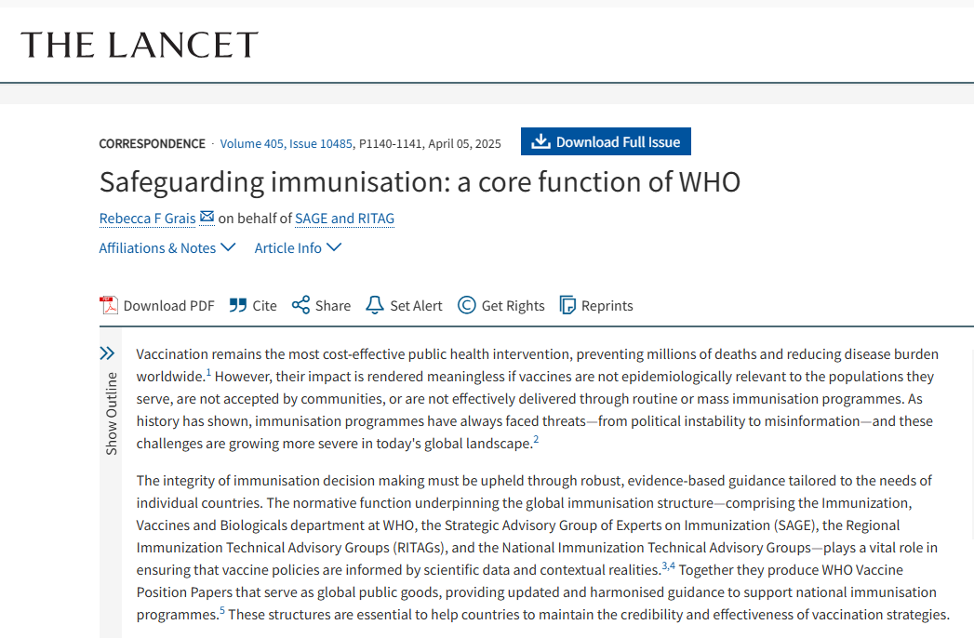
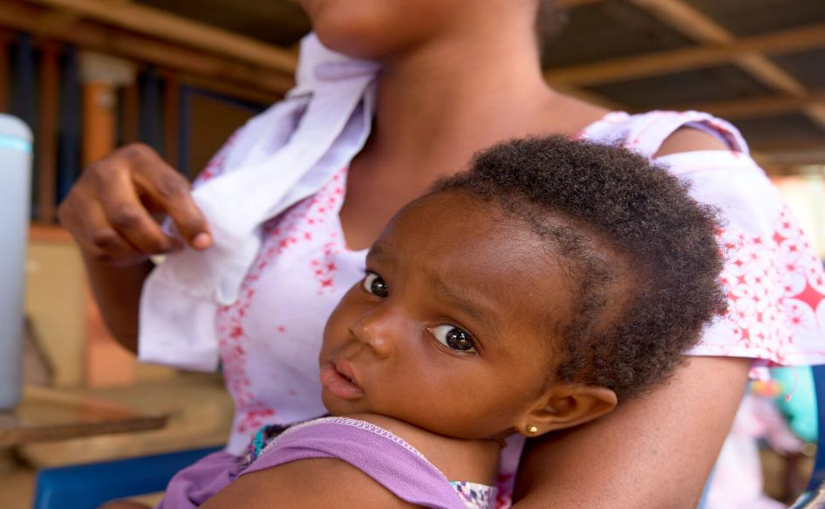
WHO and SAGE’s normative role in immunization policy is more critical than ever
WHO’s 2025-28 strategy: ‘developing evidence-based norms and standards’ a key component for advancing equity and resilience in a turbulent world
WHO’s prioritization exercise highlighted immunization and policy as core function
The normative function underpinning the global immunization structure (SAGE, RITAGS & NITAGS) play a vital role in ensuring vaccine policies are informed by scientific data & contextual realities
Key Attributes
Transparency
Independence
Best available evidence
Evidence to policy methodology
Support country decision-making in evolving contexts

Slide 11



REPORT FROM GAVI, THE VACCINE ALLIANCE
Gavi and Alliance partners have supported eligible countries in making measurable progress in reducing zero-dose children, revitalizing HPV vaccination, and accelerating malaria vaccine rollout.
Funding gaps and sustainability pressures require sharper prioritization and stronger coordination.
Guidance from SAGE in setting evidence-based priorities will be essential to ensure immunization programmes optimize their vaccine portfolios and continue to deliver impact equitably and sustainably.

Slide 12



REGIONAL REPORTS
All WHO Regional Offices have been affected by drastic reductions in human and financial resources, which will significantly affect their ability to support immunization activities in their Member States.
While there has been progress in restoring immunization coverage through catch-up vaccination efforts, immunity gaps persist and have led to large and disruptive VPD outbreaks in several countries.
There is concern across all the WHO Regions about the potential for further backsliding because of the constrained resources in the current global health environment.
Efforts are increasingly focused on subnational levels to maximize the impact of available resources, reduce the number of unvaccinated and under-vaccinated children, and advance immunization equity.

Slide 13

IA2030 –MID-TERM REPORT
13

Slide 14
Despite significant progress towards impact goals, we are off-track to reach most targets defined in ia2030
Prevent Disease
Promote Equity
Build Strong Programs
1
2
3
Failure to meet IA2030 coverage targets will lead to an increase in avoidable future deaths
Numbers of Zero-dose (ZD) children are increasing, and Acceleration is needed on HPV introductions
Global coverage of key antigens is improving while some remained stagnant.
50mn future deaths averted globally
50% reduction in number of Zero- dose children
90% Global Coverage for DTP3, MCV2, PCV3 & HPVc
34%
deaths
averted
DTP3
85%
110
Observed deaths averted
(cumulative, 2021-2024)
1.3M
(11%) ZD
increase
PCV3
67%
74
50M (2030 target)
13
(2019 baseline)
14
(2024)
MCV2
76%
72
All countries achieve VPD Control elimination and eradication targets
HPVc
28%
16
6.5M (2030 target)
Baseline coverage
90% (2030 target)
Measles
#
# of countries that have achieved / sustained 90% coverage
Maternal & Neonatal Tetanus
Rubella
500 Vaccine introductions in low - and middle-income countries
Improve Universal Health Coverage
Poliovirus (WPV)
194 (2030 target)
Countries that have achieved target
On
Track
for target
Some VPDs have a declining trend while other large and disruptive outbreaks are increasing
308 Cumulative
UHC index in most recent year
Yellow Fever
WPV
Ebola
Cholera
Measles
Meningococcus cVDPV
500 (2030 target)
Baseline UHC Index of 68
2021
2022
2023
2024
2021 result unchanged from baseline
Source: IA2030 Scorecard and Dashboard

Slide 15



IA2030 mid-term report
The IA2030 mid-term report acknowledged the progress made against impact goals to date and reaffirms that the overall vision and strategic priorities remain relevant even though progress is falling behind for several 2030 targets.
In an evolving context, SAGE highlighted the importance of the IA2030 partnership to continue supporting countries navigate complex trade-offs, strengthen local monitoring and action cycles, build capabilities to make data-driven decisions based on locally generated evidence, and maintain efforts to integrate immunization into primary health care.
To enable this, IA2030 structures at the global and regional level should be reviewed to strengthen focus on driving coordinated action towards common priorities at all levels.

Slide 16

INFLUENZA A(H5)
16

Slide 17
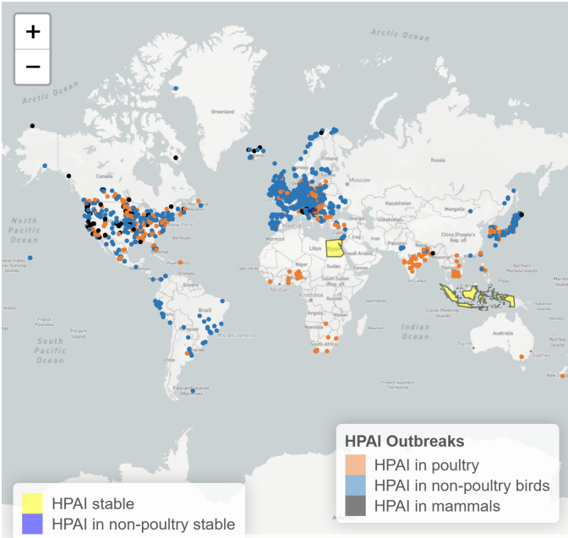
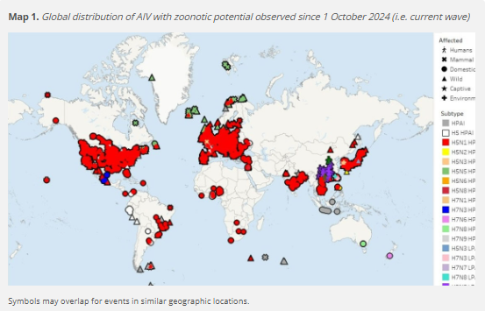
Avian influenza outbreaks, World Organization for Animal Health (WOAH) and Food and Agriculture Organization of the United Nations (FAO)
1 Oct 2024 to Sept 2025
https://www.woah.org/app/uploads/2025/09/hpai-report-74.pdf
https://www.fao.org/animal-health/situation-updates/global-aiv-with-zoonotic-potential
Notes:
AI outbreaks in animals from Oct 2024. WOAH map shows type of animal, FAO map show by subtype

Slide 18
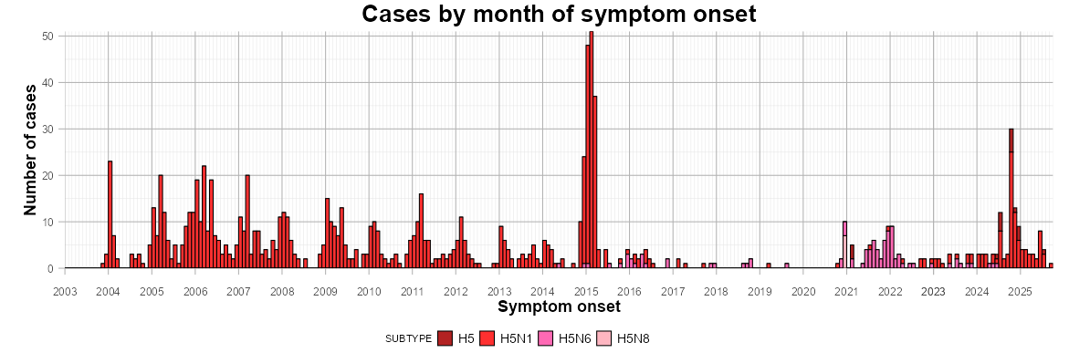
Detections of zoonotic influenza A(H5) Gs/Gd lineage viruses in humans
2003 to 10 Sept 2025
*This may include detections in persons without symptoms that could represent contamination and not infection.
Notes:
For human cases of H5, here is the epi curve for cases since 2003, specifically of H5 Gs/Gd lineage viruses. This includes cases of H5N1, H5N6, H5N8 as well as H5 where the N-type is not known.
Peak in 2015 indicates cases from Egypt. And another increase end 2024 with cases from US.

Slide 19
Summary: approved A(H5) vaccines
22 approved vaccines: 19 A(H5N1) & 2 A(H5N8)
An additional vaccine was previously temporarily authorized
13 licensed for use during the interpandemic and/or emergency periods
4 of the manufacturers with approved vaccines are currently in clinical trials for other A(H5) vaccine candidates
Active licenses: 21 active (1 not currently active due to lack of demand)
NRA license: EMA, FDA, MFDS, PMDA, NMPA, TGA, Thai FDA
Prequalified: 1 (LAIV) for use from 12 months to less than 18 years of age [prudent to not use during the interpandemic/emergence period]
Currently commercially available (2025): 2 manufacturers
Population indication: 9 available for children (8 for 6m+; 1 for 12m+); 12 available for older adults (61 or 65+)
Doses: 2 doses (minimum spacing is typically 21 days)
Platform: 21 Inactivated Influenza Vaccine (IIV); 1 Live Attenuated Influenza Vaccine (LAIV)
Adjuvants: 17 products are adjuvanted with AS03, MF59, or alum

Slide 20
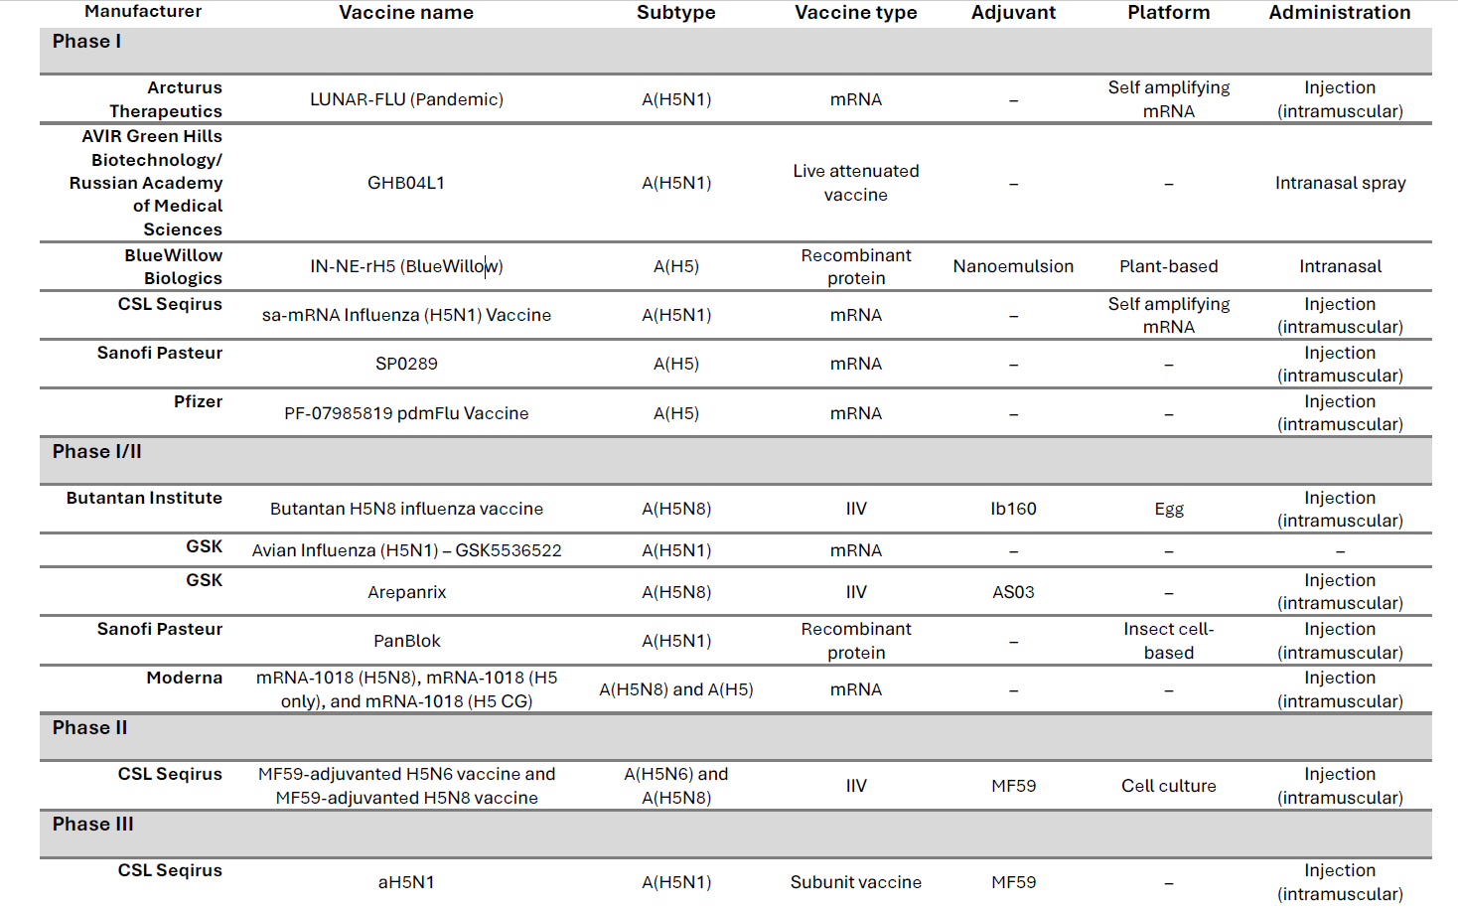
At least 13 influenza A(H5) vaccine candidates in clinical studies
Most of them in Phase I/II
9 developers, of which 4 already have licensed seasonal or pandemic influenza vaccines
Includes A(H5N1), A(H5N8), and A(H5) vaccines
6 mRNA, 1 live attenuated, 2 recombinant, 3 IIV, and one subunit vaccine
5 vaccine candidates are adjuvanted

Slide 21
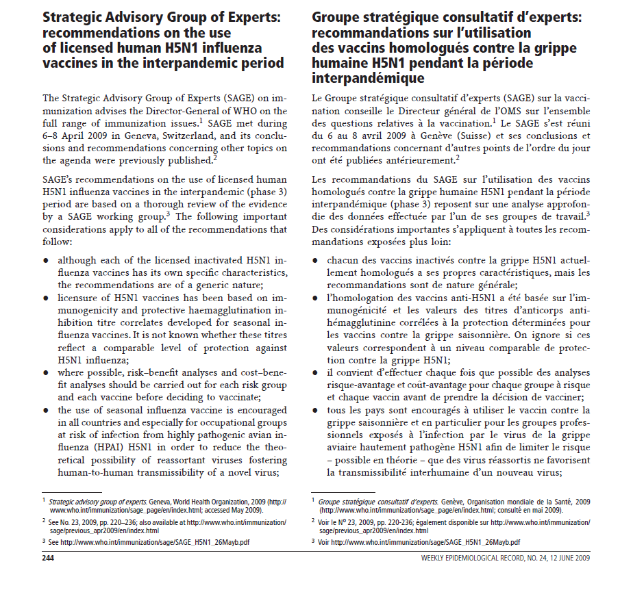
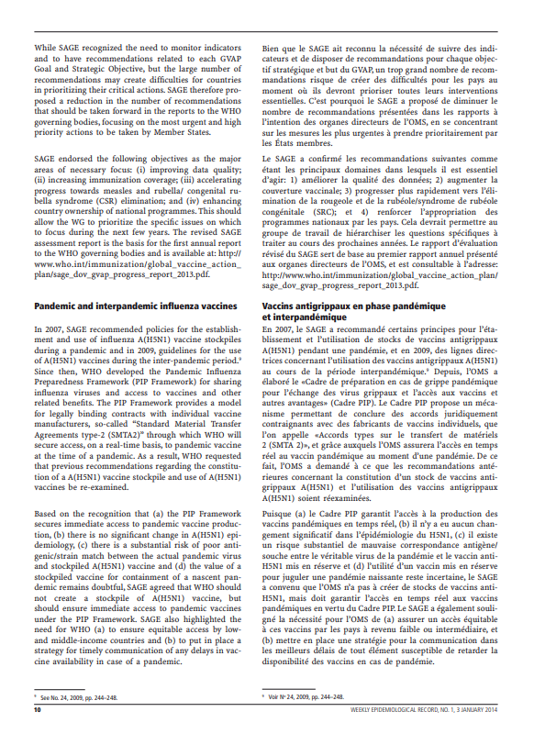
Background: Existing SAGE recommendations on the use of licensed human H5N1 influenza vaccines in the interpandemic period
Timeline
2007
2009
2010
2013
SAGE recommendation on creation of H5N1 stockpile
SAGE recommendation on target groups/ no change to stockpile but encouragement to generate data
SAGE recommendation: no change to H5N1 target groups/ some updated recommendations on H5N1 stockpile
SAGE recommendation: no change to H5N1 target groups/use of Pandemic Influenza Preparedness (PIP) Framework (established in 2011) instead of WHO H5N1 stockpile
Source: Strategic Advisory Group of Experts: recommendations on the use of licensed human H5N1 influenza vaccines in the interpandemic period. Wkly Epidemiol Rec. 2009;84(24):244-8 (https://www.who.int/publications/i/item/WER8424 ); Meeting of the Strategic Advisory Group of Experts on Immunization, November 2013 – conclusions and recommendations. Wkly Epidemiol Rec. 2014;89(1):1-19 (https://www.who.int/publications/i/item/WER8901 )

Slide 22



INFLUENZA A (H5) VACCINES – SAGE RECOMMENDATIONS
SAGE recommended that countries should consider issuing recommendations on the use of available licensed influenza A(H5) vaccine(s) for the interpandemic¹ and emergence periods² when this aligns with their public health priorities. Such recommendations should be based on a careful review of the evidence using the evidence-to-recommendations framework.
The primary objective for the potential use of currently licensed influenza A(H5) vaccines for the interpandemic and emergence periods should be the prevention of severe disease in individuals at higher risk of infection with influenza A(H5) viruses.
Based on existing epidemiological data, SAGE recommended targeting the following groups for vaccination, based on their risk of exposure:
laboratory workers who handle influenza A(H5) viruses;
first responders in zoonotic influenza outbreaks;
health workers who evaluate and manage suspected or confirmed human cases, including potential vaccinators; and
people with ongoing contact with animals or their environments in geographic areas where animal/human infections have been reported³.
1. As per WHO’s Preparedness and Resilience for Emerging Threats (PRET) framework defined as no human cases of the virus being reported, although animals may be infected.
2. As per WHO’s PRET framework defined as sporadic human cases or clusters of human cases of influenza A(H5) are detected, but no sustained human-to-human transmission.
3. This could include individuals routinely, occupationally or otherwise exposed to animals, their secretions or contaminated environments, such as poultry/farm workers, veterinarians, zookeepers, backyard bird flock owners, live bird market vendors, people with recreational exposure to animals (e.g., hunters, wild bird watchers).

Slide 23

COVID-19
23
Notes:
I’ll be giving a brief recap of the RSV immunization products to protect infants and the recent SAGE policy recommendations.

Slide 24

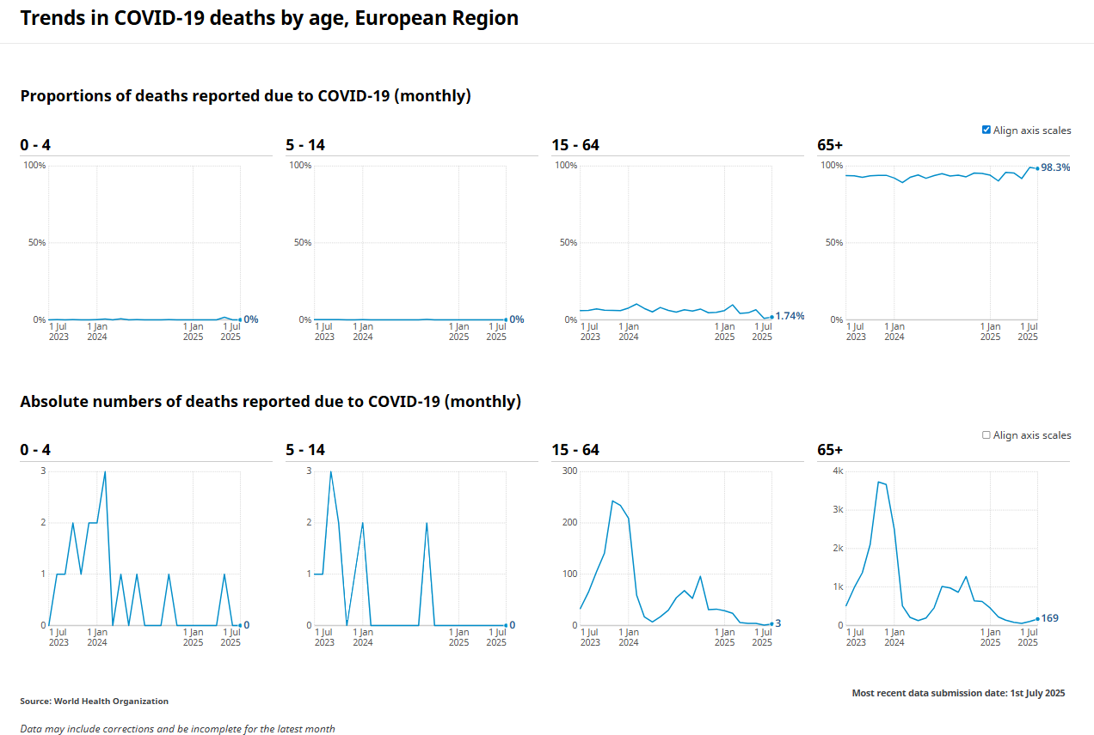
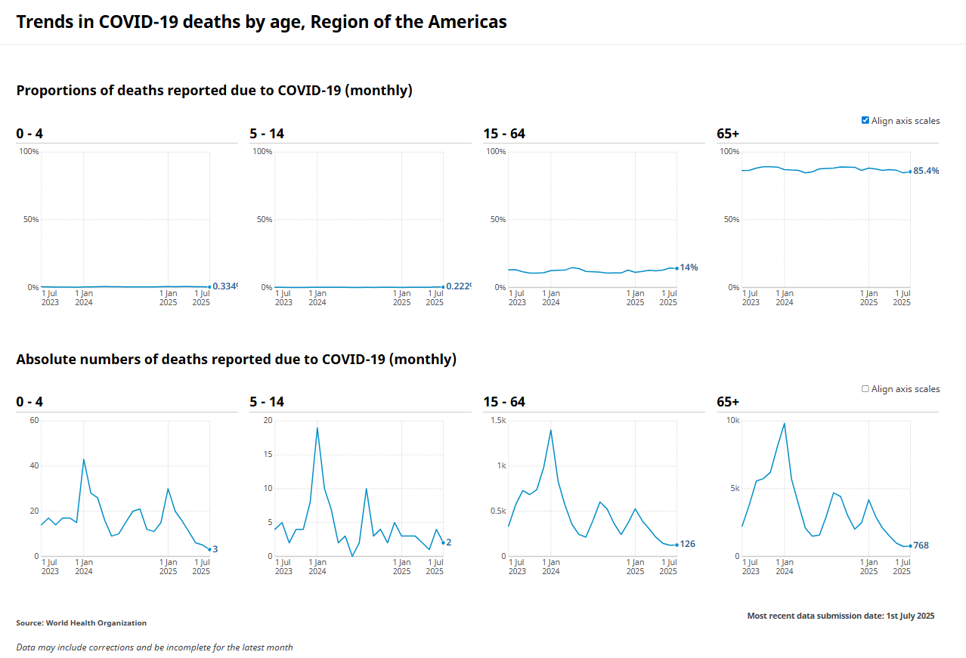
COVID-19 deaths reported by age As of 31 July 2025
Europe
Americas
~ 2%
~ 14%
COVID-19 deaths | WHO COVID-19 dashboard

Slide 25
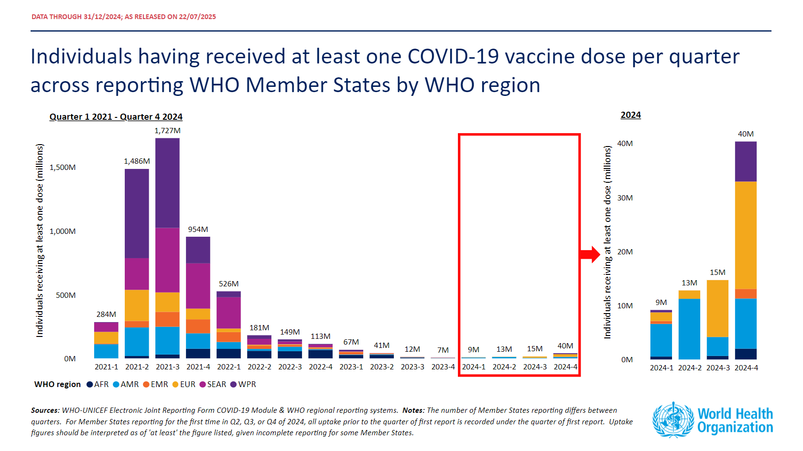

Slide 26
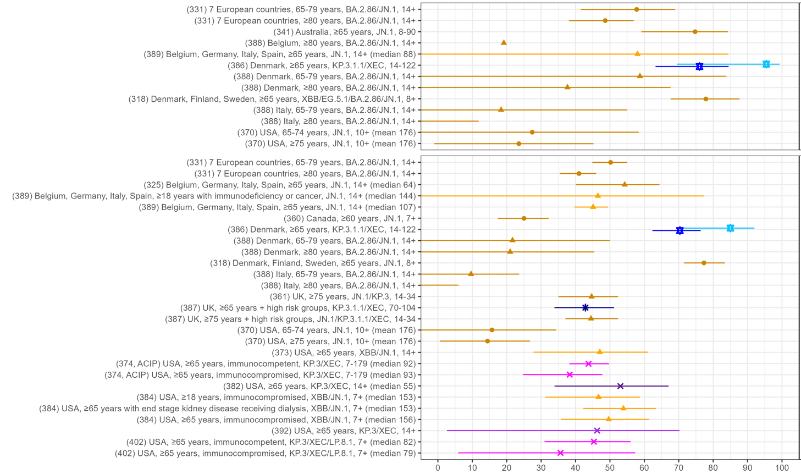


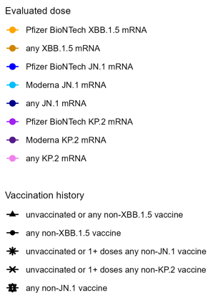
Up-to-date or relative VE (%) against death and severe disease during JN.1 predominance (BA.2.86/JN.1/KP/XEC/LP.8.1), high priority use groups
(ref no) country, population, subvariant, time since last dose (days)
VE Range
XBB.1.5 vaccines: -21 to 84%
JN.1 vaccines: 76-96%
KP.2 vaccines:
VE Range
XBB.1.5 vaccines: -6 to 78%
JN.1 vaccines: 43-85%
KP.2 vaccines: 36-53%
VE estimates for entire follow-up period where available
VE (%)
Notes:
JN.1 predominance >50% (based on paper if available, or Our World in Data)
Note overall VE (many waned estimates)
*If study does not have overall VE estimate but rather only estimates by time interval, the early or peak estimate is plotted (n=6 estimates)
SAGE –
Show this slide with all pops
Same slide with early estimates
Then elderly
Immunocompromised, comorbidities (including comparable immunocompetent groups)
‘Waning’
Pregnancy
ADD JN.1 period to all titles where relevant
TAG-CO-VAC:
TAG-CO-VAC → include ranges by vaccine
374=Link-Gelles (up-to-date VE); note reference group received last dose 2+ years ago on average (median 720-775 days prior for 65+ years and median of 998 days for 18+ years)
382=Wilson (up-to-date VE)
386=Hansen et al (relative VE, no unvaccinated in reference group)
387=UKHSA data (up-to-date VE); note ref group is ‘unvaccinated or received last dose at least 3 months prior’
Outcome icons. Tombstone = death; building = severe disease/hosptitalization; head with thermometer=symptomatic disease; hands with germs=infection.
All studies numbered according to table for booster studies as part of living systematic review on ViewHub.org.

Slide 27



COVID-19 – SAGE OBSERVATIONS & CONCLUSIONS
There has been a decline in the number of reported cases and deaths due to COVID-19 globally. The annual uptake of vaccination is low and mainly limited to high-income countries in Europe and the Americas.
Variant-adapted COVID-19 vaccines show moderate relative vaccine effectiveness in preventing COVID-19 cases and hospitalizations, though protection wanes by six months.
The current Roadmap remains valid, though SAGE advised that that the recommendations be reviewed and updated based on the current context and other health priorities in countries.
SAGE recommended an updated review of the evidence on the effectiveness of COVID-19 vaccines during the Omicron period, with a focus on the effect of vaccination in pregnancy on birth outcomes and infant COVID-19 to reassess the validity of recommendation on vaccination during pregnancy.

Slide 28
NEW TUBERCULOSIS VACCINE
28

Slide 29
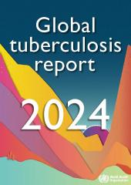
The global TB situation
A quarter of the world’s population has been infected with TB bacilli.
Estimated incidence
Estimated deaths
All forms of TB, 2023
10.8 million
(10.1–11.7 million)
55% men | 12% <15y
1.09 million*
(0.98–1.2 million)
HIV-associated TB, 2023
662,000
(589,000–739,000)
161,000
(132,000–193,000)
MDR/RR-TB, 2023
400,000 (360,000–440,000)
150,000 (94,000–210,000)
* Excluding deaths attributed to HIV/TB

Slide 30
Global clinical TB vaccine development pipeline: prophylaxis in adolescents and adults.
Phase 1 | Phase 2A | Phase 2B | Phase 3
AdHuAg85A McMaster Univ, Cansino | AEC/BC02 Anhui Zifei Longcom | MTBVAC Biofabri, Univ Zaragosa, IAVI | BCG as travel vaccine HJF
H107e/CAF10b SSI | BNT164a1 and BNT164b1 Biontech, Gates MRI |  | GamTBvac Gamaleya, MoH Russia
TB/FLU-05E Smorodintsev/MOH Russia | ID93/GLA-SE (QTP101) Quratis, NIH |  | Immuvac (MIP) ICMR, Cadila
 |  |  | VPM1002 SII, VPM
 |  |  | M72/AS01_{E-4} Gates MRI, GSK
1. Most advanced and promising
2. Fast follower
3. Next generation
4. Where are the results?
Modified from Stop TB Partnership.

Slide 31

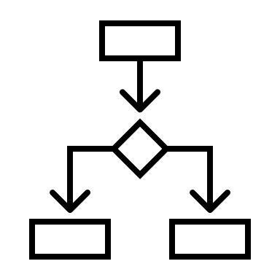

TUBERCULOSIS VACCINES - CONCLUSIONS
As of May 2025, there are 16 candidate TB vaccines in clinical development; 5 are in phase 3 trials with a prevention of disease endpoint. One of these candidates, M72/AS01E may be licensed as early as 2028.
Results of multi-country, multi-region vaccine clinical trials that will only have adequate statistical power to detect efficacy in 1 or 2 high TB burden countries or single-country clinical trials can be extrapolated to other countries unless there are major epidemiological differences. Phase 4 impact studies may be required to determine effectiveness in other settings or priority groups*.
SAGE advised that provisions should be made to collect adequate data on the safety and immunogenicity of the vaccine in IGRA negative individuals to inform recommendations since such individuals are likely to be vaccinated during programmatic rollout of the vaccines.
SAGE proposed conducting scenario analyses, risk assessment and contingency planning, including potential efficacy in IGRA negatives, to proactively align and inform decision making. It will be important to ensure commitment from developers and donors to generate additional data and evidence.
SAGE cautioned that inclusion of asymptomatic tuberculosis as a component of a composite endpoint may compromise the demonstration of efficacy against severe tuberculosis. SAGE supported the development of a roadmap to generate evidence on the characteristics of asymptomatic tuberculosis to enable decision-making.
*If correlates of protection are established, immunobridging trials may be used.

Slide 32

COMBINATION VACCINES
32

Slide 33



Combination vaccines could help broaden and strengthen immunization programs, but few are in development
Challenges
Potential solutions
Opportunities
The potential for new vaccines to address major public health challenges, including AMR, has never been greater.
But immunization schedules are already saturated with multiple vaccines often administered at the same visit.
Combination vaccines could simplify immunization schedules, increase coverage, allow introduction of new vaccines, and enhance efficiency of immunization programs.
However – they will likely cost more.
REGULATORY: Evaluate simplifying licensure pathways, focusing on the benefit/risk of a combination as a whole
POLICY: Articulate public health impact of combinations relative to stand-alone components
ECONOMIC: Assess full health impact and economic value of combinations
COMMERCIAL: De-risk investment by providing clarity on priorities, approval and policy pathways
Build on the successful experience with DTP-Hib-HepB-(IPV) and MR combinations

Slide 34
Staged approach to prioritize combinations
Vaccines to consider combining
Hypothetical combinations
Program-compatible
Technically feasible
Public Health and Market Opportunity
Value assessment
Licensed
In Development
1. Identify vaccines to consider combining and apply entry criteria to focus on the most relevant vaccines | 2. Combine vaccines pairwise for analysis | 3. Identify programmatically compatible combinations | 4. Identify technically feasible combinations | 5. Identify the combinations with greatest potential impact and sustainability | 6. Health economics value assessment and priorities

Slide 35
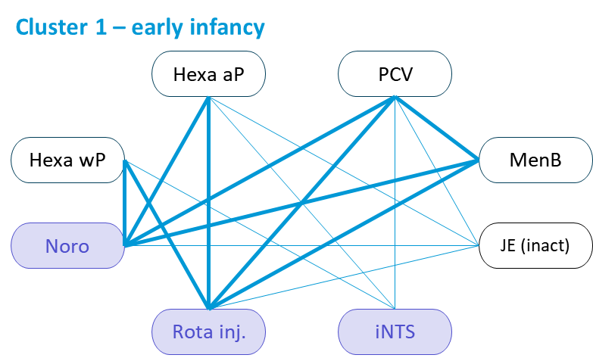
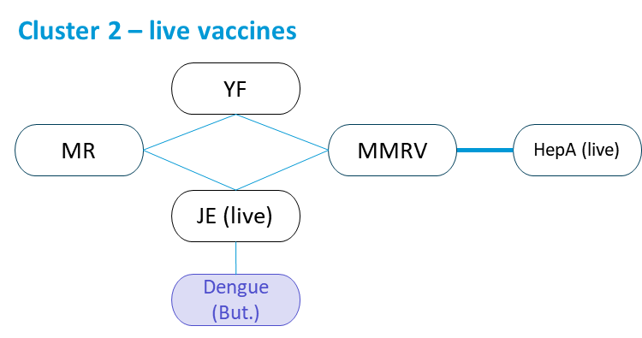
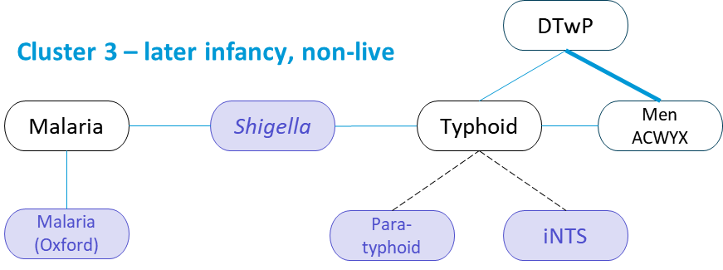
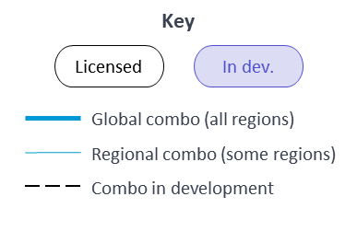
Emerging opportunities, cluster view
Lines connecting 2 vaccines represent novel combinations
35 combinations remain. Of them, 31% (11/35) are of 2 licensed vaccines, and 69% (24/35) are regional rather than global.

Slide 36



COMBINATION VACCINES - CONCLUSIONS
Combination vaccines could help countries to ease delivery of existing vaccines and introduce new ones by reducing the number of injections to be administered at a single visit, thereby improving acceptance and uptake, and reducing health worker workload.
SAGE supported the development of a framework to identify, analyze and prioritize novel combination vaccines, along with a rigorous process aimed at optimizing public health impact.
SAGE highlighted the importance of engaging with national and regional immunization technical advisory groups to identify regional priorities for combination vaccines.

Slide 37

POLIOMYELITIS
37

Slide 38
Poliomyelitis - agenda
Update on the status of polio eradication
Goal 1: eradication of WPV1
Goal 2: elimination of cVDPV2
4 items for recommendation:
1-Update on bOPV Cessation Planning and resource mobilization
2-bOPV in RI with wP-Hexavalent vaccine introduction
3-Immunogenicity of the fractional Sabin IPV and the programmatic implications
4-nOPV2 expanded use in areas with persistent transmission

Slide 39
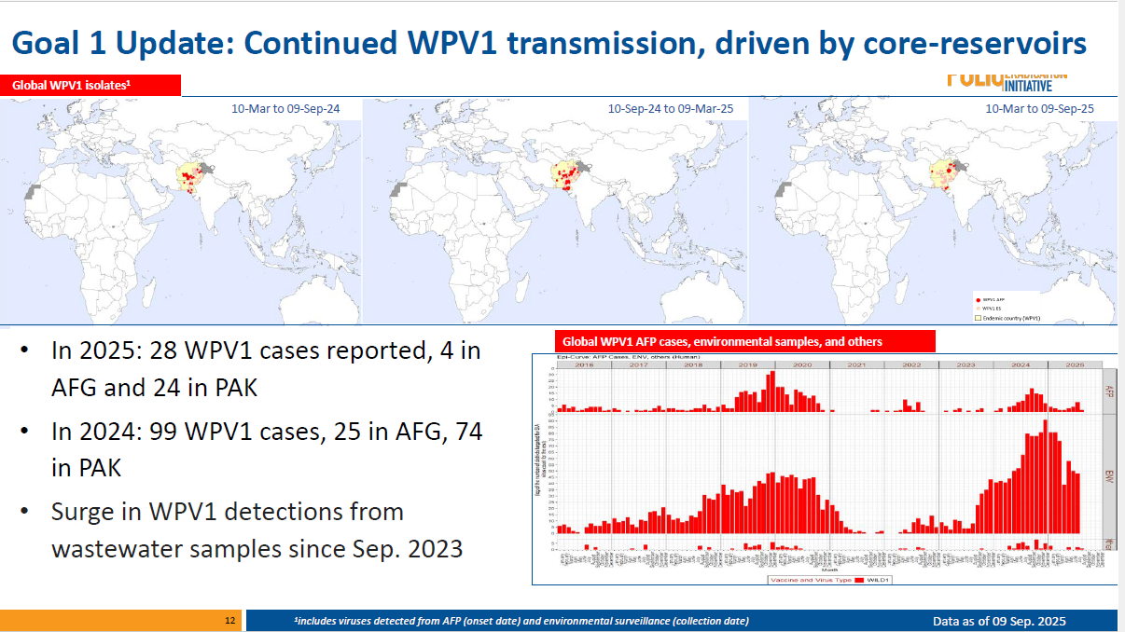

Slide 40
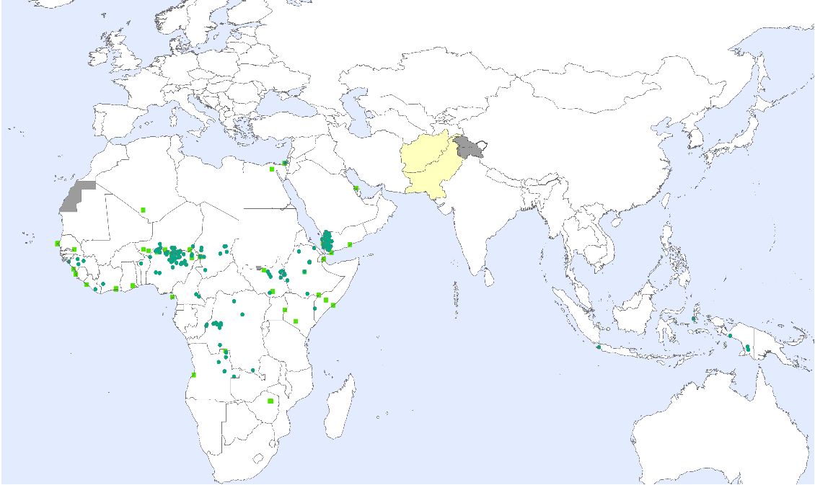
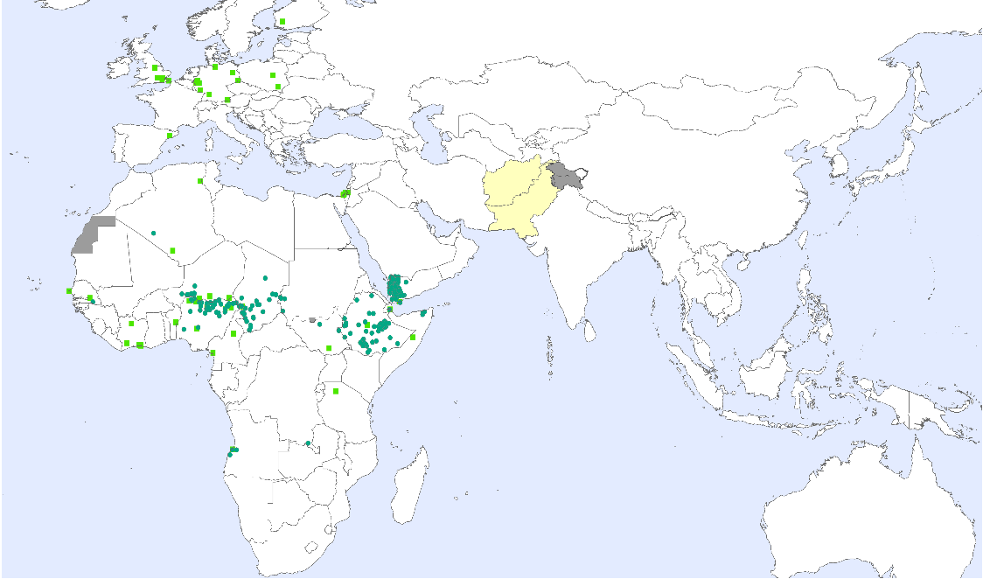
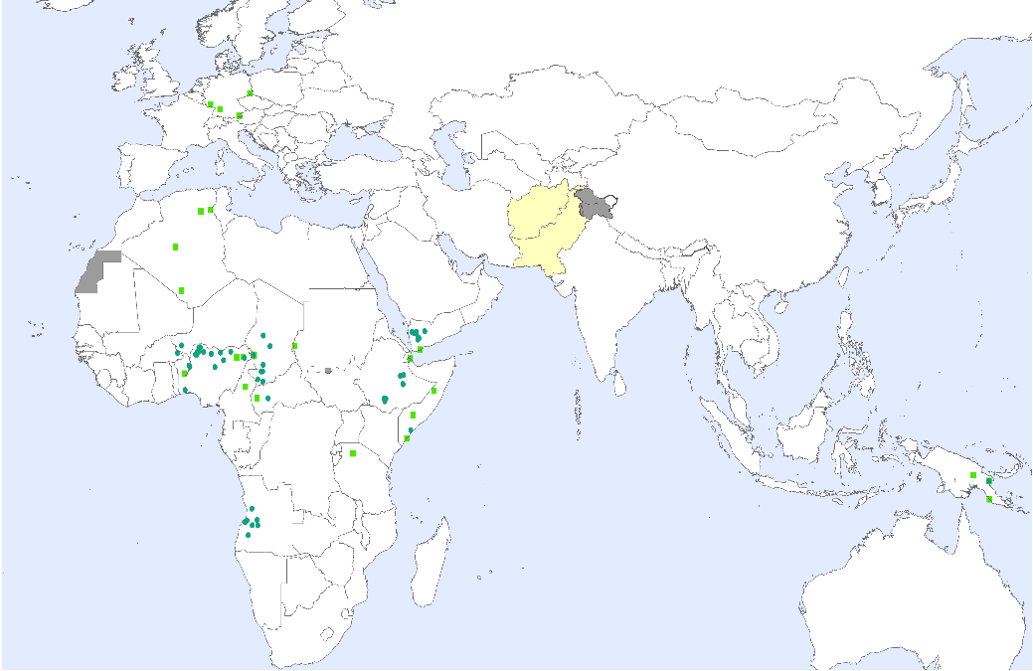

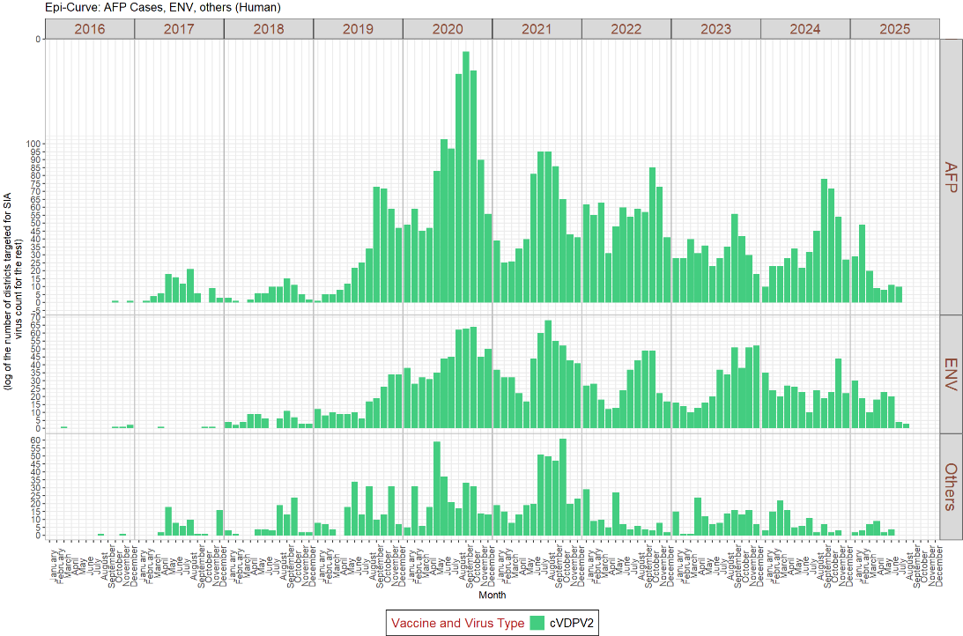
Goal 2 Update (cVDPV2): Progress in Southern AFR & DRC; Lake Chad Basin & Horn of Africa driving cVDPV2 transmission
Global cVDPV2 isolates¹
10-Mar to 09-Sep-24
10-Sep-24 to 09-Mar-25
10-Mar to 09-Sep-25
Overall downward trend since 2022
In 2025: Total of 136 cVDPV2 cases
102 from the African Region (9 countries)
Rest from EMR; (1 Djibouti, 1 Somalia, 2 Sudan, 29 Yemen) and WPR; (1 Papua New Guinea)
In 2024: 448 cVDPV2 cases
cVDPV2 detections from wastewater samples from multiple countries of European Region
Global cVDPV2 AFP cases, environmental samples, and others
¹includes viruses detected from AFP (onset date) and environmental surveillance (collection date)

Slide 41
Update on bOPV Cessation Planning to SAGE
GPEI has completed several steps of bOPV cessation planning
Developed policy framework (Guiding Principles, Triggers and Enablers)
Estimated doses, budget, and timeline for pre-cessation SIAs
Provided signal to manufacturers on bOPV needs for pre-cessation SIA
Next steps
Monitor achievement of triggers and preparation of enablers
Support planning at regional and country level for achieving bOPV cessation
Consideration of contingency plans
SAGE deliberation
SAGE reiterated its support for safe cessation of bOPV and strongly recommends commitment of necessary resources for proper coordination, and implementation.

Slide 42
Sabin-based Fractional IPV (sfIPV)
Fractional-dose IPV with Salk-based IPV has been used in the program for >10 years (with SAGE’s endorsement): In RI in 6 countries (i.d.); For outbreak response (in endemics and in cVDPV2 outbreak countries)
In 2021, SAGE recommended that WHO‑prequalified FULL DOSE Sabin‑based IPV may be used interchangeably with traditional Salk‑based IPV
Full-dose sIPV is currently used in RI in >40 countries
SAGE reviewed new clinical data on fraction Sabin-based IPV (fsIPV) and concluded that fsIPV may be used in the same way as Salk based fIPV is currently used expanding programmatic options for RI and outbreak response

Slide 43
bOPV in RI after wP-Hexa Introduction
wP-Hexa is being progressively introduced to replace stand-alone IPV vaccines in OPV-using countries
Several countries have expressed uncertainty around whether the introduction of a 3-dose wP-Hexa schedule necessitates changes to the bOPV RI schedule
SAGE reiterated that bOPV-using countries introducing wP-Hexavalent vaccine into RI should continue using bOPV without change in the number of doses until further guidance is available

Slide 44
Expanded use of nOPV2
Current Standard Operating Procedures focus on outbreak response campaigns (SIAs) with nOPV2 and are effective in stopping the outbreaks in most geographies
Declining population mucosal immunity against polio type 2 necessitates use of nOPV2 beyond the conventional mode of SIA delivery in areas of persistent cVDPV2 transmission
SAGE supports countries to expand nOPV2 use to interrupt cVDPV2s in select geographies with persistent transmission (defined as uninterrupted transmission for >6 months) with administration of the vaccine through all possible opportunities outside of traditional and time-limited modalities of polio SIAs This approach will provide countries an outbreak response tool to be implemented alongside existing strategies such as SIAs.
Specific and contextualized guidance will be provided by WHO technical teams in the affected geographies.

Slide 45




POLIOMYELITIS – OBSERVATIONS AND RECOMMENDATIONS (1/2)
SAGE was concerned about continued transmission of wild poliovirus in Pakistan and Afghanistan, the persistent transmission of circulating vaccine-derived poliovirus type 2 (cVDPV2) in many African countries, and continued detections of cVDPV2 in wastewater samples in Europe.
SAGE reaffirmed its support for the safe cessation of bivalent oral poliovirus vaccines (bOPV) from routine immunization and urged that necessary resources to achieve safe bOPV cessation be mobilized.
SAGE recommended the use of fractional doses, including intradermal doses, of Sabin-based inactivated poliovirus vaccines (IPV) in a similar way to the use of fractional doses of Salk-based IPV.
SAGE reiterated that bOPV-using countries introducing the whole-cell pertussis hexavalent vaccines should continue administering bOPV without change in the number of bOPV doses in routine immunization schedule, until further guidance on bOPV cessation is provided.
SAGE expressed its support for the expanded use of the novel type 2 oral poliovirus vaccine (nOPV2) as part of the response to reduce cVDPV2 transmission in select geographies with persistent transmission of cVDPV2.

Slide 46


POLIOMYELITIS – OBSERVATIONS AND RECOMMENDATIONS (2/2)
SAGE noted that polio eradication cannot be achieved by technical interventions alone and strongly underscored the importance of sustained political leadership and accountability at every level to achieve polio eradication.
SAGE called for a broader discussion on the overall achievability of eradication plans and for a discussion on contingency plans at future SAGE meetings and sought clarifications on its responsibility and accountability within the GPEI ecosystem, relative to those of other GPEI advisory bodies.

Slide 47

MALARIA
47

Slide 48
Status of malaria vaccine roll-out As of 24 Sept 2025
23
Countries
introduced
23 countries introduced¹ (4 nationally, 19 sub-nationally)
Current cumulative annual target population of >10 million children …rapidly increasing. Supply sufficient to meet demand.
But, limited geographic reach due to funding constraints: Gavi support limited to a maximum of 85% vaccine volume for target population in moderate and high transmission areas. Risk of further cuts due to funding gap for 2026-2030 strategy period
Market shaping ongoing: GSK and Bharat Biotech commit to progressive RTS,S/AS01 price reductions to < US$5/dose by 2028.³ SII to reduce R21/Matrix-M price (depending on volumes procured)
Introduced nationally
Introduced sub-nationally
Approved for introduction, not yet introduced
Sources:
1 WHO Malaria Vaccine Introduction Dashboard (24 Sep 2025)
3 GSK press release (25 Jun 2025)
Notes:
Malawi, Ghana, Kenya, Cameroon, Burkina Faso, Liberia, Benin, Sierra Leone, Côte d'Ivoire, South Sudan, Mozambique, Central African Republic, Niger, Chad, Democratic Republic of the Congo, Sudan, Nigeria, Burundi, Uganda, Mali, Guinea, Togo, Ethiopia
Additional introductions and scale up in 2025 and 2026

Slide 49
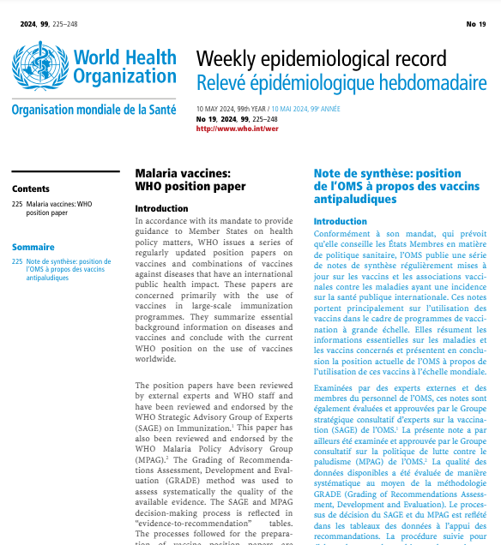
Rationale and background
The SAGE and MPAG were asked to address the following questions:
Is a 3-dose malaria vaccine schedule safe and effective?
In areas of perennial malaria transmission (including low transmission), should a 3-dose malaria vaccine schedule be considered as an alternative to a 4-dose schedule in some contexts?
Malaria vaccines: WHO position paper
(May 2024 update)
WHO recommends the use of malaria vaccines for the prevention of P. falciparum malaria in children living in malaria endemic areas, prioritizing areas of moderate and high transmission
RTS,S/AS01 Phase 3 trial (2009–2014) suggested 4th dose was needed to maintain vaccine efficacy against severe malaria and to avoid rebound; however, subsequent RTS,S/AS01 evidence and findings brought these conclusions into question
SAGE and MPAG* previously endorsed an approach where WHO recommendations could be updated as new data becomes available – particularly if the 4th dose provides little incremental impact over a safe and effective 3-dose schedule
The SAGE/MPAG Working Group recommended the RTS,S/AS01 case-control study to complement the cluster-randomised MVIP pilot evaluations that measured population-level estimates – and to assess the value of the 4th dose
4-dose schedule from around 5 months of age¹
A 5th dose, given one year after dose 4, may be provided where malaria risk remains high
Provided as part of a comprehensive malaria control strategy
Source: https://www.who.int/teams/immunization-vaccines-and-biologicals/policies/position-papers/malaria
*Strategic Advisory Group of Experts on Immunization (SAGE) and Malaria Policy Advisory Group (MPAG)

Slide 50

Key result from case-control study: Effectiveness against severe malaria by age range, in children who received 3 doses only of RTS,S/AS01 and in children who received 4 doses of RTS,S/AS01
Interval of up to 15 months from when children receive Dose 3 (~7 to 9 months old) until becoming eligible for Dose 4 (22 or 24 months old)
Dose 3
Dose 4
Median time since Dose 4, 10 months (IQR 5, 17)
Median age of severe malaria cases, 33 months (IQR 29, 42)
4 doses
54% [39, 66] average effectiveness
4th dose
30% [9, 45] incremental effectiveness
(vs. 3 doses alone)
3 doses
56% [40, 67] average effectiveness
3 doses
35% [15, 50] average effectiveness
No Dose 4
received
Median time since Dose 3, 9 months (IQR 5, 11)
Median age of severe malaria cases, 18 months (IQR 14, 20)
Median time since dose 3, 20 months (IQR 15, 25)
Median age of severe malaria cases, 30 months (IQR 25, 36)
Estimates adjusted for child’s sex, ITN use reported at home visit, caregiver’s highest level of education, and household wealth ranking
4-dose schedule in Malawi at 5, 6, 7 and 22 months of age; in Ghana at 6, 7, 9 and 24 months of age; and in Kenya at 6, 7, 9 and 24 months of age.

Slide 51
Summary of RTS,S/AS01 case control study results: Safety and Effectiveness against severe malaria and cerebral malaria
Severe malaria:
56% reduction among children receiving three doses during the period until the 4th dose was due
From the age when children were eligible for 4th dose:
35% reduction among children who did not go on to receive the 4th dose
54% reduction in those receiving four doses lasting at least 18 months after the 4th dose
30% incremental effectiveness of dose 4, compared to 3 doses
Cerebral malaria:
78% reduction among children who received 4 doses
45% incremental effectiveness of dose 4, compared to 3 doses
Rebound:
No risk of severe malaria rebound in children who received three doses (and not dose 4).
Evidence of sustained protection beyond the age when children were due to receive the 4th dose
Safety
The results further strengthened the evidence of no association of RTS,S/AS01, and the safety signals reported in the Phase 3 clinical trial

Slide 52




MALARIA VACCINES – CONCLUSIONS & RECOMMENDATIONS
After a review of all available evidence, showing that the four-dose malaria vaccine schedule provides greater protection against clinical and severe malaria than a three-dose schedule in moderate to high transmission settings, SAGE and MPAG reaffirmed its recommendation for the use of the four doses as the recommended schedule.
The case-control study embedded in the Malaria Vaccine Implementation Programme (MVIP) shows that a 4-dose schedule reduces severe malaria cases by around 54% through the study period, and the fourth dose provides a 30% incremental effectiveness above 3 doses in reducing severe malaria. There was no evidence of rebound among children who missed the fourth dose.
Where the delivery of the fourth dose may temporarily not be possible, for example in fragile, conflict-affected and vulnerable settings, children will still benefit from 3 doses, until obstacles to the delivery of the fourth dose are resolved
SAGE and MPAG expressed support for WHO’s recommendation that countries align the timing of the fourth dose with the timing of other vaccines and, where appropriate, other health interventions administered in the second year of life, thereby reducing the additional delivery burden.
All evidence on malaria vaccines to support country discussions and decisions is available on the NITAG Resource Center: https://www.nitag-resource.org/diseases/malaria

Slide 53
Thank you

