Slide 1
Update on GNN activities
GNN webinar
June 2025
Louise Henaff

Slide 2











GNN steering committee
June
Simona Ruta
  EURO representative
  NITAG Chair in Romania
Nhamo Gonah
  Representative of the AFRO region
    NITAG chair in Zimbabwe
Nigel Crawford
  Representative of the WPRO region
  NITAG Chair in Australia
Mario Melgar
  GNN Chair & PAHO representative
    NITAG member in Guatemala
Matthew Tunis
  Advisor
    NACI secretariat
Andrew Earnshaw
  Advisor
    JCVI secretariat
September
Mimi Lhamu
  Representative of the SEARO Region
    NITAG Co-chair in Bhutan
Awnish Kumar Singh
  Advisor
    NITAG secretariat India
Ridha Barbouche
  Representative of the EMRO region
    NITAG core member Tunisia
Louise Henaff
  GNN executive secretary
    SAGE secretariat
Hushendree Naicker
  Advisor
    NITAG secretariat in South Africa
Notes:
New NITAG representatives recruited (AFRO, EMRO, WPRO and PAHO)

Slide 3
Current working groups

Slide 4
Survey on off label recommendations
Members:
GNN: Simona & Awnish
WHO: Louise & Judith (HQ)
Partners: Public Health Agency of Canada
Objectives:
1. To review the use of off label recommendations by NITAGs.
2. To describe changes in the use of off label vaccines since the COVID-19 pandemic.
3. To identify evidence needed, enablers and policies in place in low-, middle- and high-income countries to support off-label use of vaccines in immunization programs.
4. To identify the legal implications of off-label vaccine use in low-, middle- and high-income countries and the impact of such implications on NITAG recommendations.
Deliverables:
Peer-reviewed publication on the use of off-label recommendations by NITAG – final draft circulated.
Future work:
Case studies to investigate how and when NITAGs make off-label vaccine recommendations and what supports are needed
Case studies in countries that have conducted post-implementation evaluations to understand how these evaluations were done, how the additional data was brought back to the NITAG and how the results further influenced policy development.
how NITAG recommendations are communicated to healthcare providers and implementation of NITAG recommendations.

Slide 5
Survey on NITAG secretariat
Members:
GNN: Andrew & Matthew
WHO: Louise
Partners: NCIRS
Results of the survey were shared with SAGE members and informed the recommendations of SAGE:
“Key challenges for NITAGs include the lack of funding
and human resources for the secretariat; an increasing
number of policy requests; limited availability of local
evidence; and reduced capacities for the timely completion of evidence-based review.”
“SAGE called for countries to demonstrate their commitment by increasing domestic funding to support the NITAG secretariats and their operations and enacting legislation that recognizes the role, importance, and functionality of NITAGs.”
Meeting of the Strategic Advisory Group of Experts on Immunization, March 2025: Conclusions and recommendations
Deliverables:
Report
Peer-reviewed publication – waiting for first draft.
Future work:
Case studies in selected countries for each region
Add a question on the JRF
Webinar showing the survey results and presenting some NITAG secretariat?

Slide 6
Proposed Inclusion of a new question in the JRF
Does the advisory group have a dedicated secretariat?
Definition of a dedicated secretariat:
  At least one staff member who dedicates a minimum of 50% of their time to both administrative and technical duties in direct support to the NITAG.
This question will initially be excluded from the key functionality criteria, pending the successful piloting and streamlining of the reporting process.
Proposition will be reviewed in September by the eJRF Revision Committee meeting.

Slide 7
Working group on the NITAG twinning
Members:
GNN: Awnish
WHO: Louise & Sidy (AFRO)
Partners: CDC & NCIRS & TFGH
Objectives:
Develop the guidance on twinning
Reflect on monitoring and evaluation framework of the twinning programs
Support the roll out of the NITAG twinnings
Document lessons learnt and the impact of the NITAG twinnings
Deliverables:
Revised Guidance on Twinning between National Immunisation Technical Advisory Groups (NITAGs) – available by June
Peer-reviewed publications on the experience of NITAG twinnings

Slide 8
Online Learning journey

Slide 9
Working group on the NITAG learning journey
Members:
GNN: Mario & Awnish
WHO: Louise (HQ), Jenifer (PAHO), Gerald (EMRO), Sidy (AFRO)
Partners: TFGH, NISH, NCIRS
Objectives:
Define Learning Outcomes
Develop Curriculum Structure
Select Appropriate Learning Formats and Tools
Revise or Create Engaging and Interactive Content
Develop Assessment and Evaluation Methods

Slide 10
Overview of the Modules
Evidence gathering deep dive
1
7
EPI & immunization system
  Describe the contribution of the immunization program in reducing VPD morbidity and mortality
  List the seven components of the immunization system
  Explain where the NITAG fits in the immunization system
  Demonstrate how to use pubmed or other search engines
  Develop a search based on a PICO question and generate mesh terms
Health economics
8
Introduction to NITAGs
2
  Explain why economic evidence can be useful in developing immunization recommendations
  Link different types of economic assessments to specific economic questions relevant to NITAGs
3
NITAG roles and operations
9
Evidence appraisal deep dive
Vaccinology overview for NITAGs
  Recognize types and strengths of different scientific and research study designs
  Interpret GRADE evidence profiles
4
10
  Epidemiology & immunology
  intersection with health economics, health systems, modeling & social behavioral sciences.
Modelling
Market intelligence
  Interpret modeled evidence by considering key elements
  Assess the relevance and applicability of modeled evidence and integrate it
5
11
Communication
EtR
6
Prioritization of new vaccines introduction
12
Notes:
Here are eight modules—one per week.
This first module is an orientation. It doesn’t contain any technical information.
Modules 2 through 7 contain the main content for the course. You will have to spend more time studying that content and preparing for the weekly online session.
Module 8 is a summary module.
If you successfully complete all eight modules and pass the course test, you will receive a certificate of completion.

Slide 11
The learning journey
Get Started
Complete One Module Each Week for Twelve Weeks
Register
Study Group
Overview
Self-Paced
Reflection
Group Session
Apply
  The GNN secretariat & WHO regional focal points review the application
2 cohorts
  By time zone
  12 people
Receive welcome packet
  Schedule Links
  Participant Handbook
Each week discover the Module
  Videos
  Readings
  Interactive Exercises
Prepare for Group Session
  Complete reflections in your handbook
  Complete quiz
Facilitated by lead organizer and module expert
  Group Discussions
  Group Exercises
  Q&A

Slide 12
What is next
From working group
From NITAG members
By October, finalise the modules
  Select the pre-read
  Record the lecture
  Develop exercise or case studies
  Prepare the test
Liaise with the WHO Academy
Identify the guest speakers for facilitated discussion
Launch the call for application
If interested, apply to be part of the pilot cohort (November)
Circulate the call for application to your respective NITAG members
Provide feedback to the structure, the topics or suggested case studies
Reach out to secretariat for specific topics you would like to see developed.

Slide 13
NRC

Slide 14


Slide 15
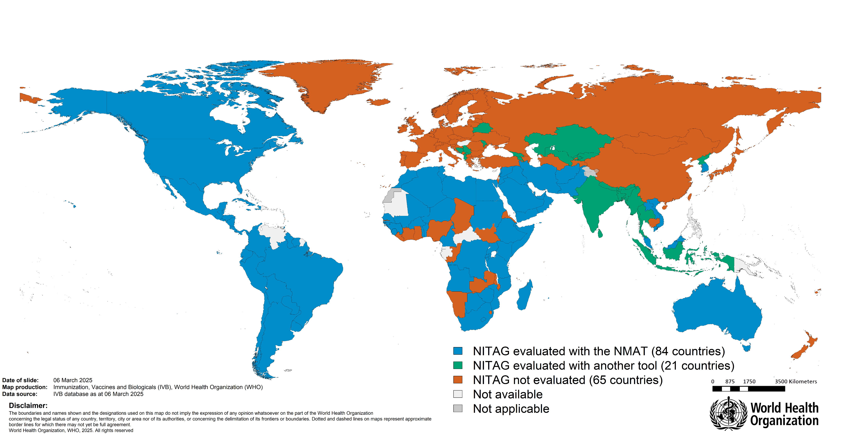
NITAGs and their partners are gradually conducting evaluations
84 countries conducted an evaluation using the NITAG Maturity Assessment Tool
21 NITAGs were evaluated with another tool
NITAGs from EURO & WPRO need to continue evaluation efforts
Evaluation should be regularly conducted, ideally with the NMAT, and improvement plans should be monitored.

Slide 16

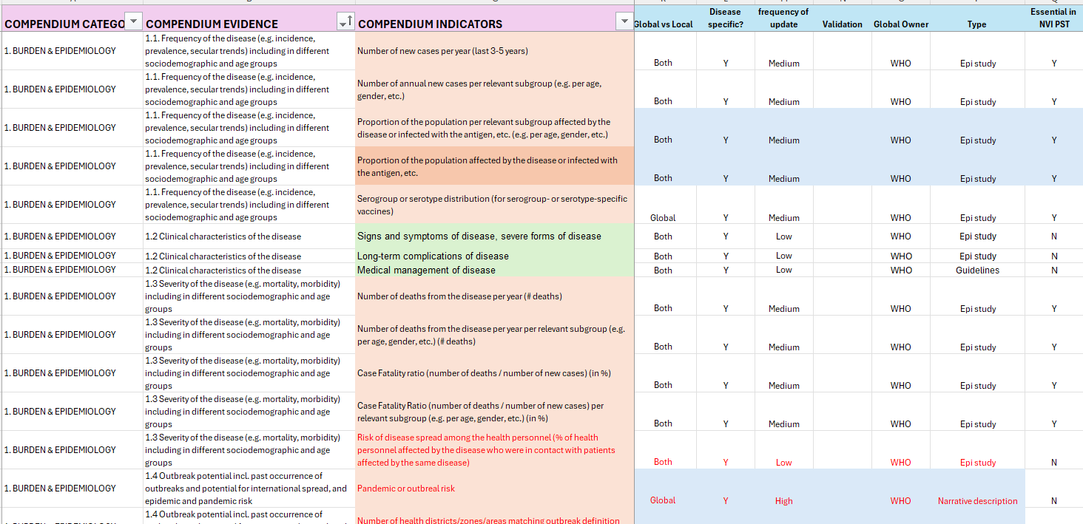
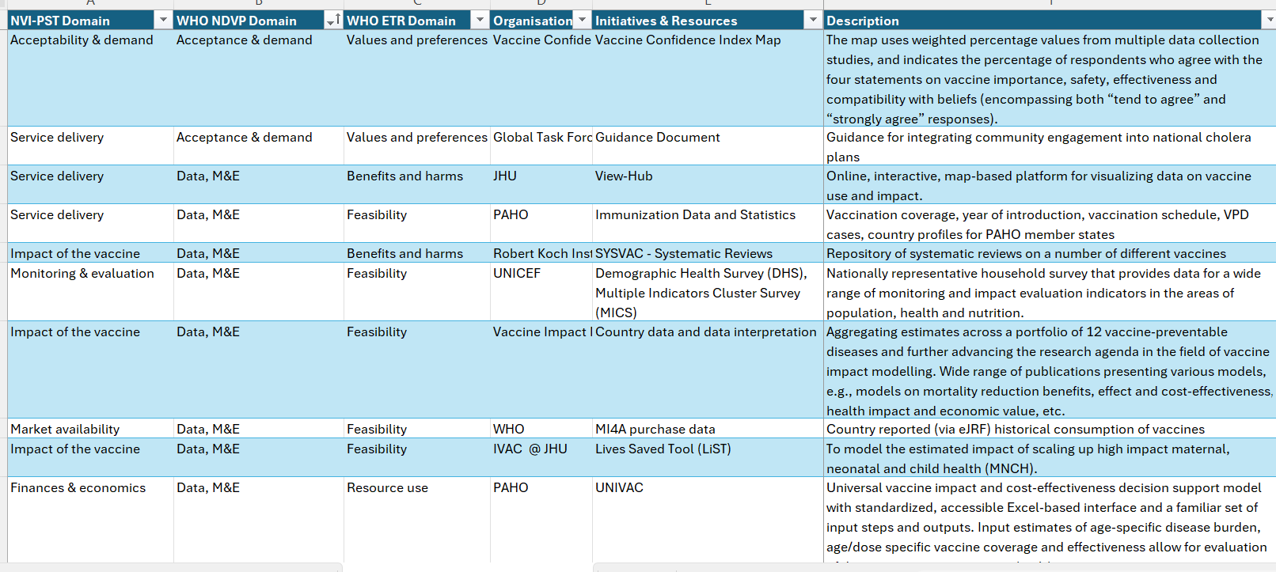

The vaccine evidence compendium
We used a review of most frequent indicators
Vaccine evidence compendium
We did a review of known data sources
Long list of vaccine criteria and topics/indicators that could be considered by NITAGs
Long list of vaccine evidence data sources
34 criteria covering 113 indicators, split into 10 categories
Sources:
NVI-PST
Evidence to recommendation guidance
Regional and country consultations
95 vaccine evidence data sources
Sources:
Landscape analysis
Global, regional and country consultations

Slide 17

To be launched in July
Vaccine Compendium - Value proposition
A one-stop shop that grants access to global immunization evidence as an entry point for country decision-making
Where can I find it?
NITAG resource centre from July2025
Launch in July as proof of concept
Which vaccines?
4 vaccines in phase 1 in 2025
Hexa,
HPV,
RSV,
PCV
1
2
3
4
Key Principles
Neutrality
Not preempting countries decision nor influencing
Integration
Facilitate use by integrating information in a platform in use by NITAGs: GNN website
Standardisation
Standardising vaccine evidence to enhance comparability across vaccines
Co-creation
Involvement of countries in the design and format

Slide 18
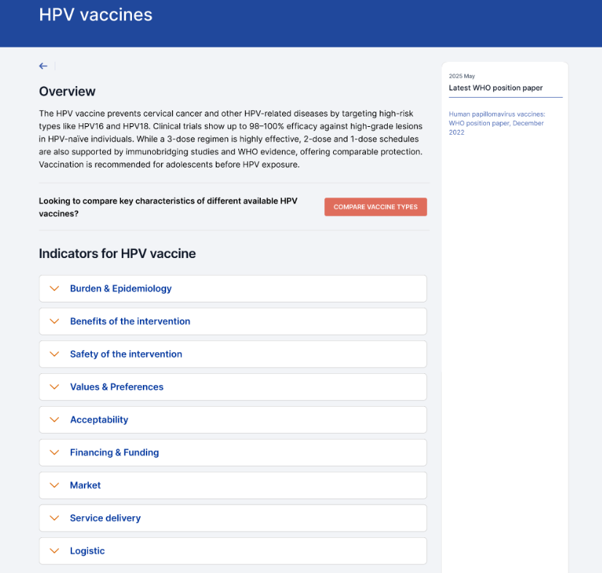
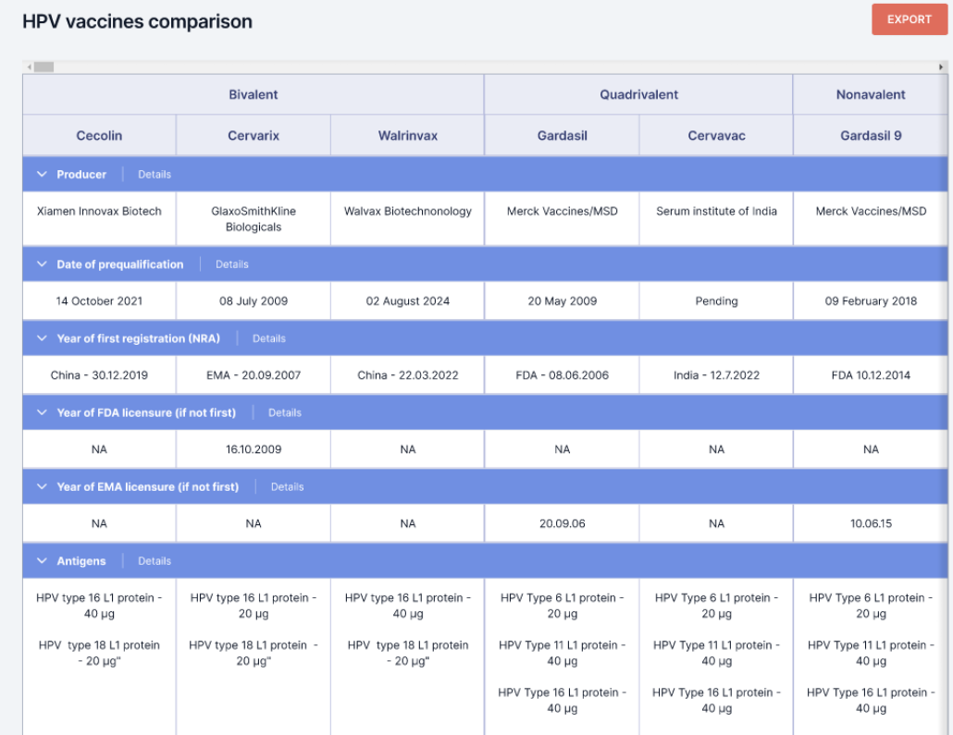

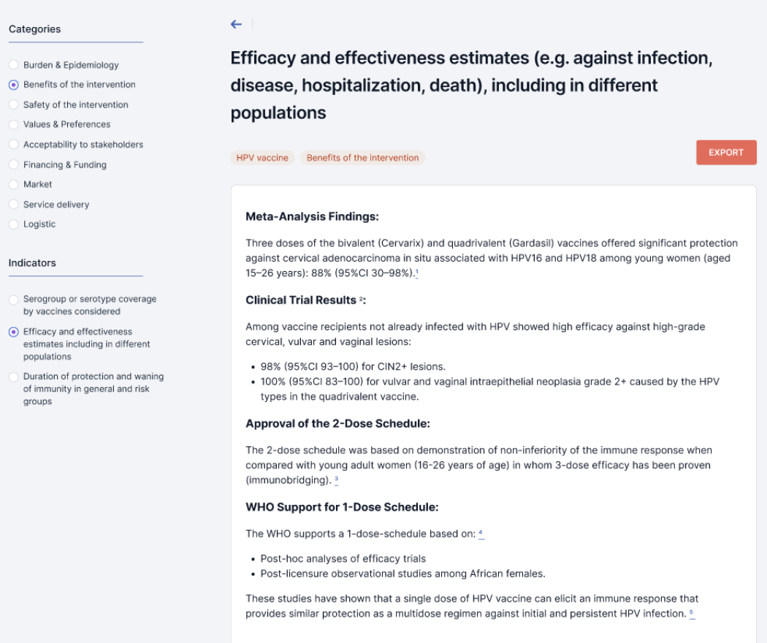
Prototype visuals

Slide 19
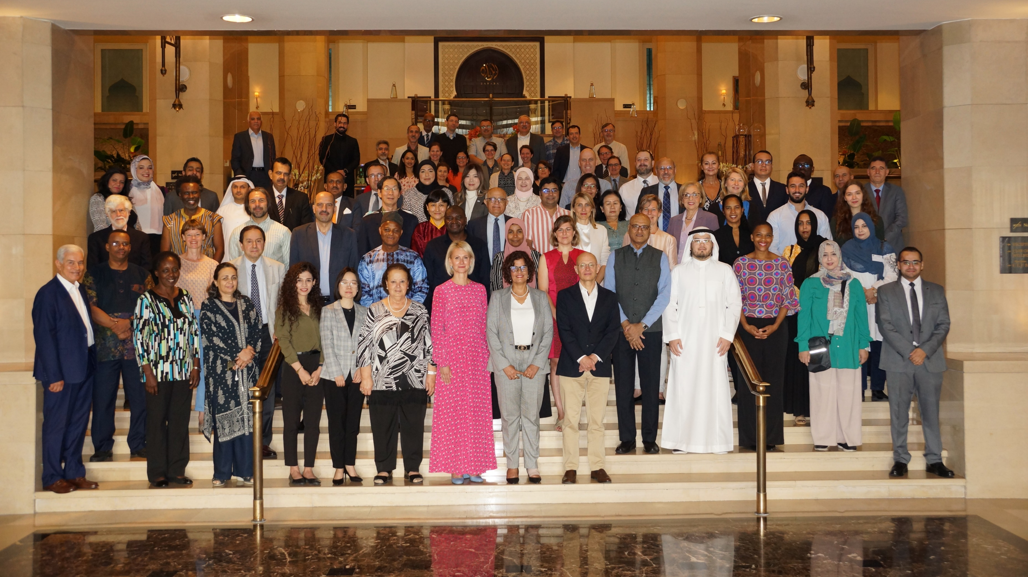
GNN Meeting

Slide 20
Tentative dates : October 28-30 2025
Day 1:
Global trends (JRF and NMAT results)
Partners tools to strengthen NITAGs
Regional updates (tuk tuk)
Twinning
Presentation of a selection of new GNN members
Experiences of NITAGs on Prioritization of NVI
Day 2:
Link between NITAGs and HTA (case studies)
Schedule switch options
RSV
Off-label recommendations (including case studies)
NITAG Secretariat & engagement with industry
Report from SAGE
Day 3:
Infectious diseases modelling
Role of NITAGs in PHEIC: Mpox
Operating in emergency situations
Forward looking session
  AI
  Combination of vaccines
  Future of vaccination (horizon of new vaccines – pipeline, expansion of program and service delivery)
Additionnal topics:
Pannel discussion: lifecourse immunization - integrating geriatrics and adult perspectives into NITAG work

Slide 21
Other projects involving GNN

Slide 22


Introduction to VPOP
Countries face expanding vaccine portfolios and constrained environments, risking hard-won health gains
Gavi 6.0 SG 1a aims to strengthen countries capacities to make prioritisation and optimisation decisions
The role of VPOP: prioritisation & optimisation as solutions
Vaccine prioritisation:
Deciding which vaccine programmes* to invest in, and in what order, when limited by capacity and resources
(e.g. malaria vs HPV introductions).
Vaccine Optimisation:
Assessing new products, presentations, schedules, or uses and switch to more opportune ones
(e.g. PCV product switch or schedule change).
The impact of successful VPOP
At country-level
At global-level​
Planned future vaccine introductions with programmatic, financial, and synergy considerations
Country preferences informed global strategies, enabled shared learning, and helped anticipate and mitigate supply risks
Guided by an evidence-informed decision-making process, aligned with national priorities.
The Lusaka Agenda is implemented to align global institutions around one plan, one budget, one report
* e.g. NVIs, increasing coverage of existing programmes or campaigns.
Notes:
These processes are interconnected: optimising a vaccine portfolio can free up resources for new introductions, and prioritisation decisions must consider optimisation opportunities. Together, prioritisation and optimisation enhance vaccine introduction and service reach, ultimately saving more lives. Note the strategic indicators that are being developed under SG 1a, and further operational indicators to measure VPOP.

Slide 23
An Alliance approach – Progress to Date
The working group, formed in late 2023 by Gavi, WHO, and UNICEF, fosters collaboration by linking program planning and market shaping to ensure demand for new vaccines while addressing access barriers.
Progress to Date: Key Achievements & Milestones
5 country pilots completed
9 country requests for support
SOPs developed for technical assistance requests and development of market risk assessment
2 regional trainings/webinars
1 White Paper
1 SAGE recommendation
2 research projects to inform VPOP model development
Pilots & Research
Pilots with NVI PST in Ethiopia, DRC, Uganda, Guinea Bissau, and Niger
CHOICES 1.0 designed to help countries make optimisation decisions
Research by CHAI and IVAC with countries to evaluate their experiences in prioritisation and optimisation
Capacity Building & Training
NITAG workshops & Training of Trainers focused on building local and regional capacity
Sensitization to NITAGs, EPI Managers and other country and regional stakeholders through GNN and other regional meetings and webinars (WHO AFRO, WHO EMRO)
Advocacy & Stakeholder Engagement
White paper written to sensitize global stakeholders
Presentation at SAGE March 2025
Integrate into 6.0 operationalization: Health Systems Strategy, Foundations Fund, SG1a indicator
Notes:
Prioritisation and optimisation are separate concepts, but complementary
Internal Working Group at Gavi, including coordination with MICs team

Slide 24
Evidence-based recommendation on the prioritization and sequencing of new vaccines recommendations
Phase 1: Framework Adaptation
Phase 2: Assessment, Prioritization and Sequencing
Phase 3: Recommendations
1 month
3 months
2 months
Workshop
1
Workshop
2
Presentation to Ministry of Health and integration into national program
Process design and stakeholder engagement
Data collection
Validation and documentation
Objectives:
Develop workplan and timeline
Engage key stakeholders
Define list of vaccines and the timeframe to be considered
Select criteria for decision-making
Plan for data collection
  Objectives:
  Collect and assess available data
  Translate evidence into prioritizations using vaccine ranking
Explore programmatic constraints
Develop sequencing recommendations
Objectives:
  Document actionable recommendations
  Ensure consensus and consistency
  Develop final recommendation materials
Output:
Prioritized and weighted criteria for decision-making
Preselection of vaccines to consider for introduction
Workplan to collect and prepare data for assessment
Output:
Prioritized vaccine lists for introduction (high, medium and low priority)
Scenarii for sequencing based on known constraints
Output:
Finalized recommendation shared with EPI and Ministry of Health

Slide 25



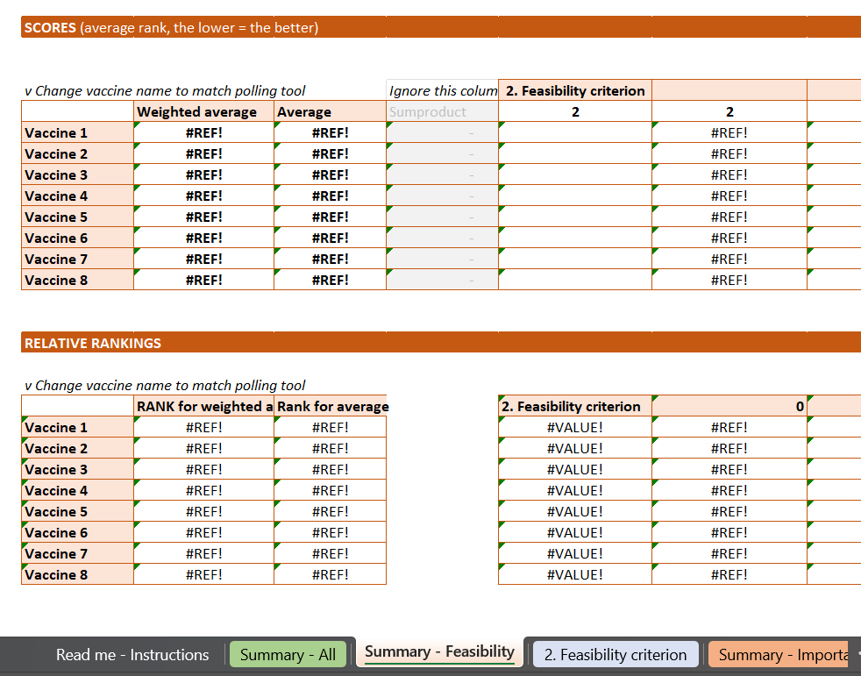
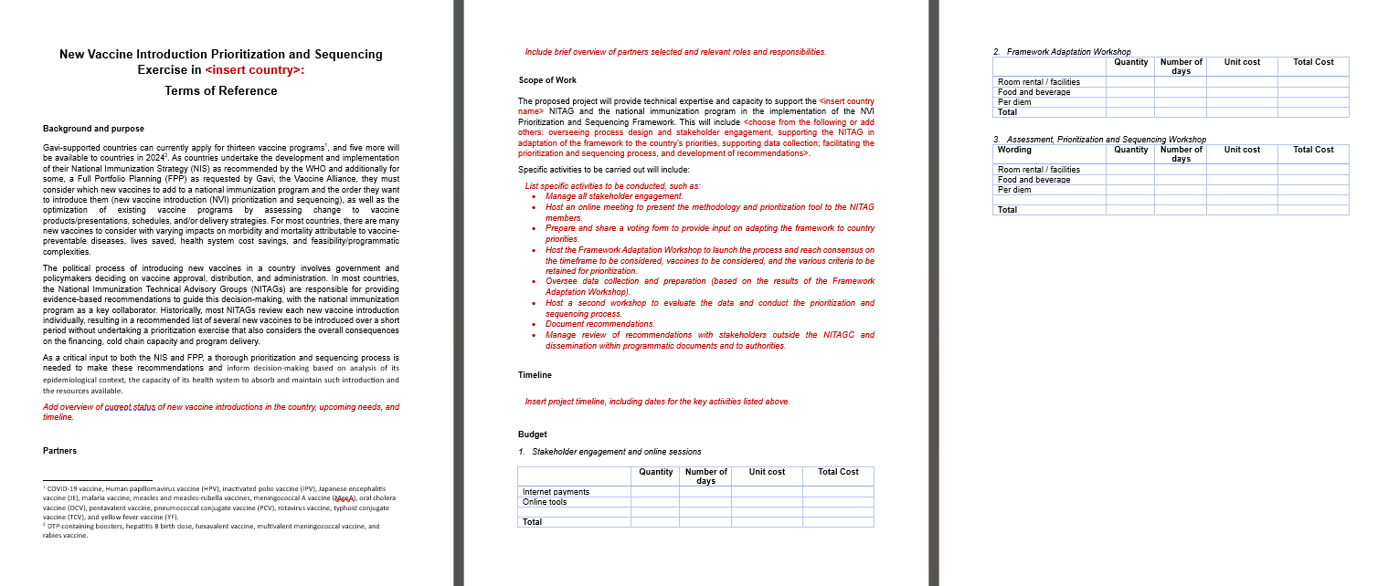
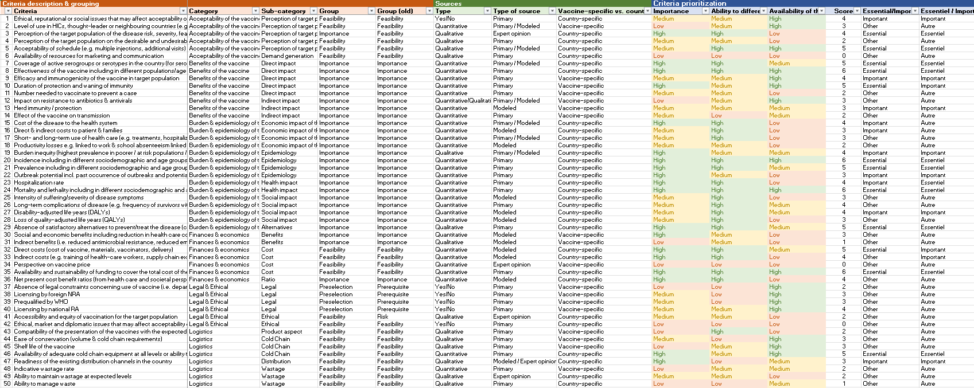
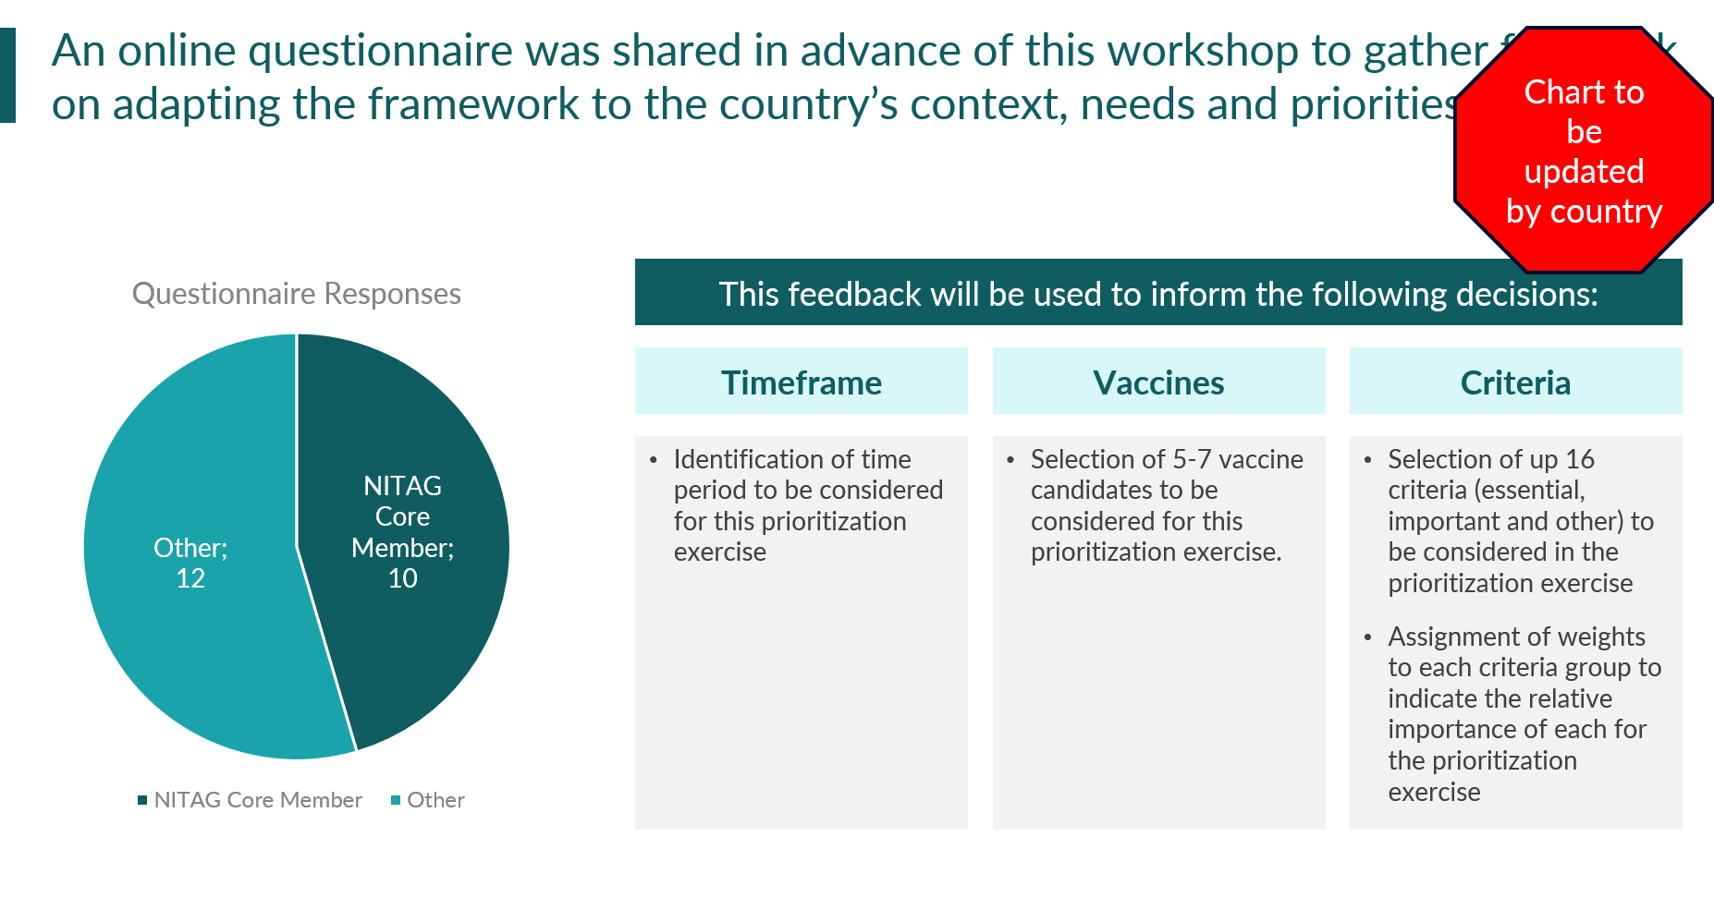
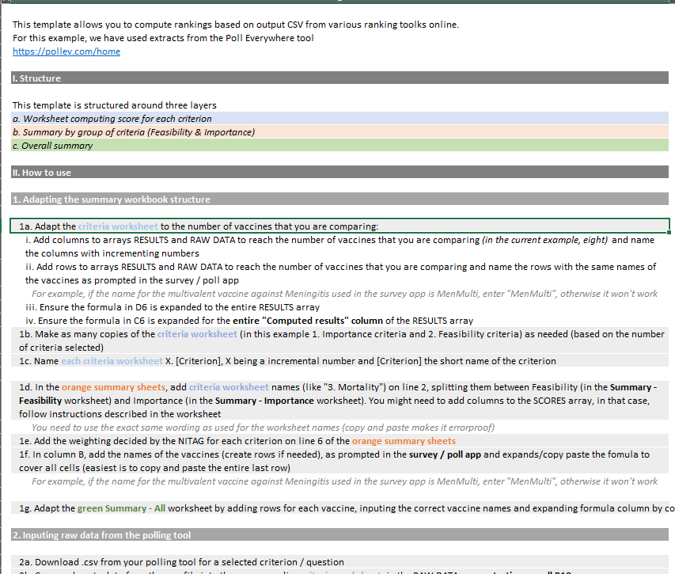
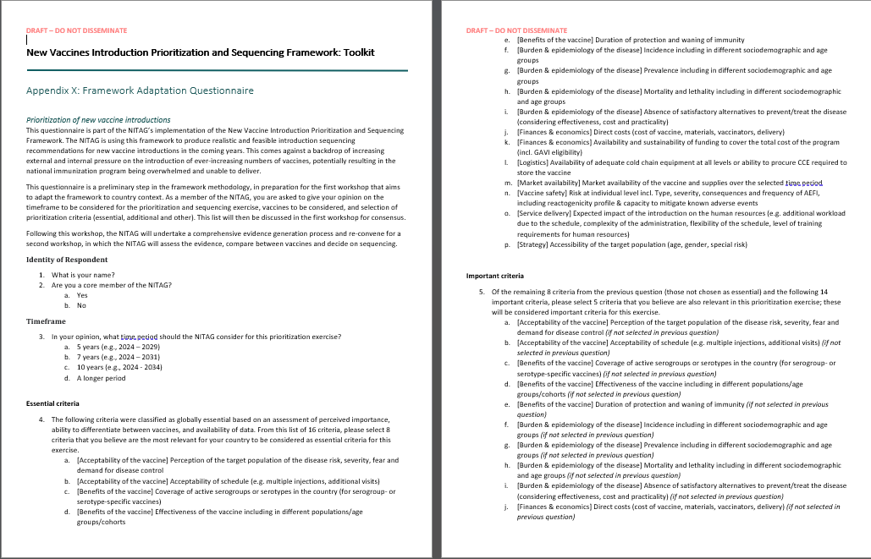
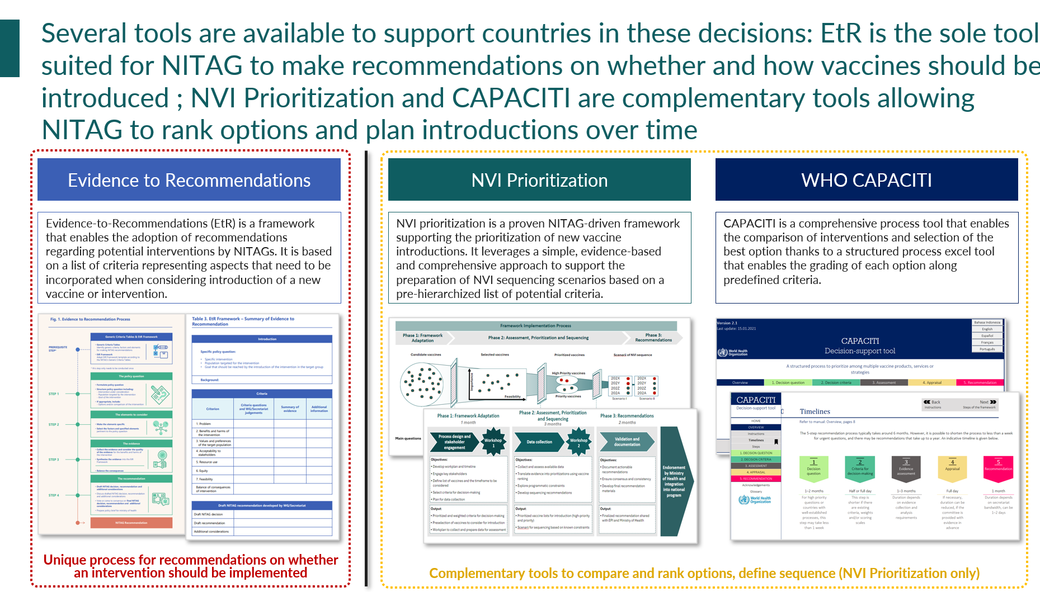
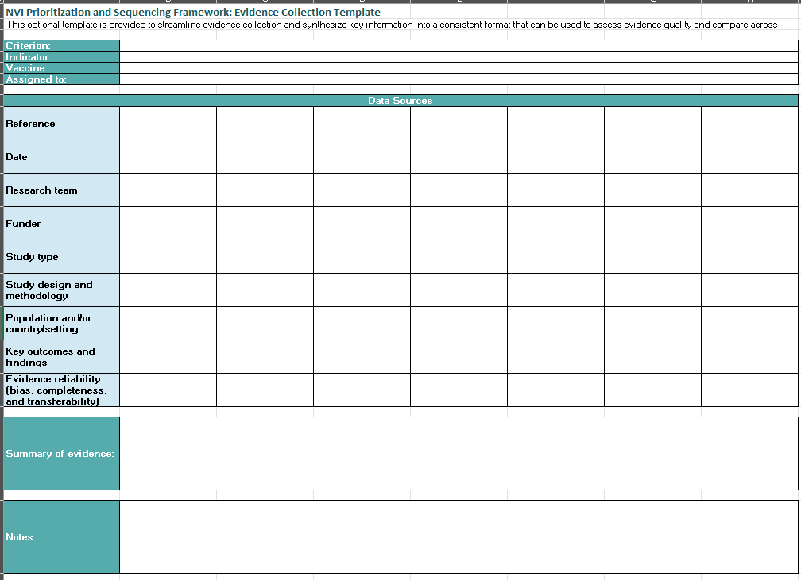
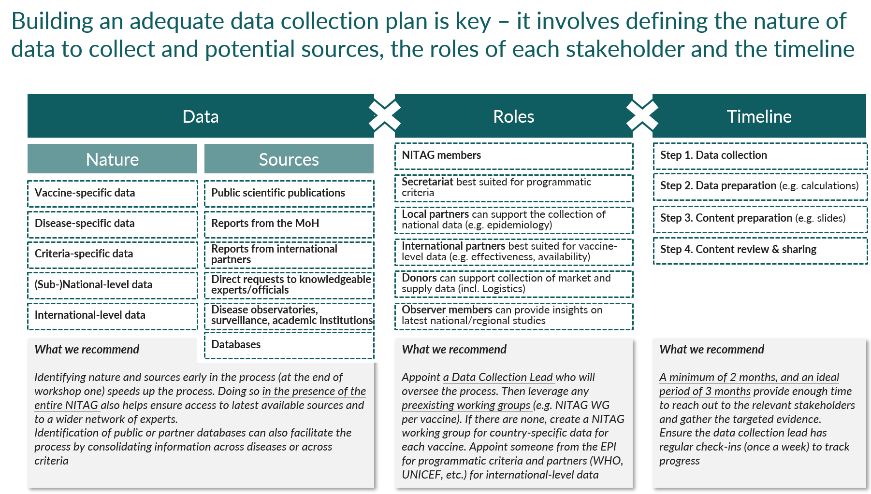
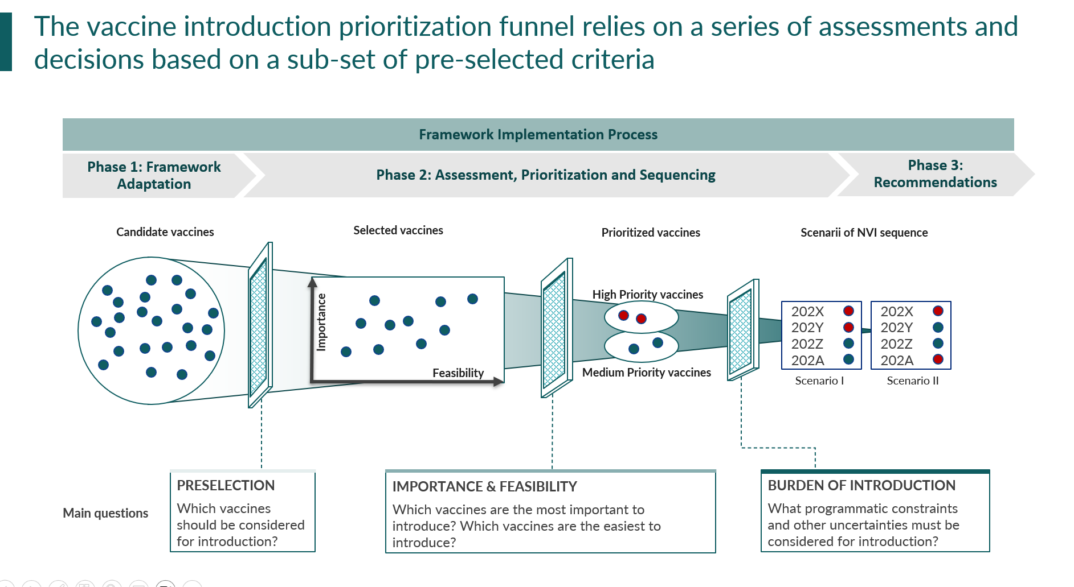
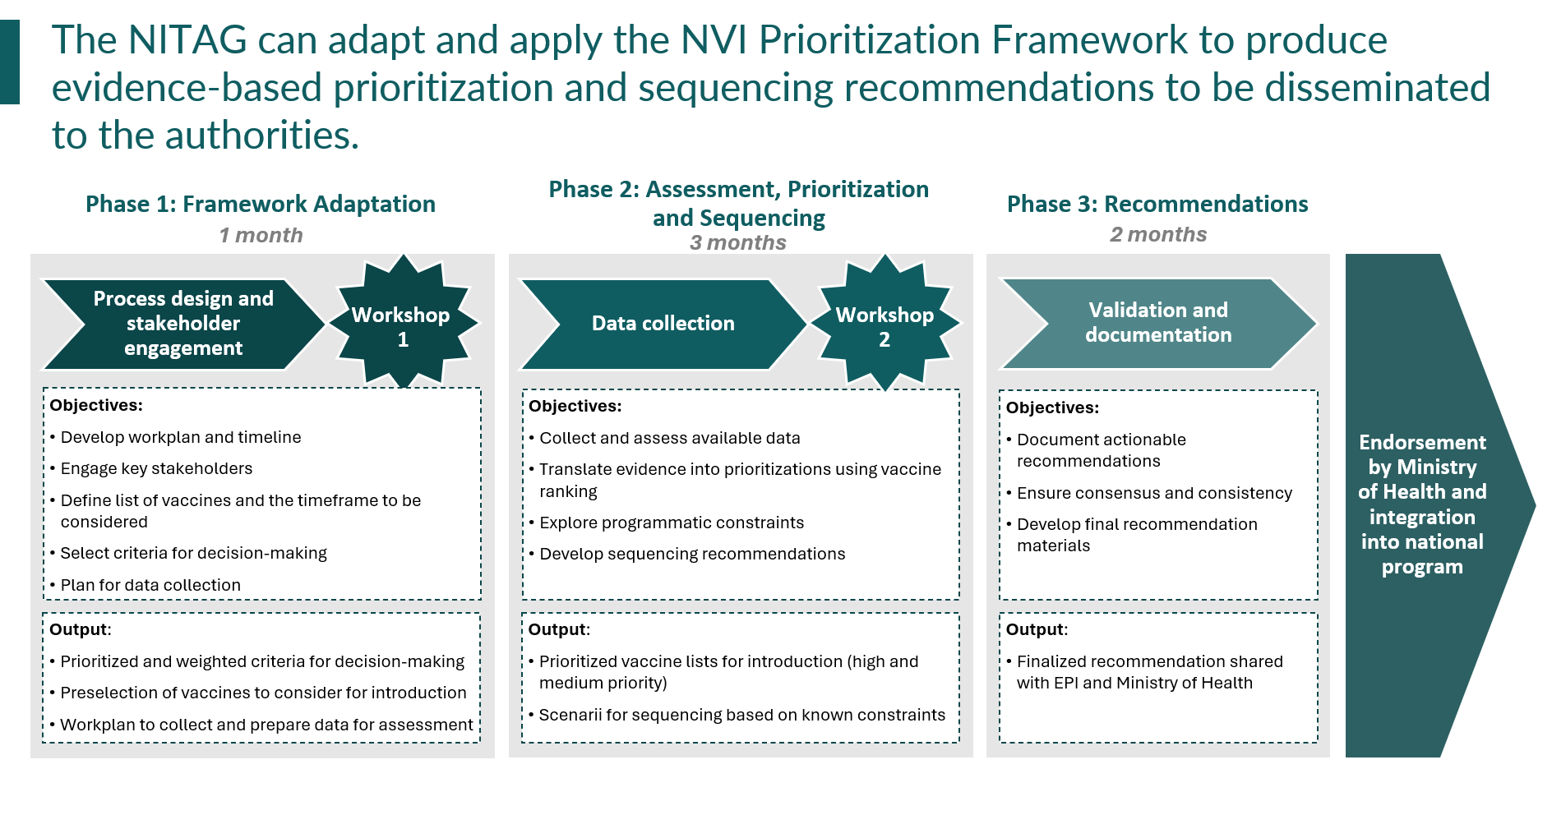
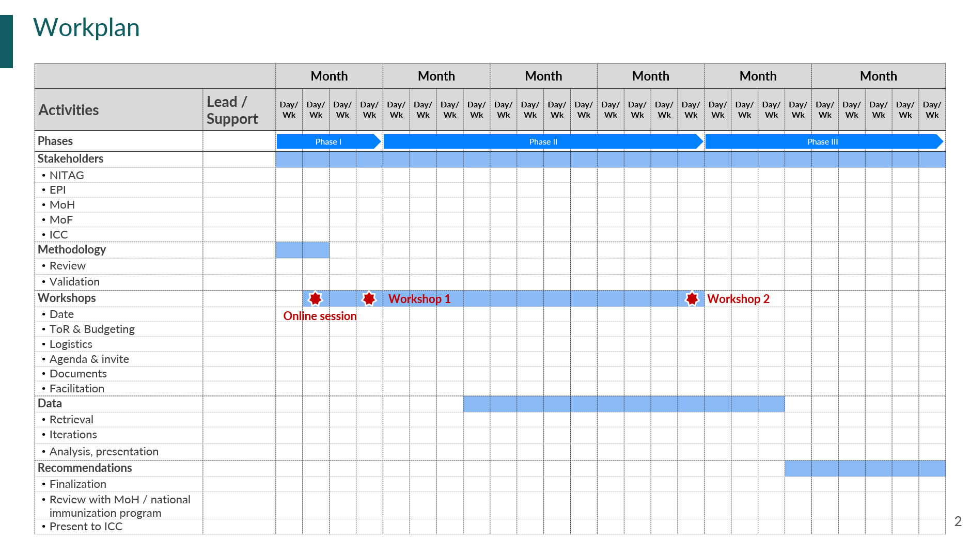
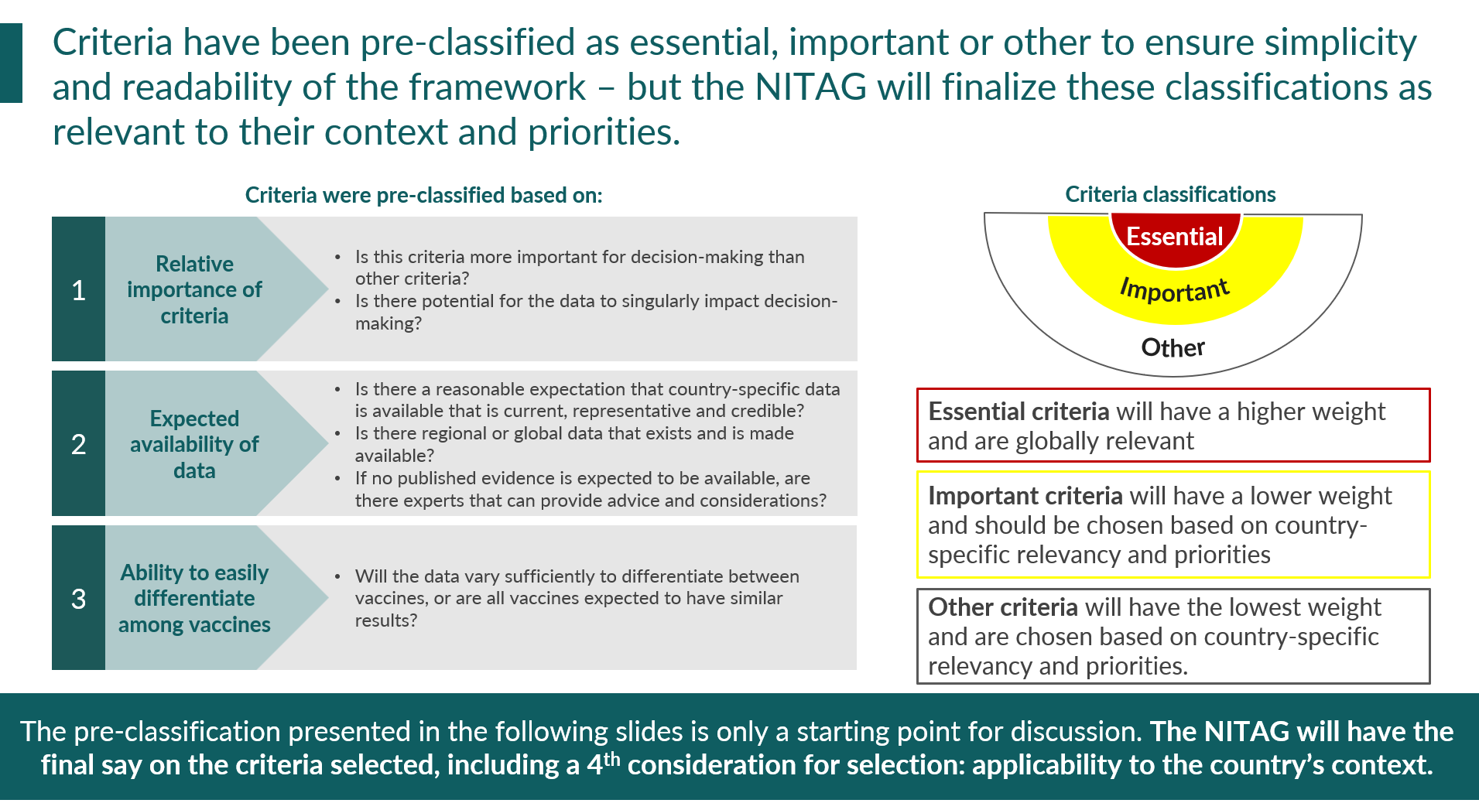
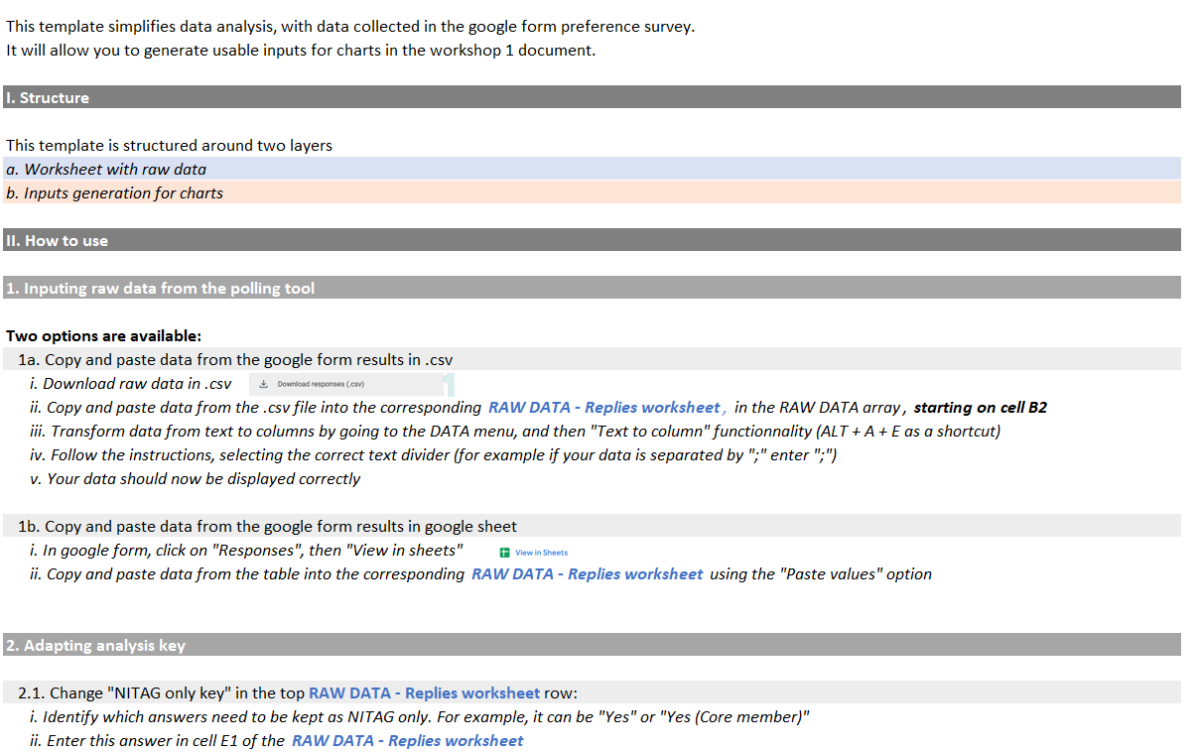
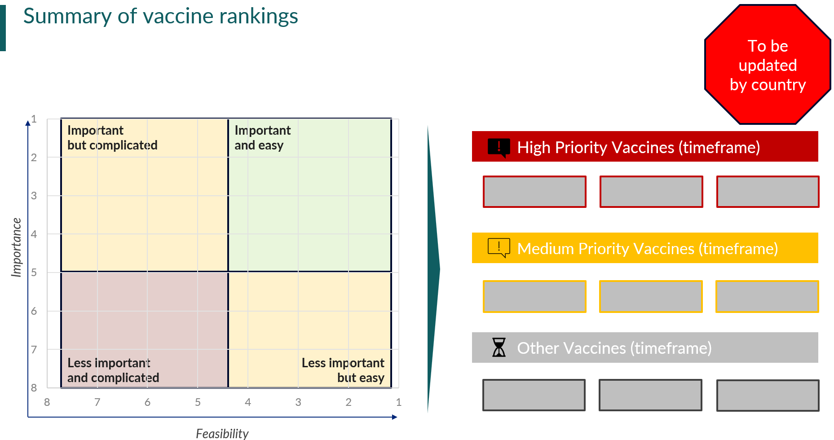
Introduction to the NVI-PST: zoom on tools
https://www.nitag-resource.org/training/building-and-strengthening-technical-competencies/prioritizing-new-vaccines-introduction
Phase 0 – Process design and Preparation
Phase 1 – Selection of vaccines, criteria and timeframe
Phase 2 – NVI prioritization & sequencing
0.1
Partner Terms of Reference
A model of ToRs to contract with a partner supporting the NVI prioritization process
1.1
Prioritized list of
criteria and indicators
List of all 71 criteria, ranked, prioritized and a list of 110+ indicators for essential and significant criteria
1.4
Workshop 1 slidedeck
An enriched 45-page blank flow of the first workshop aiming at adapting the framework to the country context
2.1
Ranking Calculations
model
A pedagogical model walking secretariats through the steps required to translate ranking votes from WS2 into vaccine scores
0.2
Stakeholder engagement slidedeck
A 17-slide deck presenting the approach, methodology and timeline
1.2
Criteria & Vaccines
Questionnaire
A model of questionnaire to collect NITAG members’ preferences on timeline, vaccines, and criteria ahead of workshop 1
1.5
Data collection
planning matrix
A tool allowing NITAG and secretariat to plan data collection and collect evidence in a single template
2.2
Guide to collecting evidence
& building content
A guide to collecting evidence and synthesizing it to facilitate workshop 2 discussions, enriched with examples of slides
0.3
Workplan template
A 3-slide deck listing all activities and responsibilities in a Gant chart
1.3
Online session slidedeck
A proposed 36-page slidedeck to introduce the project and the online forms to all NITAG members, including a comprehensive review of criteria
1.6
Google form result analysis
A pedagogical excel model facilitating the translation of Google form responses on criteria/vaccine preferences into inputs for Workshop 1 charts
2.3
Workshop 2 slidedeck
An enriched 59-slide blank flow for the second workshop aiming at prioritizing vaccines and defining sequencing scenarios

Slide 26
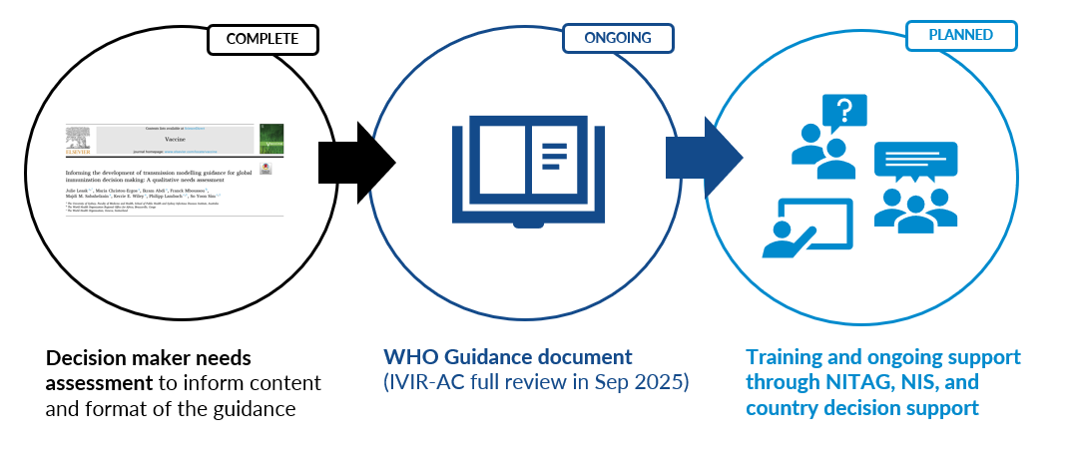
WHO & IVIR-AC guidance to translate modeling to support evidence-informed decision making for immunization
https://www.sciencedirect.com/science/article/pii/S0264410X25000970/

Slide 27
WHO guidance to translate modeling to support evidence-informed decision making for immunization
Step 2: development of guidance document
Chapters informed by the needs assessment:
How can I work together with modelers?
How can I translate modeled evidence into decisions?
Establish effective communication and collaboration with modelers
How should modeled
results be interpreted?
Apply modeled evidence to make informed decisions
Develop skills to effectively interpret model outputs
How are models made?
Explore the steps involved in creating effective models
The NITAG and technical partners' review will take place over the next two weeks.
A heartfelt thank you to the 22 NITAG members who generously volunteered to review the document!
What are models and how
can they help us?
Learn about different models, their use and users

