Slide 1

New Vaccines Introduction Prioritization and Sequencing Tool (NVI-PST)
Introduction to the framework and methodology

Slide 2
Context: Countries are pushed to introduce more and more vaccines, potentially resulting in the entire EPI being overwhelmed and unable to deliver
Countries & NITAGs are facing increased pressure to introduce new vaccines and NVI recommendations are often siloed…
…resulting in the adoption of ambitious new vaccine introduction roadmaps built without an adequate process…
… which bears risks on the immunization programs
Political agenda
Example
Absence of financial sustainability
Vaccine | Disease | Year
RTS, S/AS 01 | Malaria | 2024
RR | Measles & Rubella | 2024
Rotarix | Rotavirus | 2024/2025
R21-Matrix-M | Malaria | 2024/2025
Gardasil | HPV | 2026
Shanchol/Euvichol | Cholera | 2026
HepB | Hepatitis B | 2027
TCV | Typhoid | 2028
Donors’ agenda
Inability for the program to deliver
Recommendations from experts
Competition for resources between vaccine programs
Public and media
pressure
Competition for resources with other health programmes
Regional & neighboring countries expectations
Lower acceptability & demand

Slide 3
To avoid these pitfalls, countries need to proactively prioritize between available and future vaccines and develop a clear new vaccine introductions roadmap
What countries should do
Why
Provide an evidence-based vaccine prioritization to inform and balance the political agenda
Inform the national immunization strategy (NIS) and roadmap while integrating the programmatic considerations to ensure feasibility
Kick-start financial discussions to anticipate funding constraints and dependances
Identify data gaps and mandate new studies to ensure future decisions rely on up-to-date evidence
Send market signals to donors and manufacturers to ensure availability at the time of introduction
Prioritize between available and future vaccines
Propose a new vaccine introduction sequence

Slide 4
The prioritization of vaccines is part of a broader process carried out by the NITAG and should occur regularly to ensure national strategy is updated
NIS¹/FPP²
Introduction
Prioritization
Introduction
Optimization
Recommended frequency | Every 3-5 years ; biennial refresh or when needs arise | 2 years before prioritized introduction or upon request from the MoH | Upon request from the MoH
Objectives | Prioritize between available vaccines | Define whether vaccine should be introduced Determine strategy and recommended product | Change product / product presentation Adapt immunization strategy and schedule (e.g. following SAGE recommendation update)
Output(s) | - Prioritized list of vaccines to be introduced over time - Main and alternative scenarios for introductions sequencing | - Recommendation on introduction, schedule, strategy and product to be used | - Recommendation on strategy, schedule and product to be used
Evidence type and level | Broad evidence collection (multiple criteria, multiple vaccine) | Focused evidence collection Pre-set list of criteria | Focused evidence collection Limited list of criteria
Available tools & processes | NVI-PST (New Vaccine Introduction Prioritization & Sequencing Tool) CAPACITI | EtR (Evidence-to-recommendation) framework | EtR (Evidence-to-recommendation) framework CAPACITI GAVI Portfolio optimization process
Evidence from prioritization fed into EtR
1. National Immunization Stratgy; 2. Full Portfolio Process (GAVI process)

Slide 5
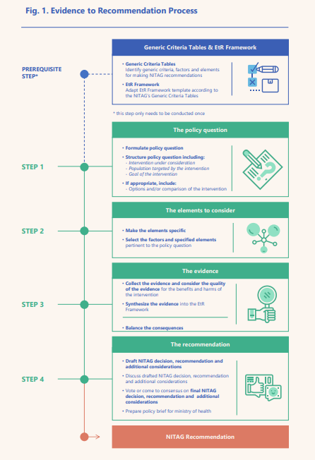
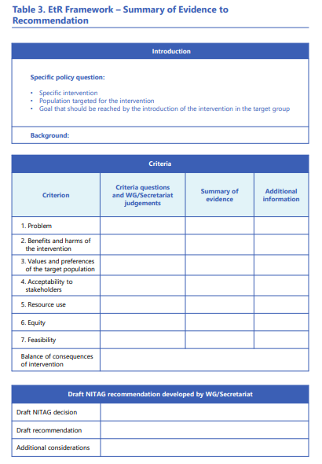
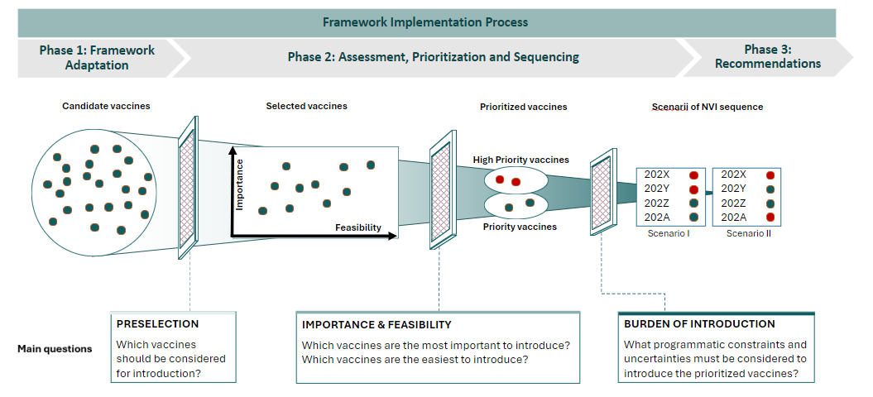
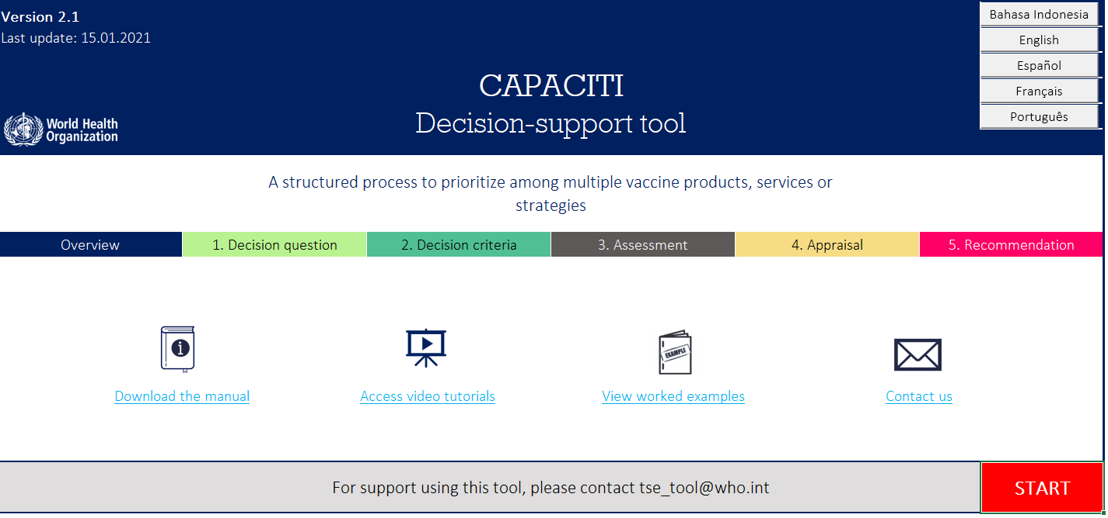
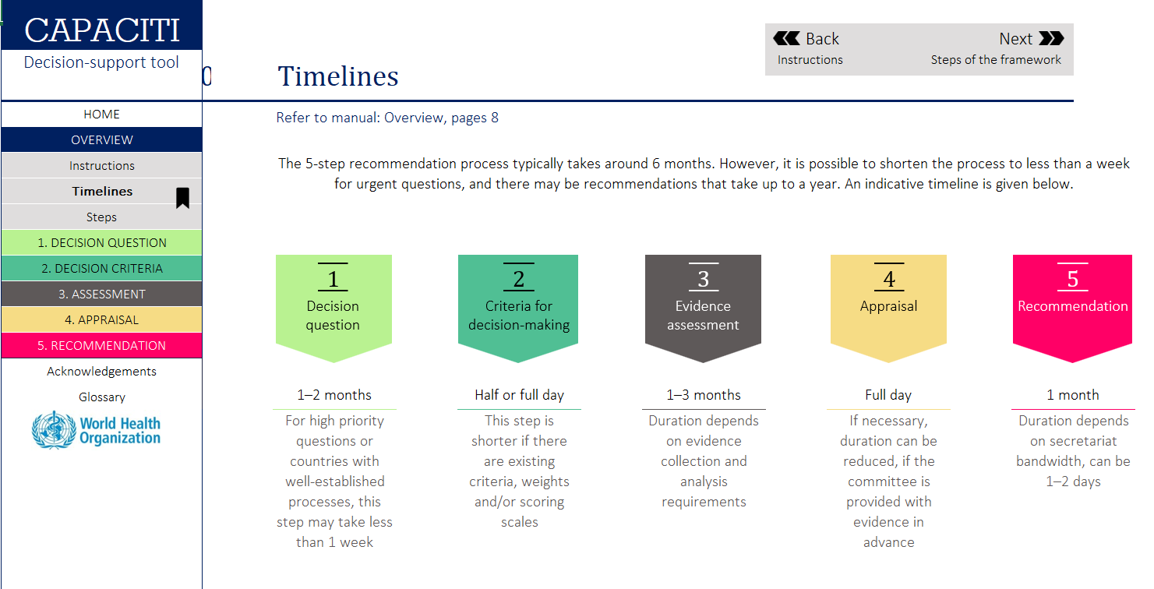
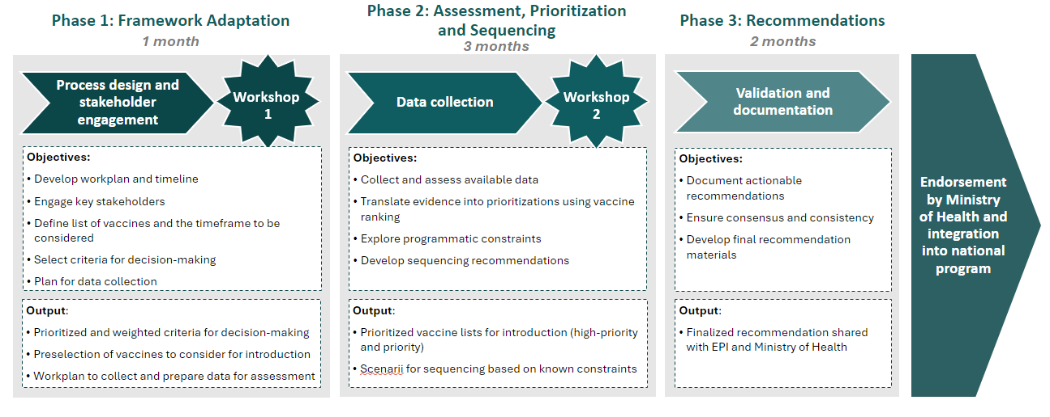
Several tools are available to support countries in these decisions: EtR is the sole tool suited for NITAG to make recommendations on whether and how vaccines should be introduced ; NVI Prioritization and CAPACITI are complementary tools allowing NITAG to rank options and plan introductions over time
Unique process for recommendations on whether an intervention should be implemented
Complementary tools to compare and rank options, define sequence
Evidence to Recommendations
NVI-PST
WHO CAPACITI
Evidence-to-Recommendations (EtR) is a framework that enables the adoption of recommendations regarding potential interventions by NITAGs. It is based on a list of criteria representing aspects that need to be incorporated when considering introduction of a new vaccine or intervention.
NVI-PST is a proven NITAG-driven framework supporting the prioritization of new vaccine introductions. It leverages a simple, evidence-based and comprehensive approach to support the preparation of NVI sequencing scenarios based on a pre-hierarchized list of potential criteria.
CAPACITI is a comprehensive process tool that enables the comparison of interventions and selection of the best option thanks to a structured process excel tool that enables the grading of each option along predefined criteria.

Slide 6
NVI-PST and EtR are complementary tools used during different phases of the introduction process
 | EtR | NVI-PST
When to use it? | Upon request from MoH Ahead of vaccine introduction / strategy or product change | Every 3 to 5 years, ahead of National Immunisation Strategy or to refresh NIS
Decision question
Type of decision questions | Recommendation for introduction, strategy, product choice | Prioritization between introductions, sequencing of options
Examples | Should one dose of an HPV vaccine be given to girls between 9-14 years of age to reduce HPV infections and associated cancers? Should adolescents aged 12-15 years receive COVID-19 vaccination with a vaccine licensed for this age group? | Which vaccines should be prioritized for introduction in the next 5 years? When should priority vaccines be introduced?
Criteria
Number of criteria | Extensive (all 7 criteria groups should be considered) | Limited (selection of 10-15 out of 71 proposed)
Process for criteria selection | Definition of a Generic Criteria Table Specification of criteria based on the disease/question | NITAG members vote on pre-hierarchized (3 levels) criteria NITAG members select a limited number of criteria based on vote and discussion
Criteria weighting | No (implicit) | Yes (explicit)
Evidence
Breadth of evidence | Focused: limited number of vaccines, multiple criteria | Large : multiple vaccines, multiple criteria
Depth of evidence | Deep: comprehensive literature and evidence review | Superficial
Evidence grading | Systematic: grading must be discussed | Optional : grading can be discussed during workshops
Recommendation | Evidence is reviewed for each criteria A judgement is made on each of the criterion questions A judgement is made of the balance of all advantageous and disadvantageous consequences An overall recommendation is drafted | Evidence for each criteria is presented Vaccines are ranked (vote) for each criteria Overall rankings are computed using weight Overall rankings are discussed to establish priority lists Scenarios are drafted using priority lists and burden of introduction
Process
Output | A final NITAG decision and recommendation on the respective policy question | Priority lists of vaccines, sequencing scenarios of NVI (per year)

Slide 7


The NVI-PST Framework was designed specifically for prioritization and sequencing of several vaccines for a defined future period of time
 | NVI-PST | CAPACITI
Inception | BMGF-funded tool, pilot-driven approach to answer short-term needs in pilot countries | BMGF-funded tool developed iteratively with 12 countries’ inputs
Date of publication | 2024 | 2020
Examples of implementing countries | DRC, Niger, Ethiopia, Uganda | Indonesia, Ethiopia
End-users | Tailored for NITAGs and EPI processes | No specified end-user
Resource intensity | Medium | High
Scope | New Vaccine Introduction Prioritization and Sequencing | Any comparison between options
Type of decision question | Which new vaccine(s) should be prioritized and when should they be introduced? | Which options should be prioritized and in which order?
Comparison & sequencing between options
Timeline planning of options
Mode of decision & recommendation | Supporting decision by highlighting “important” and “feasible” interventions based on rankings and constraints | Supporting decision by highlighting “best option” based on grading
Statement-based
Visualization-based
Grade-based decision support | Preference-based grading | Evidence-based grading
Type of MCDA
Quantitative
Qualitative | For criteria ranking only
Available tools | PDF document | Excel-based tool
Supporting tools | List of criteria, preference survey template, workshop presentation template, workplan, excel models for ranking | Guidance manual and self-study training modules
Other items | Voting system, criteria hierarchization | Step-by-step guidelines, uncertainty modelling

Slide 8
The NVI-PST Framework has been built to be evidence-based, simple yet comprehensive, iterative and to allow for tweaks based on countries own priorities
Evidence-based
Decisions on sequencing are often influenced by national and international agenda and rely on opinions rather than facts
This framework relies on measurable evidence to ensure consistency of decision-making through time
Simple
Existing tools and processes either refer to overabundant criteria or to no criteria at all
This framework refers to a limited number of criteria which will be selected by the NITAG
The selected criteria should allow the NITAG to answer simple but crucial questions.
Comprehensive
Decisions regarding vaccine introductions are often taken independently and with different processes based on the nature of the decision
This framework is designed to be comprehensive in terms of vaccines and type of country
Adaptative
To allow for better appropriation by countries, the prioritization framework will be discussed and adapted by the NITAG, which will be done mainly through the addition or removal of secondary criteria and the selection of candidate vaccines
Iterative
Current decision-making on NVI sequencing is done on a reactive basis, often to answer requests from technical partners or submit grant applications to donors
This exercise can be conducted by the NITAGs on a recurring basis to ensure adaptation to evolving research and markets
Sources: discussions with WHO/GAVI, Capaciti manual

Slide 9
The prioritization and sequencing framework relies on a series of assessments and decisions based on a sub-set of pre-selected criteria
Framework Implementation Process
Phase 1: Framework Adaptation
Phase 2: Assessment, Prioritization and Sequencing
Phase 3: Recommendations
Candidate vaccines
Selected vaccines
Prioritized vaccines
Scenarii of NVI sequence
High Priority vaccines
202X
202Y
202Z
202A
202X
202Y
202Z
202A
Importance
Feasibility
Medium Priority vaccines
Scenario I
Scenario II
Low Priority vaccines
Main questions
PRESELECTION
Which vaccines should be considered for introduction?
IMPORTANCE & FEASIBILITY
Which vaccines are the most important to introduce? Which vaccines are the easiest to introduce?
BURDEN OF INTRODUCTION
What programmatic constraints and other uncertainties must be considered for introduction?

Slide 10
The NITAG can adapt and apply the NVI Prioritization Framework to produce evidence-based prioritization and sequencing recommendations to be disseminated to the authorities.
Phase 1: Framework Adaptation
Phase 2: Assessment, Prioritization and Sequencing
Phase 3: Recommendations
1 month
3 months
2 months
Workshop
1
Workshop
2
Endorsement by Ministry of Health and integration into national program
Process design and stakeholder engagement
Data collection
Validation and documentation
Objectives:
Develop workplan and timeline
Engage key stakeholders
Define list of vaccines and the timeframe to be considered
Select criteria for decision-making
Plan for data collection
  Objectives:
  Collect and assess available data
  Translate evidence into prioritizations using vaccine ranking
Explore programmatic constraints
Develop sequencing recommendations
Objectives:
  Document actionable recommendations
  Ensure consensus and consistency
  Develop final recommendation materials
Output:
Prioritized and weighted criteria for decision-making
Preselection of vaccines to consider for introduction
Workplan to collect and prepare data for assessment
Output:
Prioritized vaccine lists for introduction (high, medium and low priority)
Scenarii for sequencing based on known constraints
Output:
Finalized recommendation shared with EPI and Ministry of Health

Slide 11
A straightforward 9-step process for prioritization
Workshop
1
1 | Preselect 4-6 vaccines to be included in the exercise (voting through an online questionnaire can help)
2 | Review and select 10 to 15 criteria out of 71 proposed and assign weight to each criteria (voting through an online questionnaire can help)
3 | Define measurable indicators for each criteria
4 | Collect indicator data and prepare content to allow for easy comparison of vaccines for each criteria
5 | Rank vaccines on importance criteria (e.g. burden of disease, benefits of the vaccine) criteria
6 | Rank vaccines on feasibility criteria (e.g. programmatic, logistics)
7 | Based on importance and feasibility score, define priority level (high/medium/low) for each vaccine
8 | Define programmatic and vaccine-specific constraints
9 | Draft scenarios based on priority level and constraints
Workshop
1
Data collection
Data collection
Workshop
2
Workshop
2
Workshop
2
Workshop
2
9
Workshop
2

Slide 12
This process is embedded in the larger plan resulting in the drafting and endorsement of recommendations
Phase 1: Framework Adaptation
Phase 2: Assessment, Prioritization and Sequencing
Phase 3: Recommendations
1 month
3 months
2 months
Workshop
1
Workshop
2
Process design and stakeholder engagement
Data collection
Validation and documentation
1 | Preselect 4-6 vaccines to be included in the exercise (voting through an online questionnaire can help)
3 | Define measurable indicators for each criteria
5 | Rank vaccines on importance criteria (e.g. burden of disease, benefits of the vaccine) criteria
6 | Rank vaccines on feasibility criteria (e.g. programmatic, logistics)
7 | Based on importance and feasibility score, define priority level (high/medium/low) for each vaccine
8 | Define programmatic and vaccine-specific constraints
9 | Draft scenarios based on priority level and constraints
4 | Collect indicator data and prepare content to allow for easy comparison of vaccines for each criteria
2 | Review and select 10 to 15 criteria out of 71 proposed and assign weight to each criteria (voting through an online questionnaire can help)

Slide 13
The framework is founded on a comprehensive list of criteria that were identified through an extensive literature review.
Title | Year | Author(s)
An analytical framework for immunization programs in Canada | 2004 | L.J. Erickson, P. De Wals, L. Farand
National decision-making on adopting new vaccines: a systematic review | 2011 | Burchett et al.
New vaccine adoption: qualitative study of national decision-making processes in seven low- and middle-income countries | 2012 | Burchett et al.
Ranking Vaccines: A Prioritization Framework: Phase I: Demonstration of Concept and a Software Blueprint | 2012 | Guruprasad Madhavan, Kinpritma Sangha, Charles Phelps, Dennis Fryback, Tracy Lieu, Rose Marie Martinez, and Lonnie King
SAGE Guidance for the development of evidence-based vaccination- related recommendations | 2017 | WHO
National decision-making for the introduction of new vaccines: A systematic review, 2010–2020 | 2021 | Morgane Donadel, Maria Susana Panero, Lynnette Ametewee, Abigail M. Shefer
Factors influencing the prioritization of vaccines by policymakers in low- and middle-income countries: a scoping review | 2022 | Guillaume et al.
The Use of Multicriteria Decision Analysis to Support Decision Making in Healthcare: An Updated Systematic Literature Review | 2023 | Pamela Gongora-Salazar, MSc, Stephen Rocks, MSc, Patrick Fahr, DPhil, Oliver Rivero-Arias, DPhil
CAPACITI Tool & Manual |  | WHO
Vaccine Investment Strategy (VIS) process |  | GAVI

Slide 14
These criteria relate to 10 topics and are categorized based on the prioritization stage
Disease and vaccine
External factors
Program factors
Prioritization stage
Burden & epidemiology of the disease
Market availability
Strategy
Importance
Finances & economics
Logistics
Feasibility
Benefits of the vaccine
Legal & ethical
Service delivery
Vaccine safety
Acceptability of the vaccine

Slide 15
Through a series of 2 workshops, up to 16 of these 71 criteria are selected to ensure simplicity and readability of the framework
Criterion | Category | Sud-category
Ethical, programmatic, reputational or social issues that may affect acceptability of the vaccine to the target population (e.g. reputation of the country producer, halal) | Acceptability of the vaccine | Perception of target population of the vaccine
Level of use in HICs, thought-leader or neighbouring countries (e.g. related to safety) | Acceptability of the vaccine | Perception of target population of the vaccine
Perception of the target population of the disease risk, severity, fear and demand for disease control | Acceptability of the vaccine | Perception of target population of the disease
Perception of the target population on the desirable and undesirable effects of the vaccine | Acceptability of the vaccine | Perception of target population of the vaccine
Acceptability of schedule (e.g. multiple injections, additional visits) | Acceptability of the vaccine | Perception of target population of the vaccine
Availability of resources for marketing and communication | Acceptability of the vaccine | Demand generation
Coverage of active serogroups or serotypes in the country | Benefits of the vaccine | Direct impact
Effectiveness of the vaccine including in different populations/age groups/cohorts | Benefits of the vaccine | Direct impact
Efficacy and immunogenicity of the vaccine in target population | Benefits of the vaccine | Direct impact
Duration of protection and waning of immunity | Benefits of the vaccine | Direct impact
Number needed to vaccinate to prevent a case | Benefits of the vaccine | Direct impact
Impact on resistance to antibiotics & antivirals | Benefits of the vaccine | Indirect impact
Herd immunity / protection | Benefits of the vaccine | Indirect impact
Effect of the vaccine on transmission | Benefits of the vaccine | Indirect impact
Cost of the disease to the health system | Burden & epidemiology | Economic impact
Direct & indirect costs to patient & families | Burden & epidemiology | Economic impact
Short- and long-term use of health care (e.g. treatments, hospitalization) | Burden & epidemiology | Economic impact
Productivity losses e.g. linked to work & school absenteeism linked to the disease | Burden & epidemiology | Economic impact
Burden inequity | Burden & epidemiology | Epidemiology
Incidence including in different sociodemographic and age groups | Burden & epidemiology | Epidemiology
Prevalence including in different sociodemographic and age groups | Burden & epidemiology | Epidemiology
Outbreak potential incl. past occurrence of outbreaks and potential for international spread, and epidemic and pandemic risk | Burden & epidemiology | Epidemiology
Hospitalization rate | Burden & epidemiology | Health impact
Mortality and lethality incl. in different sociodemographic and age groups | Burden & epidemiology | Health impact
Intensity of suffering/severity of disease symptoms | Burden & epidemiology | Social impact
Long-term complications of disease | Burden & epidemiology | Social impact
Disability-adjusted life years (DALYs) | Burden & epidemiology | Social impact
Loss of quality-adjusted life years (QALYs) | Burden & epidemiology | Social impact
Absence of satisfactory alternatives to prevent/treat the disease | Burden & epidemiology | Alternatives
Social and economic benefits including reduction in health care costs, improvement in life expectancy, in quality of life for individuals, families, caregivers and communities, productivity gains | Finances & economics | Benefits
Indirect benefits (i.e. reduced antimicrobial resistance, reduced emergency room overcrowding) | Finances & economics | Benefits
Direct costs (cost of vaccine, materials, vaccinators, delivery) | Finances & economics | Cost
Indirect costs (e.g. training of health-care workers, supply chain expenses) | Finances & economics | Cost
Perspective on vaccine price | Finances & economics | Cost
Availability and sustainability of funding to cover the total cost of the program (incl. GAVI eligibility) | Finances & economics | Cost
Criterion | Category | Sub-category
Net present cost benefit ratios (from health care and societal perspectives) of vaccine vs. alternative strategies (per life saved, case prevented, life year gained, quality-adjusted life year gained) | Finances & economics | Ratio
Absence of legal constraints concerning use of vaccine (i.e. departure from manufacturers’ recommendations/off license use of the vaccine, mandatory, recording, potential compensation for adverse events, incentives) | Legal & Ethical | Legal
Licensing by foreign NRA | Legal & Ethical | Legal
Prequalified by WHO | Legal & Ethical | Legal
Licensing by national RA | Legal & Ethical | Legal
Accessibility and equity of vaccination for the target population | Legal & Ethical | Ethical
Ethical, market and diplomatic issues that may affect acceptability of the vaccine to stakeholders | Legal & Ethical | Ethical
Compatibility of the presentation of the vaccines with the expected uses in the country (e.g. to population spread in the country) | Logistics | Product aspect
Ease of conservation (volume & cold chain requirements) | Logistics | Cold Chain
Shelf life of the vaccine | Logistics | Cold Chain
Availability of adequate cold chain equipment at all levels or ability to procure CCE required to store the vaccine | Logistics | Cold Chain
Readiness of the existing distribution channels in the country | Logistics | Distribution
Indicative wastage rate | Logistics | Wastage
Ability to maintain wastage at expected levels | Logistics | Wastage
Ability to manage waste | Logistics | Wastage
Adequacy of the labels to the local language | Logistics | Product aspect
Market availability of the vaccine and supplies over the selected time period | Market availability | Availability
Sustainability of the market availability of the vaccine and supplies in the longer term | Market availability | Availability
Ease of procurement of the vaccine | Market availability | Procurement
Safety issues related to the product being similar to an existing vaccines or drugs | Vaccine safety | Safety
Risk at population level (e.g. risk of displacement of average age of infection, potential impact of strain selection or emergence of non-vaccine serotypes) | Vaccine safety | Safety
Risk at individual level incl. Type, severity, consequences and frequency of AEFI, including reactogenicity profile & capacity to mitigate known adverse events | Vaccine safety | Safety
Contraindications and precautions for vaccination (e.g. requirement to check background especially factoring risk groups or risk factors) | Vaccine safety | Safety
Interference with other vaccines regarding immunity/protection | Vaccine safety | Safety
Ease of preparation, reconstitution & administration (open-vial policy, CTC) | Service delivery | Human Resources
Expected impact of the introduction on the human resources | Service delivery | Human Resources
Impact on existing immunization services or other health sectors - risk of overload | Service delivery | Human Resources
Availability of information systems to manage the vaccine supply chain and measure related performance metrics (i.e. coverage and vaccine utilization) | Service delivery | Systems
Interchangeability with alternative or future products/presentations | Strategy | Opportunities
Contribution to national/regional/global goals (e.g., eradication, control, elimination, reduction) | Strategy | Opportunities
Opportunity to pair introduction with other planned program (e.g. other vaccine introduction or switch with same target population) | Strategy | Opportunities
Existing recommendations / guidelines for use (e.g. SAGE, professional organizations) | Strategy | Opportunities
Accessibility of the target population (age, gender, special risk) | Strategy | Target
Ease of the considered immunization strategies - incl. geographic (stepwise or nationwide) and target populations (selective/stepwise or universal) | Strategy | Introduction
Administration strategy (single dose, routine primary series only, booster, campaigns) | Strategy | Administration
Feasibility of the program delivery strategy (physicians, CHW, nurses, pharmacists, school-based) | Strategy | Administration

Slide 16
These hierarchized criteria are selected based on clear benchmarks and will be assessed by the NITAG to produce evidence-driven prioritization and sequencing recommendations that reflect country context and priorities
Criteria Selection Benchmarks
Criteria classifications
Significant
Essential
Other
1
Relative importance of criteria
Is this criteria more important for decision-making than other criteria?
Is there potential for the data to singularly impact decision-making?
2
Expected availability of data
Is there a reasonable expectation that country-specific data is available that is current, representative and credible?
Is there regional or global data that exists and is made available?
If no published evidence is expected to be available, are there experts that can provide advice and considerations?
Essential criteria will have a higher weight and are globally relevant
3
Ability to easily differentiate among vaccines
Will the data vary sufficiently to differentiate between vaccines, or are all vaccines expected to have similar results?
Significant criteria will have a lower weight and should be chosen based on country-specific relevancy and priorities
Considered for workshop #1
4
Applicability to the country context
Is the criteria relevant to the country profile? (e.g., Gavi status)
Does the criteria focus on issues or questions that are directly relevant to country context?
Does the criteria address country priorities?
Other criteria will have the lowest weight and are chosen based on country-specific relevancy and priorities.

Slide 17
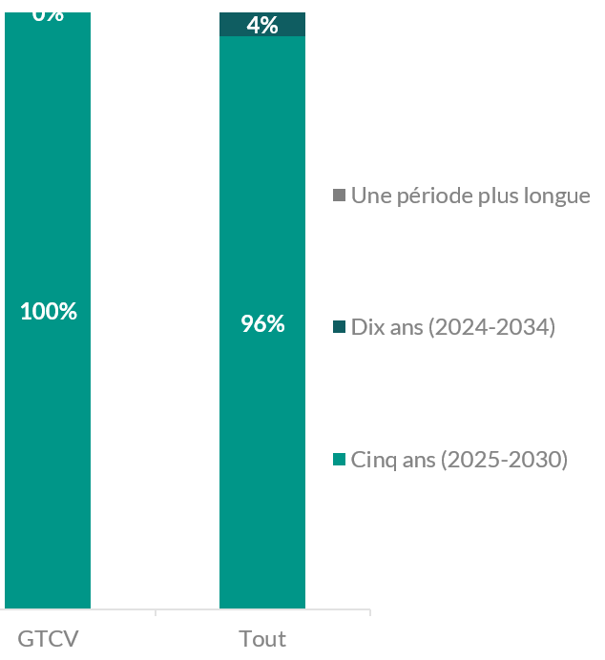
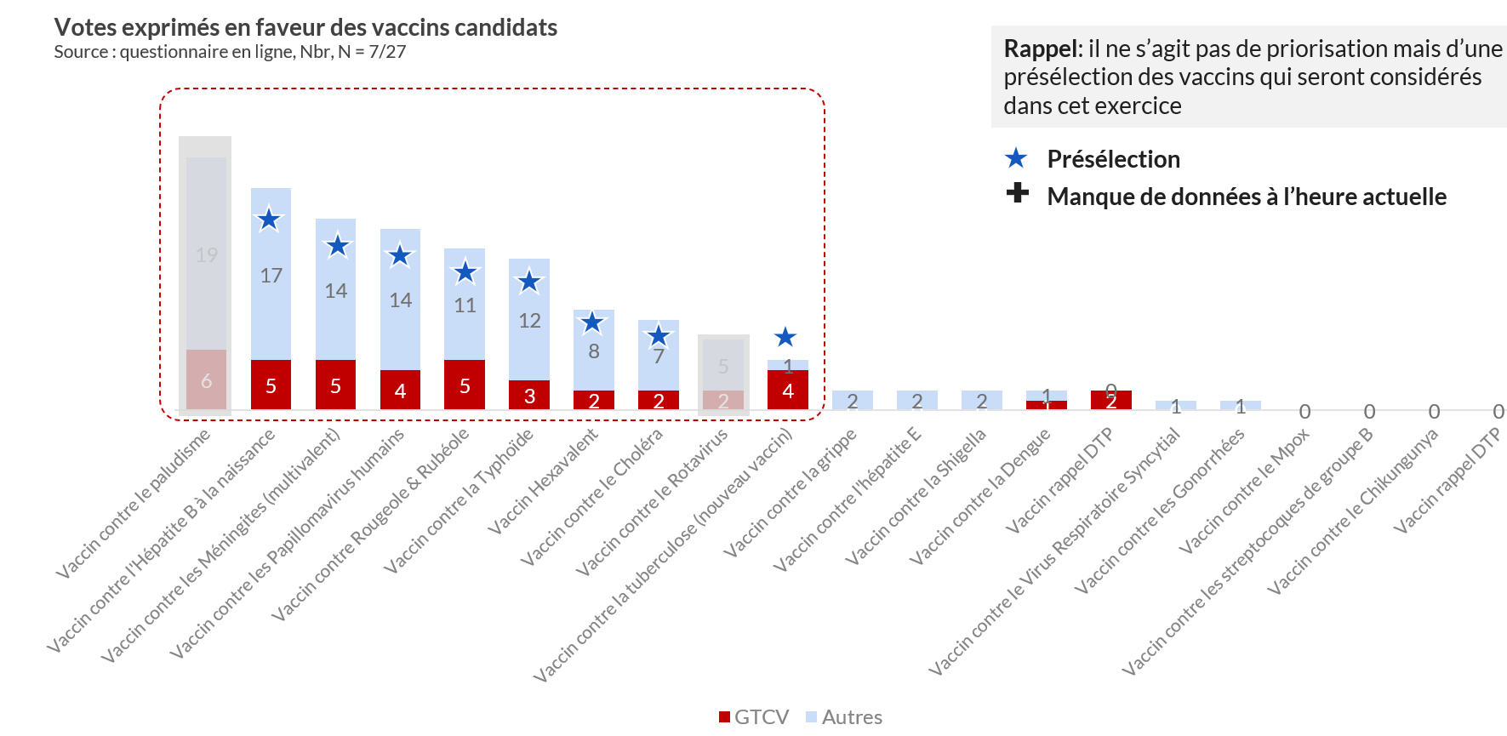
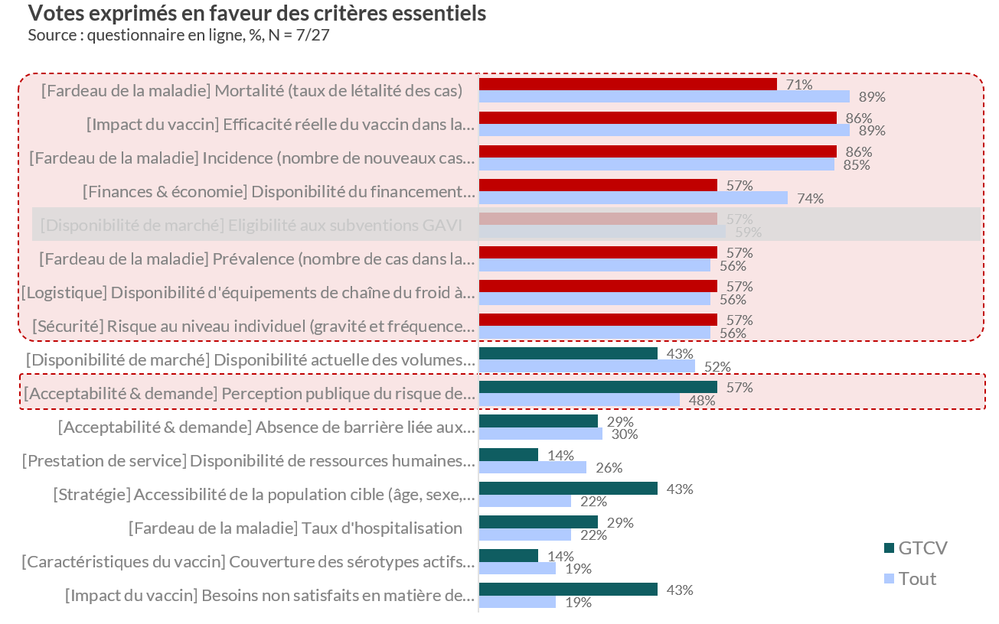
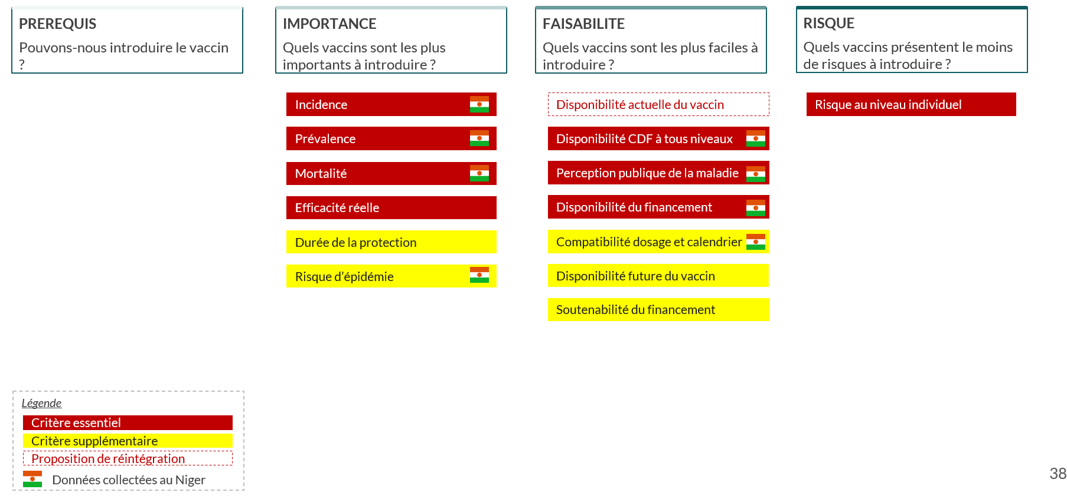
The first workshop will aim at defining the parameters of the prioritization methodology, it could leverage results from an online survey
Timeline
Vaccines
Criteria
Defining the time horizon and target recurrence of the prioritization exercise
Shortlisting vaccines to be further prioritized
Selecting the final list of criteria used for prioritization
Example charts from the Niger workshop

Slide 18
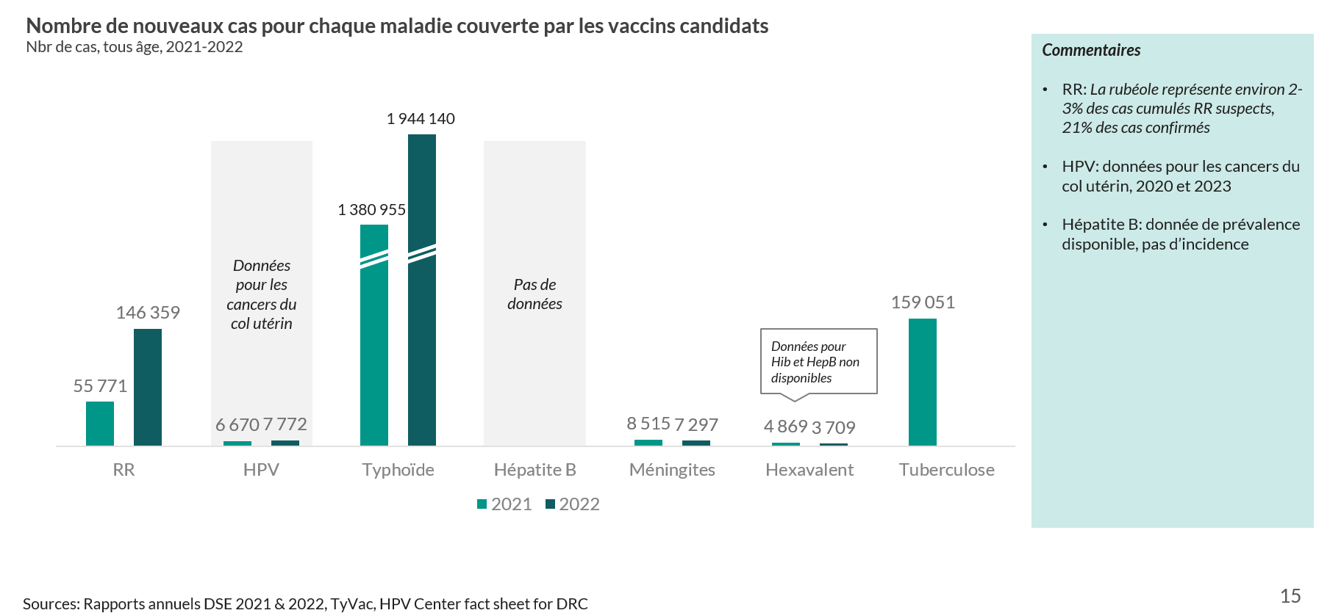
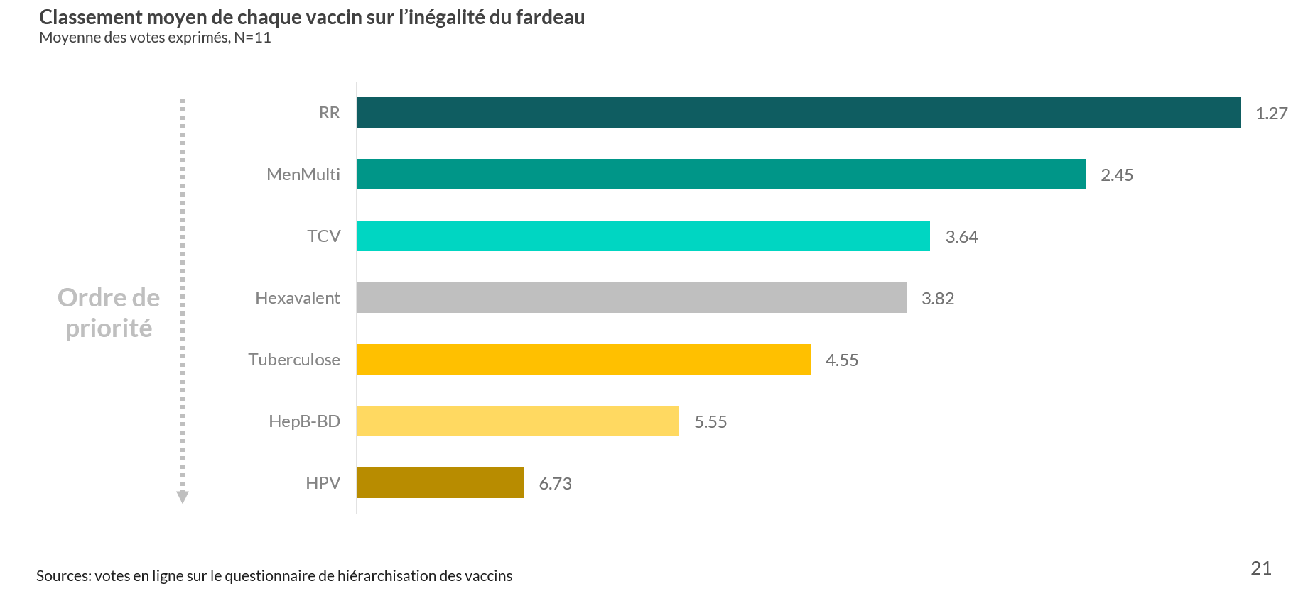
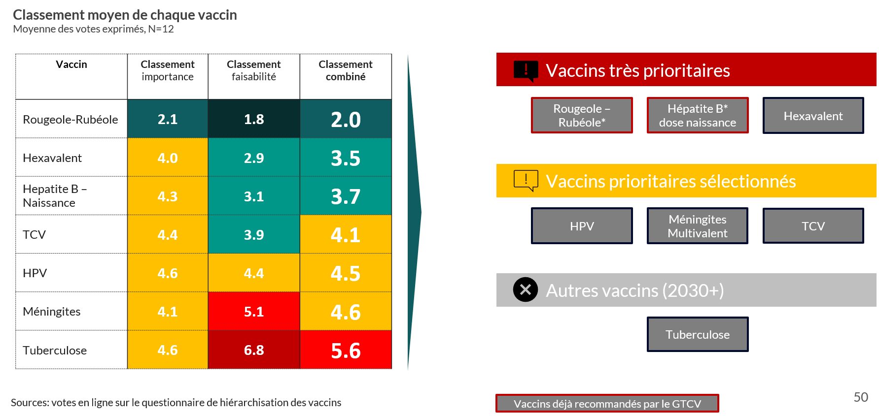
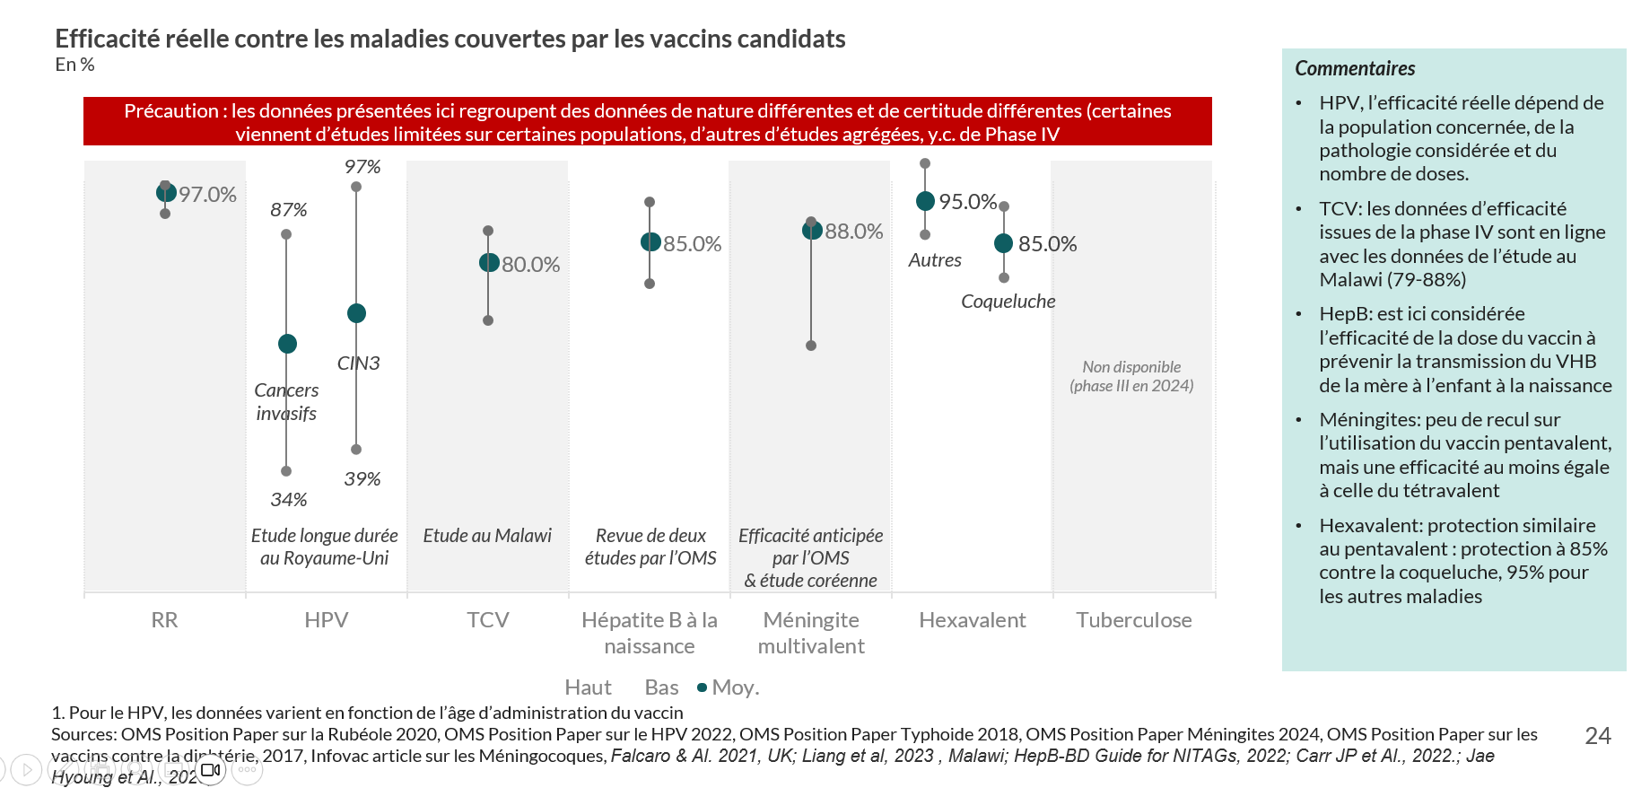
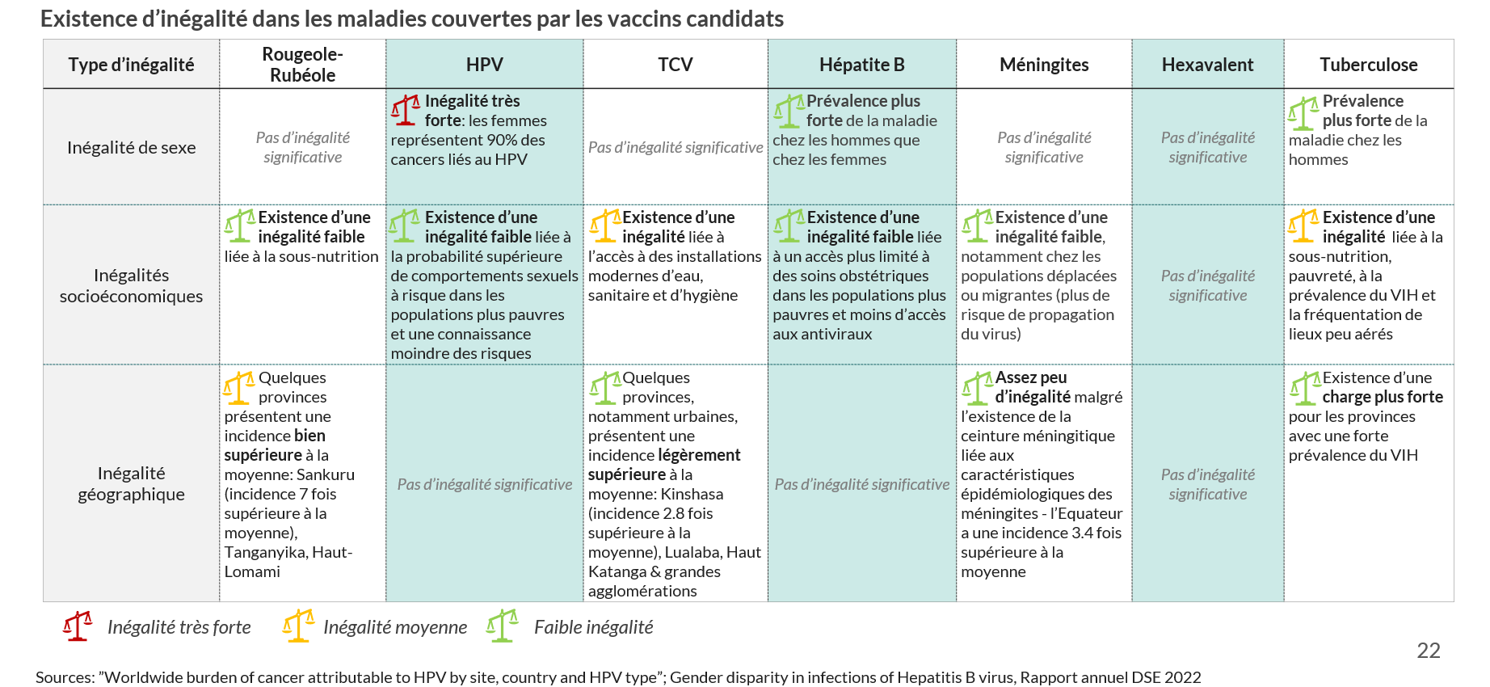
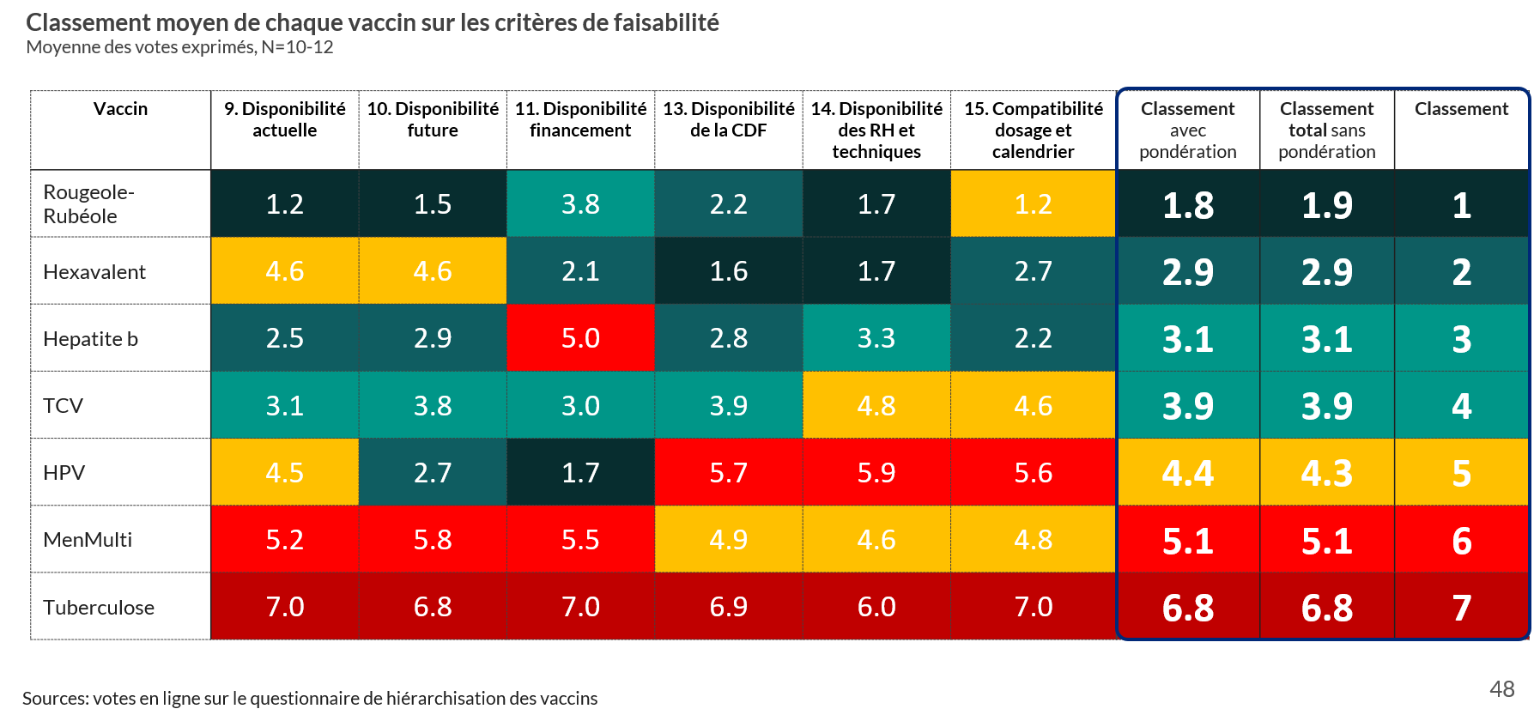
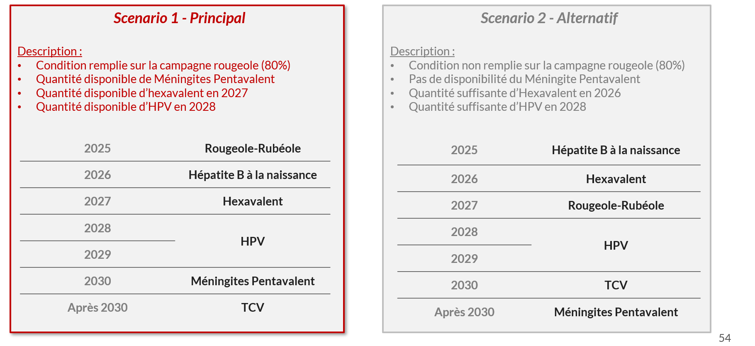
The second workshop will aim at prioritizing between candidate vaccines and producing sequencing scenarios
Reviewing evidence
Ranking vaccines
Prioritizing and sequencing
Reviewing evidence for each criteria and vaccine
Ranking between candidate vaccines for each criteria
Drafting ‘High priority’ and ‘Medium priority’ and ‘Low priority’ vaccine lists and preparing several scenarios
Example charts from the DRC workshop

